Slide 1
Technical Support Training
Exacq
24.09 Release Training
Ross White
2024-09

Slide 2
Sections
Server
Client
Web Service
Exacq Mobile 3
Enterprise Manager
Exacq Hardware
Illustra
exacqVision Mobile

Slide 3
Server

Slide 4
Bug Fixes
Fixed insertion of objects lacking metadata or bounding box (AESW-9440)
Improvements to event size estimates for bookmarks (AESW-11010)
illustra3 and illustramultipi fixed issue where Alarm 2 status would not change after being canceled (AESW-10146)
illustra3 and illustramultipi fixed issue causing edgestor backfill to hang (AESW-9581)
Onvif, fixed issue preventing simultaneous PTZ
Onvif, fixed excessive pullpoint logs on errors (AESW-10727)
Onivf, fixed potential PTZ disconnects (AESW-11469)
psfpi, fixed potential hang when evAPI attempts to cancel search (AESW-10961)
Samsungpi, fixed crash on disabled device during connection
Samsungpi, fixed potential crash when connecting to newer devices

Slide 5
Enhancements
Support Area Zoom on Axis M5000-G PTZ camera (AESW-10568)
eventpi, new event indicates thinning occurred, includes event linking sources (AESW-7651)
Installer adds firewall rules added for failover and failback
Improved analytic parsing
Provide the analytic type to core
Improved handling of transport errors (AESW-10120)
New SOAP calls for Onvif Profile M and S conformance
remotepi, move connection to production switchboard service (AESW-9771)
Additional logging around LDAP reauth queries (AESW-9769)
Improved performance by reducing amount of analytics sent from server to client (AESW-7715)

Slide 6
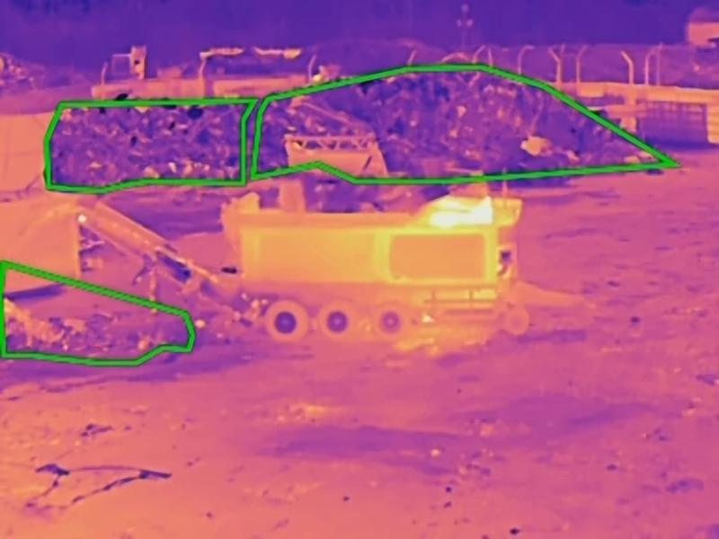
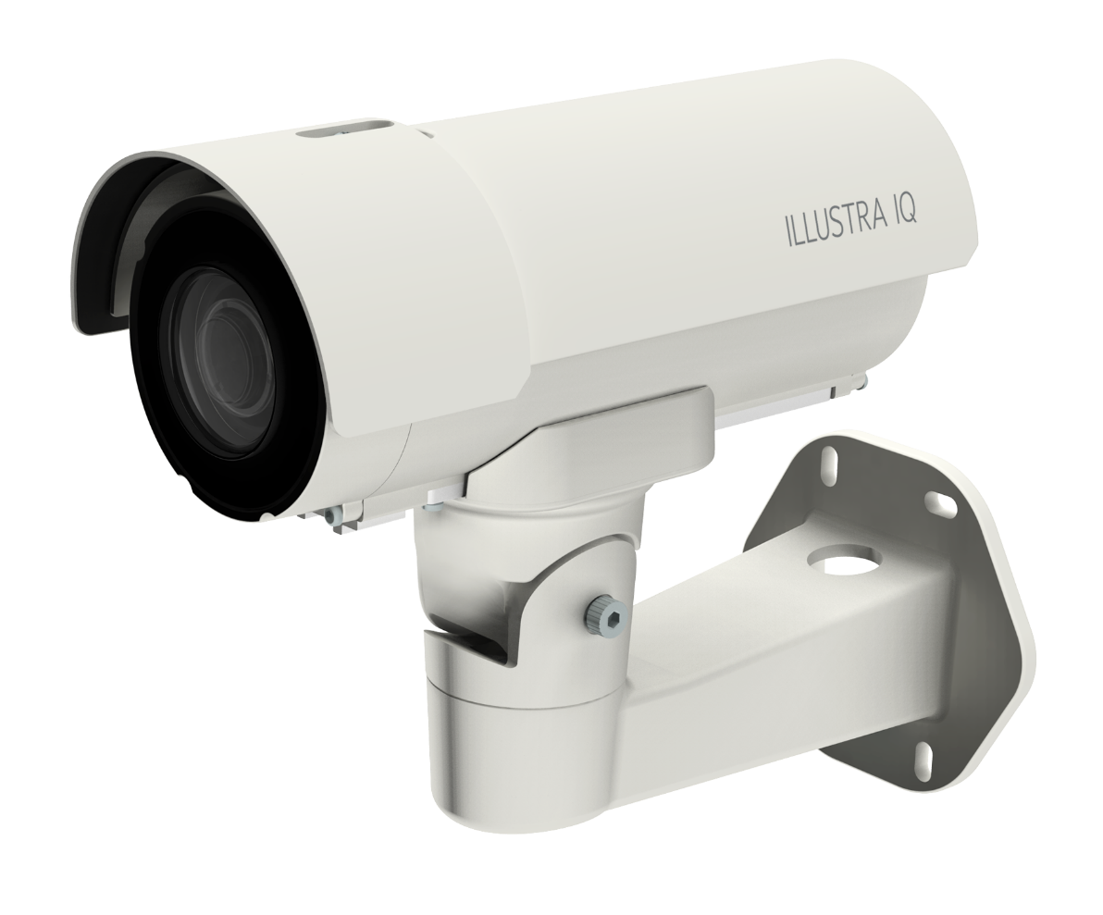
Features
Support for Wasabi S3 as archiving target (AESW-5814, AESW-10924)
Support added for Axis Thermometry (AESW-8816, AESW-8918)
Illustra LPR Support (AESW-6504)

Slide 7
Client

Slide 8
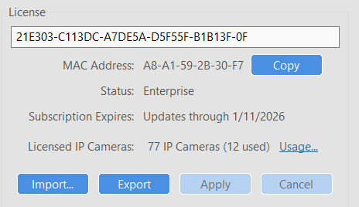
Bug Fixes
Manage the preferred MAC address in License panel (AESW-11267)
Fixed issue where exacqReply controls did not appear until window was resized (AESW-9992)
Clear grid dropdown, to fix issue where drop-down menus duplicate entries (AESW-10923)
Fixed issue with Oldest Desired Content of Cloud Drive (AESW-8097)
Fixed issue of event forward button being disabled when skipping ahead (AESW-8958)
Fixed issue of client crash when selecting Find Camera when creating a new View (AESW-10038)
Fixed client crash when selecting audio in Add Video panel
Fixed issue of auto play not working in Timeline search (AESW-8529)

Slide 9
Enhancements
Remote Connections, found on navigation tree
Added Mobile Optimized Streaming panel for Remote Connections
New toast message indicating event thinning has occurred (AESW-9871)
Client improvements to amount of analytic data passed between server/client (AESW-7716)
Support “horizontal flip” for Storage page to accommodate storage layout for new Avnet systems (AESW-10562)
Apply our security standards to Bodyworn password fields (AESW-1575)

Slide 10
Features
Support for Wasabi S3 as archiving target (AESW-11025)

Slide 11
Web Service

Slide 12
Bug Fixes
Fixed 24.03 issue where iPAD experienced video buffering and timeout errors (AESW-10945, AES-839, AES-863, AES-909)
Web client supports session timeout detection, respects the login token (AESW-9753, AES-774)

Slide 13
Enterprise Manager

Slide 14
Bug Fixes
Add missing pagination endpoints (AESW-11414)

Slide 15
Exacq Mobile 3

Slide 16
Bug Fixes
Fixed issue with video failing to play after one hour

Slide 17
Enhancements
Added notification to point users to new exacqVision Mobile app (AESW-9166)

Slide 18
Exacq Hardware

Slide 19
Hardware Refreshes
C-Series 16S & 32S QSV
G-Series Micro QSV
G-Series PoE 8ch & 16ch QSV
Q-Series Desktop & Desktop Hybrid QSV
A-Series 2A & 2A Hybrid (no RAID) QSV
A-Series FA & FAR (RAID) QSV
X-Series 1U & 2U (RAID) QSV
IMPORTANT: New BBE systems no longer come with licenses applied from factory. We have updated articles and videos on licensing new systems. Video: exacqVision System Licensing

Slide 20
exacqVision Advantage
Provides free exacqVision licensing on BBE hardware for most models of Illustra Flex and Pro cameras (Gen3, Gen4, and future generations).
Does not apply to the Flex Gen3 Multisensor, which is ONVIF only, does not have the Illustra API
exacqVision Advantage Video
Using the Illustra License Registration Tool

Slide 21
Illustra

Slide 22
Illustra
New Pro camera models providing LPR on the edge
Bullet IPS05-B12-LPR4
Dome IPS05-D12-LPR4
Pre-licensed, no additional license to purchase
Users cannot update existing Pro models to add LPR functionality
Designed for low-speed or stop-and-go traffic, such as parking entrances and gates, not designed for high-speed traffic
Users should follow the Best Practices Guide included with camera to install for best results
Part of the analytic engine looks for a vehicle (car, truck, bus) so may not work well when just holding a plate in front of the camera
Plate identification is provided via analytic to exacqVision or VideoEdge, not via Serial
LPR will continue to function even if object classification analytics are disabled
Video: Illustra IQ LPR Cameras with exacqVision

Slide 23
exacqVision Mobile

Slide 24
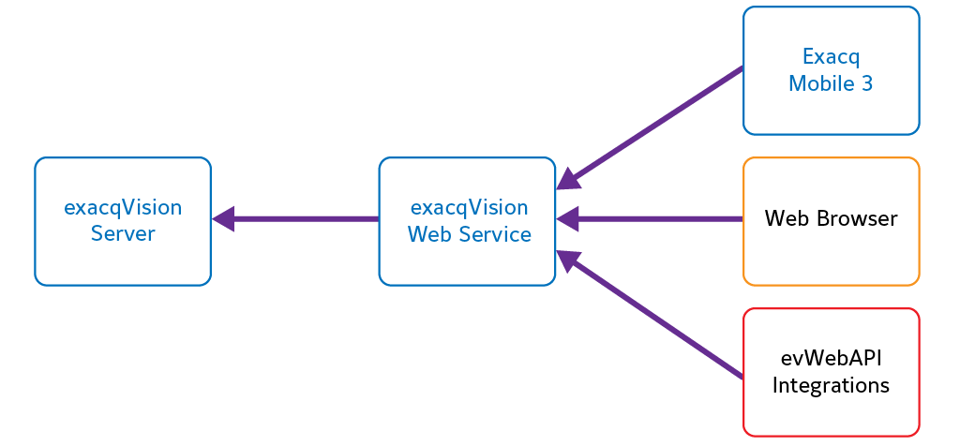

Slide 25
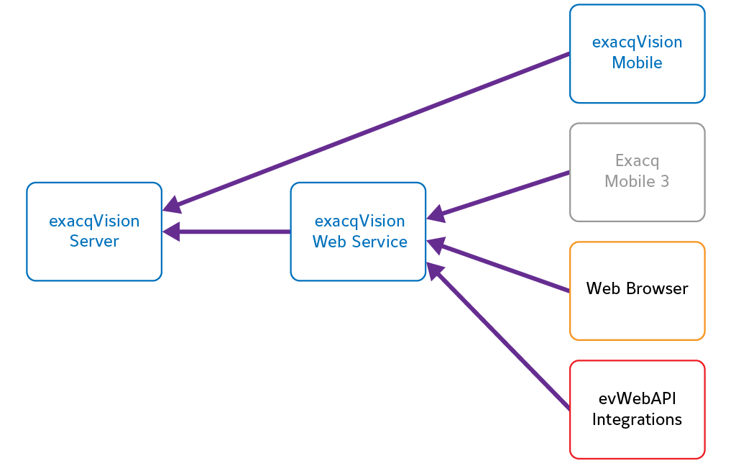

Slide 26
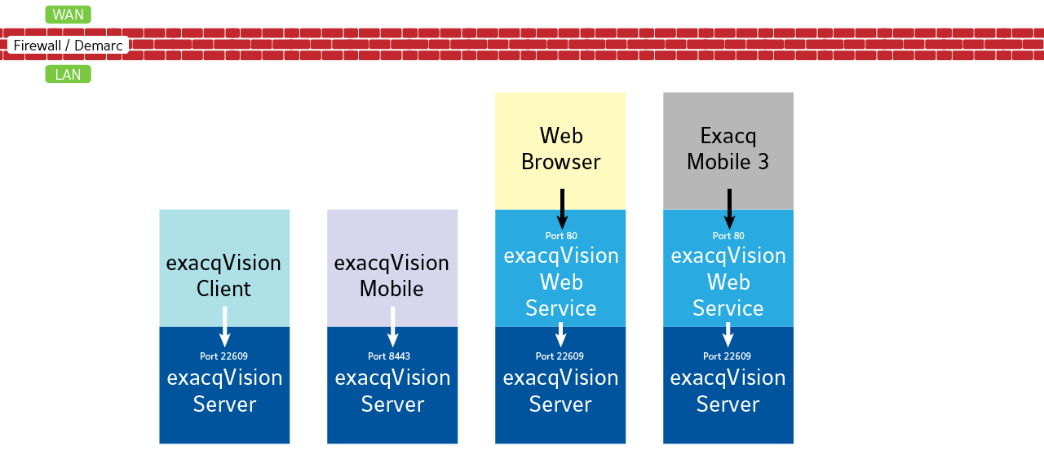
exacqVision Mobile =
Newest mobile app
Exacq Mobile 3 = previous mobile app

Slide 27
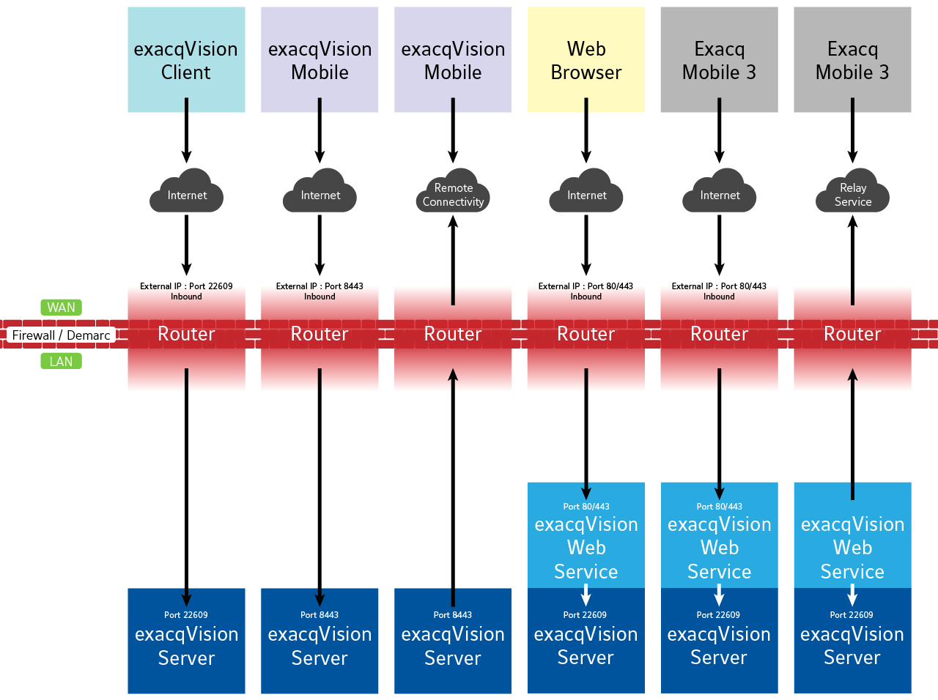

Slide 28
Versions
exacqVision Mobile requires Server version 24.09 or higher.
Remote Connectivity requires Client 24.09 or higher as the Client is needed to connect to the cloud switchboard and generate access codes.
If SSA expiration or OS requirements prevent updating to Server 24.09, users will need to continue using Exacq Mobile 3, with the exacqVision Web Service.

Slide 29
Connecting to Servers
Within the same LAN
If your mobile device is connected to the WiFi within the same network as your exacqVision Server, the mobile app user will simply enter the IP Address or Host Name of the server along with a valid User Name and Password before pressing the Connect Server button.

Slide 30
Connecting to Servers
Outside of the network (Option 1)
The traditional method for allowing an incoming connection is to configure an open port, and preferably port forwarding, on your site's router for this traffic. If using this method, the user will enter the external IP address of the site's router (assigned by the site's ISP) into the IP Address/Host Name field along with a User Name and Password.
If a customer decides to use this method, the exacqVision Server listens for incoming app connections on port 8443 by default. This is added to exacqVision Default Ports - Article 11110.
If required, this port may be changed manually, as directed in Changing the Mobile Listening Port for exacqVision Server – Article 18720

Slide 31
Connecting to Servers
Outside of the network (Option 2)
Exacq also offers a Remote Connectivity option. When using this choice, typically no port configuration of the site's router is required.
An administrator connected to the server with the Desktop Client creates a one-time use code. This is performed from the Remote Connections page found on the navigation tree of the Desktop Client. Remote Connectivity must be enabled on the server before use.
Once the Status shows it is connected and ready, enter the number of codes to generate and press the Generate Codes button.
The codes generated and displayed may only be used once and expire after 24-hours. If the mobile user does not enter it within that time, a new code will need to be generated. This is only required for the initial connection to an exacqVision Server from the mobile app. Once connected the user will not need to enter a code again to connect to the system unless they've deleted it from their app.
The user selects the Off-Premises option on the Add System page and enters the provided one-time use code and a valid User Name and Password to connect.

Slide 32
Live Mobile Demo

Slide 33
Additional Resources
exacqVision Mobile – Quick Start Video
exacqVision Mobile – Getting Started & Server Connections
exacqVision Mobile – Live Viewing and Navigation
exacqVision Mobile – Search, Bookmarks, Export
exacqVision Mobile – PTZ, Dewarp, and Security Integrations
exacqVision Mobile – Event Monitoring
exacqVision – Remote Connections
exacqVision Mobile Connection Changes
How to Determine if a Mobile User is Connected Through Remote Connections
Changing the Mobile Listening Port for exacqVision Server
Accessing exacqVision from Tablets and Phones using the exacqVision Mobile App

Slide 34
Questions

