Slide 1

Technical Support Training
Exacq
23.09 Quarterly Release
Ross White
2023-09

Slide 2
Sections
Server
Client
Web Service
Mobile
Enterprise Manager
Exacq Hardware
Illustra
Appendix

Slide 3
Server

Slide 4
Bug Fixes
Fixed issue causing server crash due to missing microSD card in Illustra multisensor cameras
If camera has no microSD for one sensor, but does for another, network loss recording action caused a crash (AESW-7549)
Prevent offload from Illustra BWC from hanging
If camera does not support metadata over HTTPS, allow metadata over HTTP when camera is added with “HTTPS if Available” setting with illustra3pi and illustramultipi
Added camera detection for all Illustra 2023 released models, this includes Flex 4 PTZ, Pro 4 Bullet, Pro 4 Compact Dome, Pro 4 Corner, and Flex 4 Dome models (AESW-5896)
Support for motion windows when adding Onvif cameras to server, some Onvif cameras would not detect motion after adding even with enabled motion windows (AESW-7220)
Fix for issue when Onvif cameras send ‘out of bounds’ motion window coordinates
(AESW-7373)
Decouple iris and focus debuffering from PTZs using Onvif

Slide 5

Features
Improvements to core, logpi, softtriggerpi, tdvrpi, and videotestpi for logging and performance
(AESW-5801)
Updated database structure and management for eventpi to improve metadata search performance, queries, and data purging (AESW-6286)
Added new retention options for AI / Object metadata
Provides ability to help manage eventpi database size (AESW-6082)
Onvif motion and transport ‘plug-n-play’ support removes the need for manually updated Onvif JSON files and now Onvif plugin can dynamically read the motion topics from Onvif cameras (AESW-6069, AESW-3746)
New ‘Power User (No Video)’ security user role
Supports countries where strict laws exist around video access (AESW-6387)

Slide 6

Enhancements
Added ability to set oldest desired content age for Cloud Drive content (AESW-3064)
Axispi now supports upper and lower clothing color metadata (AESW-7031)
Added paging support for brivopi
Added support for additional WDR modes on illustra3pi and illustramultipi (AESW-4618)
Added audit and logging of Illustra BWC privacy mode (AESW-7546)
Support added for Illustra BWC GPS data (AESW-5429, AESW-5528)
Added support for PCM16 audio for live streaming from Illustra BWC (AESW-423)
Added encrypted password storage to notify.xml for notifications (AESW-2085)

Slide 7
Build
Plugins for Basler, IoImage, IPX, Sanyo, Stardot, and UDP now unchecked by default during installation
Upgraded aws-sdk-cpp to version 1.11.1
Upgraded cURL to version 7.87.0
Upgraded OpenSSL to version 3.1
Upgraded libwebsockets to version 4.3.2
Upgraded zlib to version 1.2.13

Slide 8
Client

Slide 9
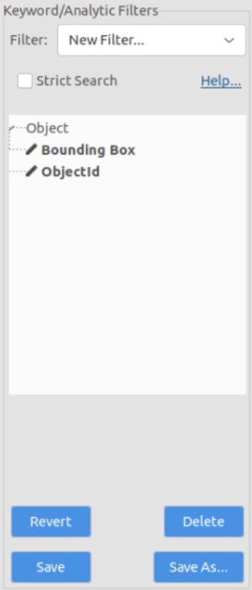
Bug Fixes
Enable appropriate buttons on the Add IP Cameras page after deleting cameras
(AESW-6809)
Fixed issue where Live view navigation tree reloaded on camera double-click (AESW-5618)
Properly size toolbar icons for 4K monitors (AESW-7231)
Properly display the disabled Analytics buttons on Linux
Buttons were appearing as enabled when they should be disabled (AESW-6662)

Slide 10

Enhancements
Client support for the Oldest Content setting for Cloud Drive content
(AESW-6779, AESW-7710)
Added new UX field for Frame-by-frame metadata retention period (AESW-6307)
Optimization for search speeds (AESW-5121)
Live analytic support for Illustra BWC (AESW-2846)
Moved generic dewarper to top of fisheye dewarper selection list (AESW-7389)
Client side support for new WDR settings (AESW-5690)

Slide 11
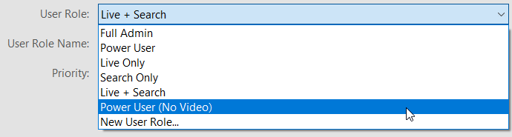

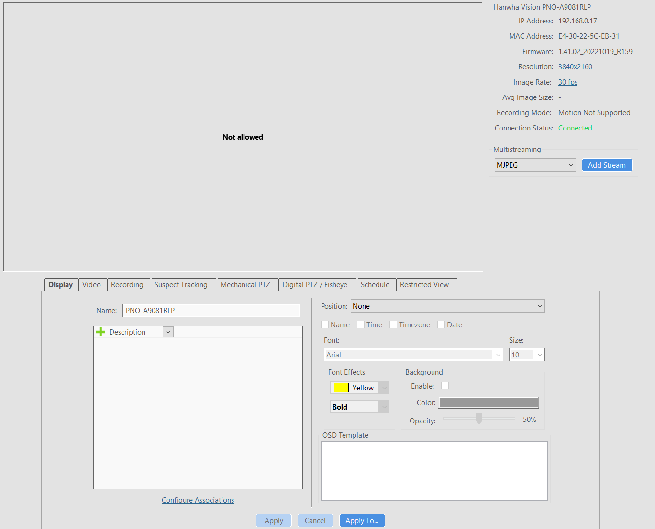
Enhancements
Client side support for the new ‘Power User (No Video)’ user role (AESW-6388)
‘Not Allowed’ text displayed for camera panels
Cameras hidden entirely from search

Slide 12
Web Service

Slide 13
Bug Fixes
Removed no longer supported SCGI proxy folder
Action taken to prevent cross site scripting errors when performing vulnerability scans (AESW-6677)

Slide 14
Enhancements
Added evAPI support for detecting restricted view configuration (AESW-4288)
Change endpoint for S2 integration to ‘video.web’ (AESW-4903)
Scale web client search playback buffer with the playback speed selected (AESW-4757)

Slide 15
Mobile

Slide 16
Features
No mobile update release this quarter, all efforts towards beta version of upcoming mobile app

Slide 17
Enterprise Manager

Slide 18
Bug Fixes
Update VMS audit log entries to use valid JSON (AESW-7458)
Use the correct logger sync
Add missing Seq settings validation

Slide 19
Enhancements
Add support for ‘Power User (No Video)’ user role (AESW-7169)
Add VMS audit trails to the EM audit logs (AESW-5498)
Added API endpoint for retrieving individual audit log entries (AESW-1340)
Add slug to audit logs where applicable (AESW-7176)
Add a user configurable timer for VMS audit log retrieval (AESW-6087)
Integration of EM/ISP logs into Seq
Provides the ability to extract logs into external Seq logging systems
Add migration files to upgrade AES encryption over the older ARC4 to enhance security
(AESW-7512)
Update Apache to version 2.4.57 (AESW-6957)

Slide 20
Exacq Hardware

Slide 21
Features
Nothing this quarter

Slide 22
Illustra

Slide 23
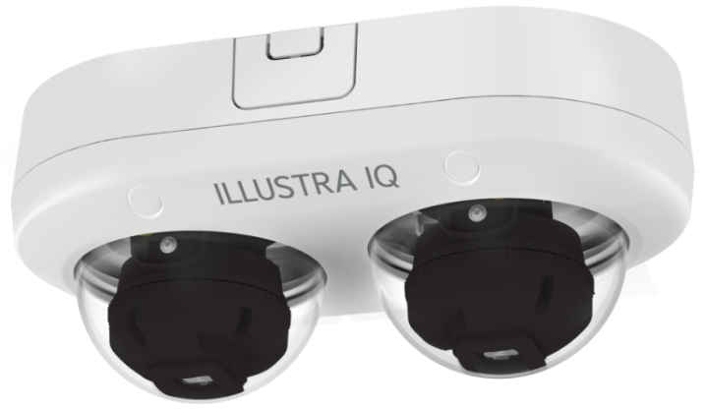
Enhancements & Life Cycle Changes
Targeted launches:
  October
    Pro Gen4 Bullet
    Pro Gen4 Corner
  November
    Flex Gen 4 Dual Sensor
  December
    Flex Gen4 Dome
    Flex Gen4 Compact
    Flex Gen4 Bullet

Slide 24

Questions

Slide 25
Appendix

Slide 26
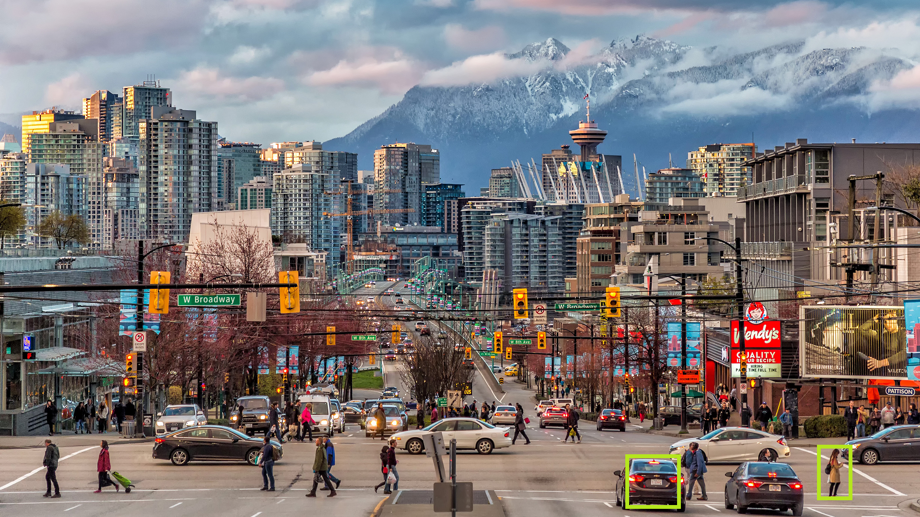
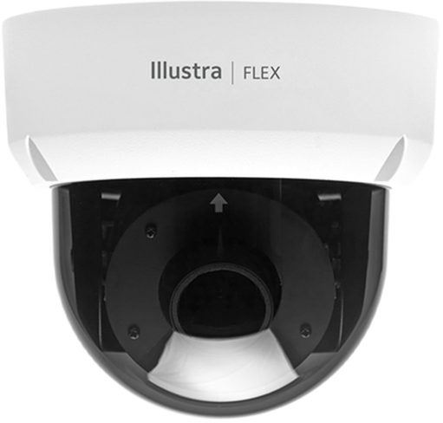
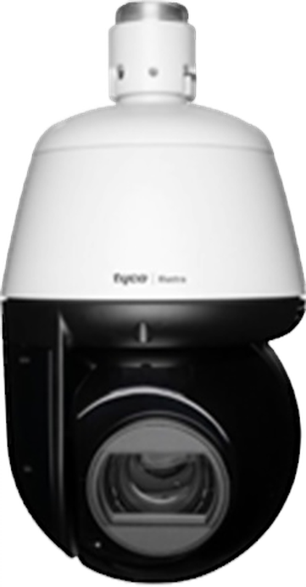
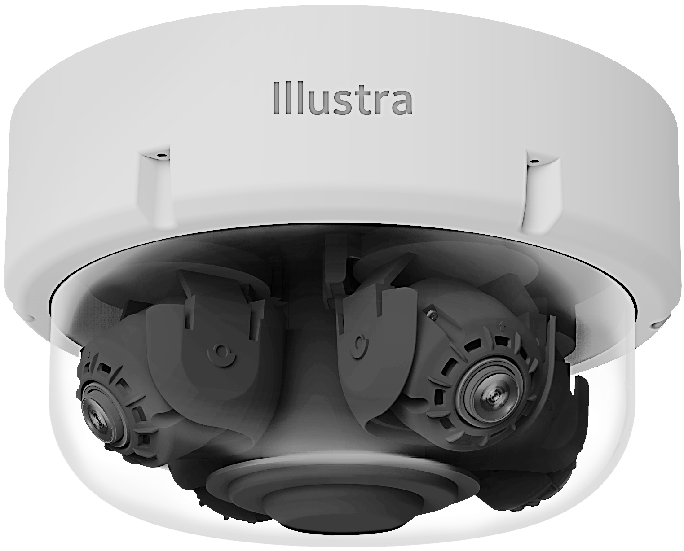
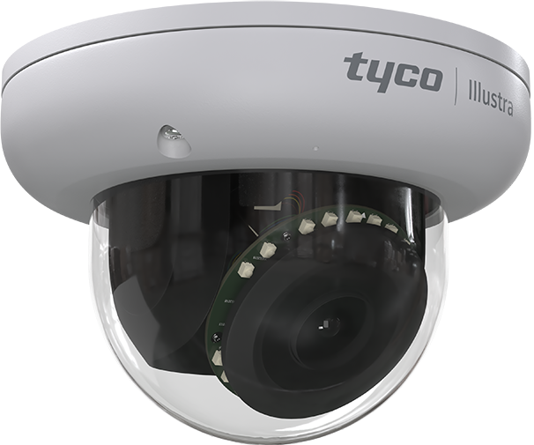
Illustra Cameras – Pixels On-Target Detection Requirements
Example Based on 2-MP Image
with Minimum Height of 108 Pixels
Up to 30 Edge Objects Detected
  Multi-Sensor supports a total of 120 Objects
  4x Cameras - 30 Objects Per Camera FOV
Detection for the Minimum Pixels-on-Target
MegaPixel Chart Showing Pro and Flex Pixels-on-Target
  Pro requires approx. 10% of the total image view
  Flex requires approx. 15% of the total image view
People Vehicles and Color Passed as Metadata
Height 108
Pixels
Height 108
Pixels
Note: Higher MegaPixel images require more pixels for height, as AI classification models rescale prior to processing the video.

