Slide 1

Technical Support Training
Exacq
23.06 Quarterly Release Training
Ross White
2023-06

Slide 2
Sections
Server
Client
Web Service
Mobile
Enterprise Manager
Exacq Hardware
Illustra
Appendix

Slide 3
Server

Slide 4
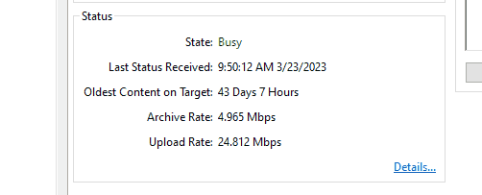
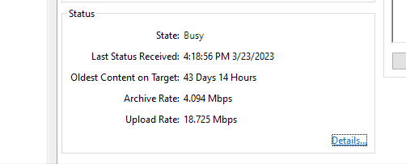
Bug Fixes
Fixed excessive Archiving status messages (AESW-4989)
Debian installer no longer enabled eventpi by default
Fixed issue capturing all metadata when multiple events are sent as one alarm
Ensure eventpi database is purged after server reboot
Fixed connection status problem from Axis cameras with older firmware
Prevent needing to restart client after adding Axis body worn camera system, caused by receiving cert before configuration (AESW-3445)
Fixed potential streaming issue from Exacq’s RTSP Server resulting in gaps (AESW-5251)
Fixed problem where time triggers were not firing on some days (AESW-4573)
Fixed socket crash from Bosch intrusion plugin (AESW-5105)
BEFORE
AFTER

Slide 5
Bug Fixes
Fixed a problem with stale metadata for Illustra3 and Illustramulti plugins
Restart the SSL session and restart metadata on error 94 from Illustra3 and Illustramulti plugins (AESW-4574)
Corrected issue with missing codecs from Panasonic camera plugin causing them to default to JPEG (AESW-631)
Fixed issue with motion issues on some Panasonic cameras (AESW-4794)
Fixed problem with issue making settings changes to Panasonic multisensor (AESW-4562)

Slide 6

Enhancements
Improvements made to search results returned for audio/video events
Improved loading time of eventpi
Cameras previous detected as Samsung are now detected as Hanwha Vision
(AESW-5539, AESW-5538)
Added Hanwha Vision option (AESW-5189)
Integration of WiseAI analytics from Hanwha
Enhanced camera discovery for new Illustra Flex Dual Sensor camera (AESW-5541)
Server installer no longer checks Illustrapi or Illustraflexpi for install by default
Changed the reported name to “Illustra Multisensor”
Added legacy tag to Illustrapi and Illustraflexpi
Added support for Axis “Optics Control” autofocus (AESW-2649)
Added support for Bosch “RuleEngine” analytics (AESW-1326)

Slide 7
Client

Slide 8
Bug Fixes
wxWidgets version upgrade
New installs, not upgrades, automatically select dark or light theme based on the OS theme and prevent user changes
(AESW-5146)

Slide 9
Enhancements
Copy selected camera information when adding a new camera
If camera is highlighted in IP Cameras List on the Add Cameras page when the New button is clicked, the Device Type field will automatically populate with the same as that which was highlighted saving time from selecting from Device Type list.
(AESW-5855)

Slide 10
Web Service

Slide 11
Bug Fixes
Updated nvrg version to fix group type retrieval, fixes issue with group items (AESW-3340)
Updated nvrg version to fix a soft trigger bottleneck, fixes issue where triggers from web or mobile client resulted in status flickering between ‘Alarm’ and ‘Normal’ in Desktop Client. (AESW-3816)

Slide 12
Mobile

Slide 13

Features
No changes

Slide 14
Enterprise Manager

Slide 15
Bug Fixes
Improved logging for DynamicDNS files for Integrator Service Portal (AESW-5897)

Slide 16
Exacq Hardware

Slide 17
Features
No changes

Slide 18
Illustra

Slide 19
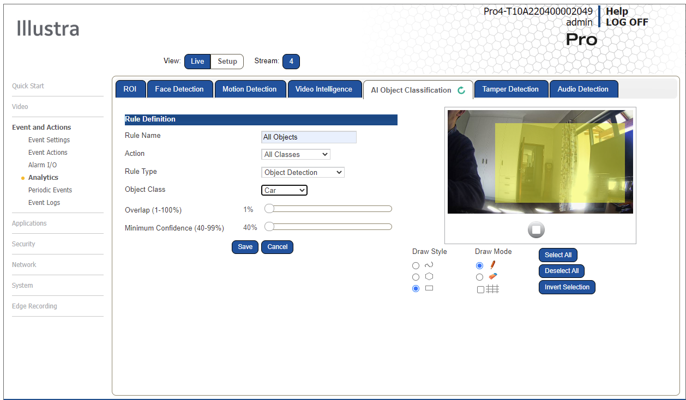
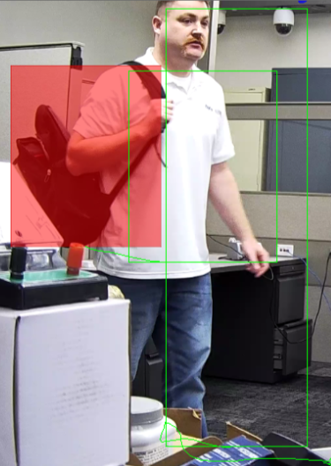

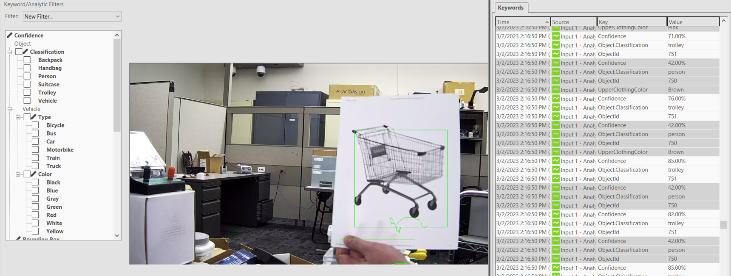
Illustra AI Gen4 Analytics
Video Intelligence Rules
  Linger
  Dwell
  Perimeter
  Object Detection
  Abandoned/Removed Objects
  Direction
  Entry
  Exit
  Crowd
  Queue Areas
AI Objects Detection
  Person
  Bicycle
  Motorcycle
  Cars
  Bus
  Truck
  Train
  Trolley
  Backpack
  Handbag
  Suitcase
Colors
  Vehicle
  Person Clothing
NEW

Slide 20
Enhancements & Life Cycle Changes
New AI Object Classes
  Trolley (Shopping Cart)
  Backpack
  Handbag
  Suitcase
Enhanced Face Detection
Final Color enhances forensic search on color

Slide 21

Questions

Slide 22
Appendix

Slide 23
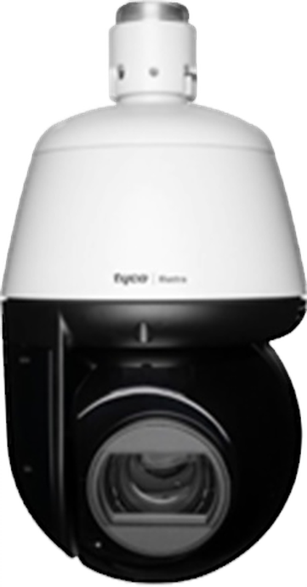
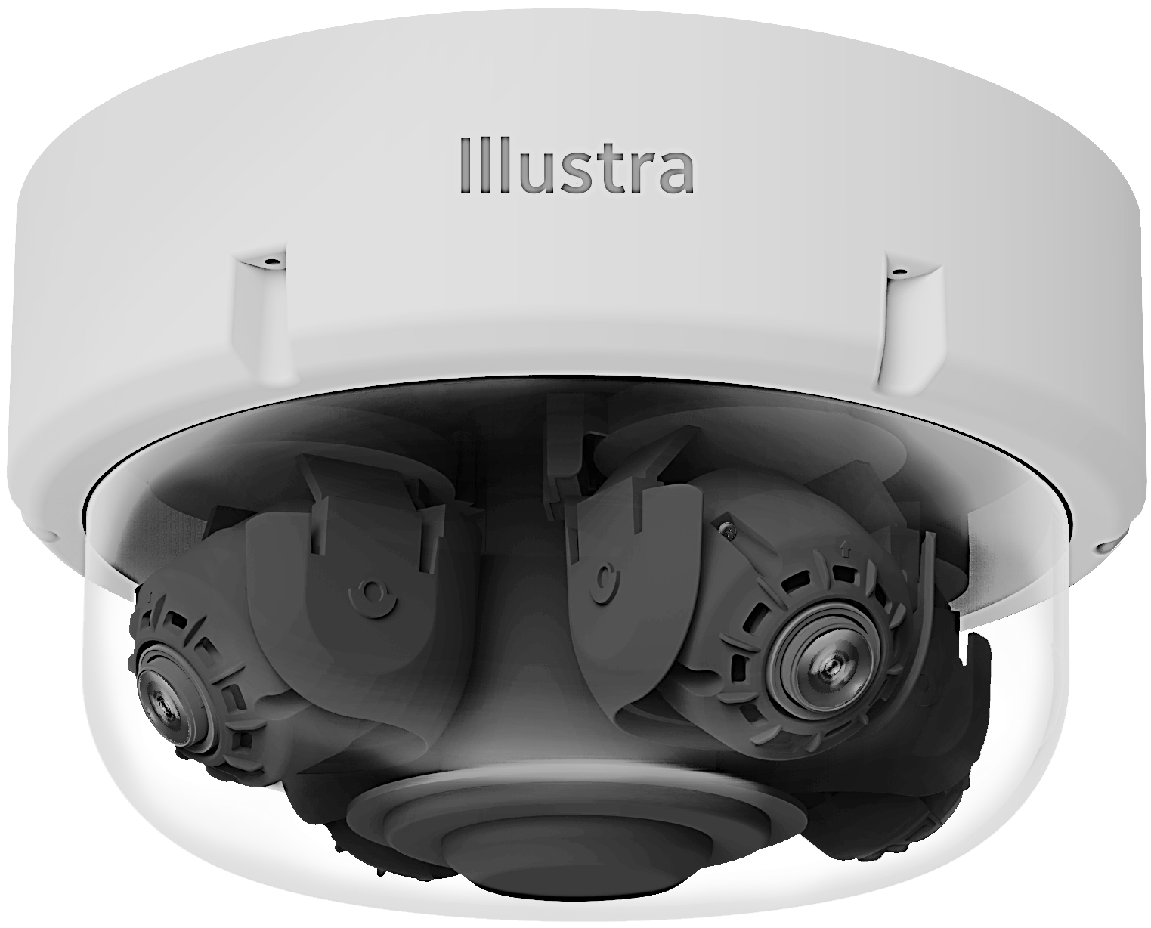
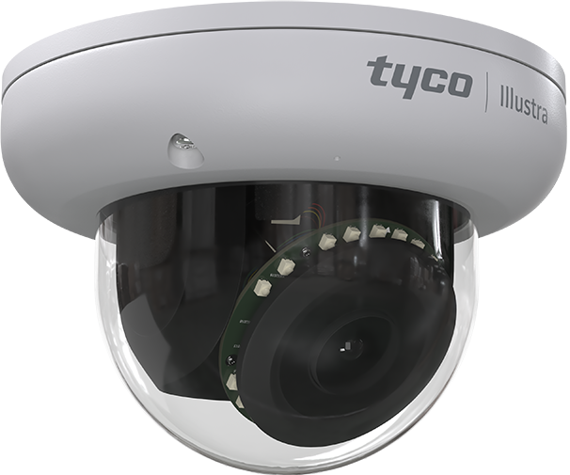
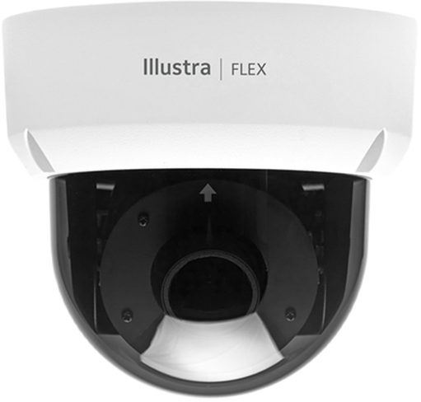
Illustra Cameras – On-Board EDGE AI Today
v
Pro Pan Tilt Zoom – 2 & 8 MP
Object Detection Types/Rules | Object Classifications | Internal Pro G4 PTZ | External Pro G4 PTZ | Pro Multi-Sensor | Pro Mini Dome | Flex Mini Dome
Person | Person | ✓ | ✓ | ✓ | ✓ | ✓
Clothing Upper & Lower Colors | Black, Blue, Brown, Gray, Green, Orange, Pink, Purple, Red, White & Yellow | ✓ | ✓ | ✓ | ✓ | ✓
Vehicles | Bicycle, Bus, Car, Motorbike, Truck & Train | ✓ | ✓ | ✓ | ✓ | ✓
Vehicle Color | Black, Blue, Green, Gray, Red, White & Yellow | ✓ | ✓ | ✓ | ✓ | ✓
Rules | Linger, Dwell, Perimeter, Object, Detection Abandoned/Removed Objects, Direction, Entry, Exit, Crowd, Queue & Areas | ✓ | ✓ | ✓ | ✓ | ✓
Tamper | Blur & Brightness | ✓ | ✓ | ✓ | ✓ | ✓
Person Re-ID | Person Characteristics Search | Full Edge Processing & Partial | Full Edge Processing & Partial | Full Edge Processing & Partial | Full Edge Processing & Partial | Partial Edge Processing
Pro Multi-Sensor – 20 & 32 MP
Pro Mini Dome - 2, 4 & 8 MP
Flex Mini Dome - 2, 4 & 8 MP
Notes:
.

Slide 24
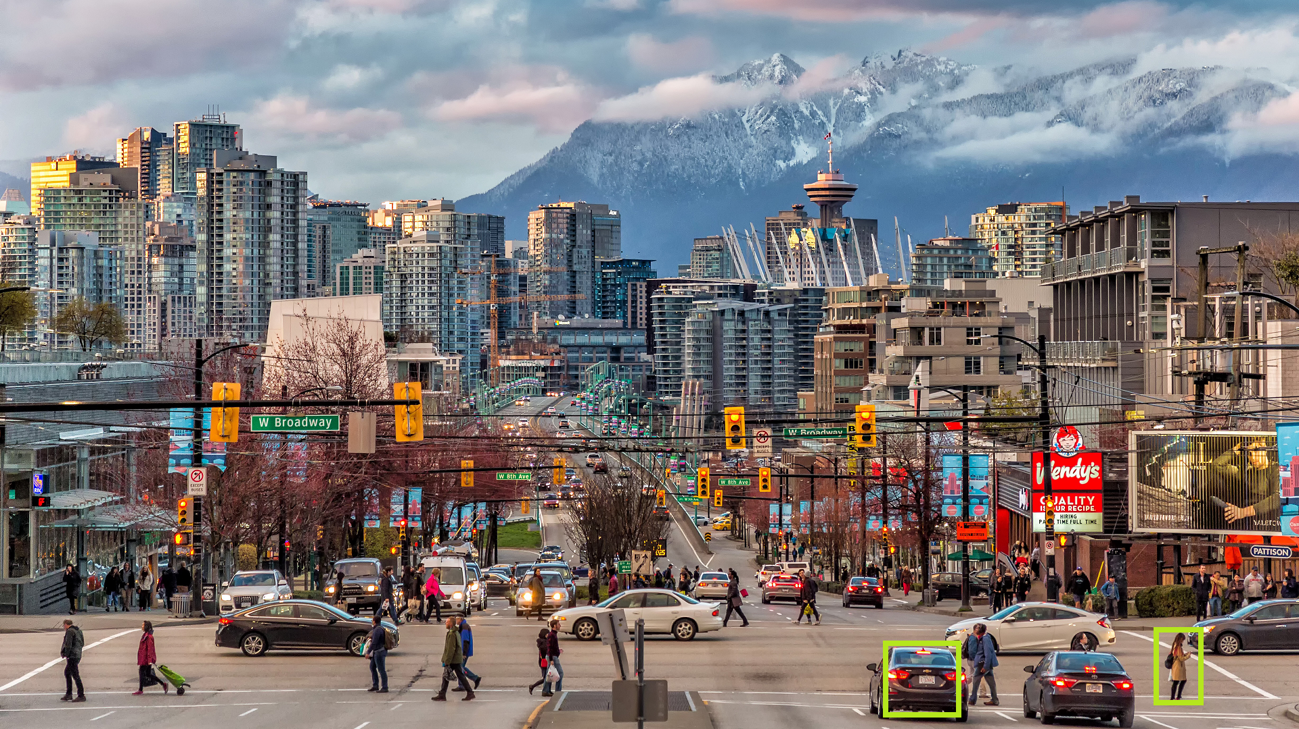
Illustra Cameras – Pixels On-Target Detection Requirements
Example Based on 2-MP Image
with Minimum Height of 108 Pixels
Up to 30 Edge Objects Detected
  Multi-Sensor supports a total of 120 Objects
  4x Cameras - 30 Objects Per Camera FOV
Detection for the Minimum Pixels-on-Target
MegaPixel Chart Showing Pro and Flex Pixels-on-Target
  Pro requires approx. 10% of the total image view
  Flex requires approx. 15% of the total image view
People Vehicles and Color Passed as Metadata
Height 108
Pixels
Height 108
Pixels
Note: Higher MegaPixel images require more pixels for height, as AI classification models rescale prior to processing the video.

