Slide 1

Technical Support Training
Exacq
23.03 Quarterly Release Training
Ross White
2023-03

Slide 2
Sections
Server
Client
Web Service
Mobile
Enterprise Manager
Exacq Hardware
Illustra
Appendix

Slide 3
Server

Slide 4
Bug Fixes
Fixed PTZ preset administration for custom users to create presets for analog cameras (AESW-4357)
Fixed monitoring RAID background tasks, like consistency checks and background initialization
22.12 shows volume as “Optl” but storcli shows “Background Initialization (X%)”
(AESW-4387)
Fixed reporting incorrect RAM, was displaying MB instead of GB (AESW-2498)
actipi – Reduce metadata channel reconnects for cameras with S3L chips, this caused cameras to stop recording after a while (AESW-4327)
illustramultipi – Fixed ability to enable motion zones per sensor, accommodated changed to camera firmware (AESW-4456)
illustramultipi – Fixed direct input/output triggers, fixed output numbering that was preventing trigger status from updating (AESW-3474)
onvifnvcpi – Fixed motion issues with AVCostar-Contera (AESW-4464)
onvifnvcpi – Increased maximum SOAP read size to accommodate Clinton encoders, see Enhancements (AESW-3474)

Slide 5

Enhancements
Modified all emissions from eventpi and notifypi to use separated IDs rather than compressed IDs, fixed in part, this is an enhancement to affect problems with searching the event database with very large amounts of records (AESW-3333)
Added camera detection of several Illustra Standard cameras to be discovered as Illustra3
(AESW-1668)
axispi – Added support for color metadata (AESW-1725)
Only vehicle color is currently provided by Axis
illustra3, illustramultipi – Added support for “final color” (AESW-2850, AESW-2844)
samsungpi – Added support for Area Zoom (AESW-4003)
onvifnvcpi – Added support for Advidia cameras (AESW-3521)
onvifnvcpi – Added support for Clinton Electronics encoder (AESW-2489)

Slide 6
Client

Slide 7
Bug Fixes
Don’t reorder keywords when building conditions panel tree
Ensures ‘Upper Clothing Color’ is listed above ‘Lower Clothing Color’ in Filters (AESW-4502)
Allow live analytic keyword colors to be processed before bounding boxes (AESW-4458)
Fixed an issue with display of multiple trigger events (AESW-3861)
Fixed issue saving image from Live view where OSD background color was removed from the saved image (AESW-4277)

Slide 8
Enhancements
Support for “final color”, choose search type based on “final color” (AESW-3345)

Slide 9
Web Service

Slide 10
Bug Fixes
Updated nvrg version to fix group type retrieval (AESW-3340)
Updated nvrg version to fix a soft trigger bottleneck (AESW-3816)

Slide 11
Enhancements
Disabled search playback in browser client until buffer threshold is reached (AESW-3622)
Enabled ability to detect an invalid session in browser client (AESW-3621)

Slide 12
Mobile

Slide 13

Features
No changes

Slide 14
Enterprise Manager

Slide 15
Bug Fixes
Removed architecture change logic from NSIS (AESW-491)
Support added for Windows authentication login for MS-SQL (AESW-3378)

Slide 16
Exacq Hardware

Slide 17
G-Series, 2nd Generation
2nd Gen
16 PoE ports with 240W total budget
4 PRO licenses
1st Gen
16 PoE ports with 240W total budget
12TB max storage
120Mbps video rate
2 monitors, 480 fps @ 1080p
Ubuntu 22.04, 12th Gen Intel Celeron, 4 GB RAM
OS on SSD
4 PRO licenses
OS on SSD
12TB max storage
120Mbps video rate
2 monitors, 240 fps @ 1080p
Ubuntu 18.04, Intel Atom, 4 GB RAM

Slide 18
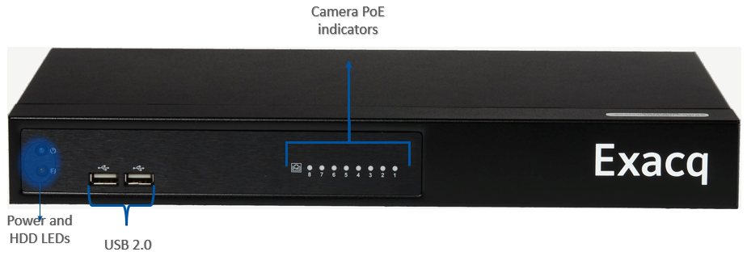
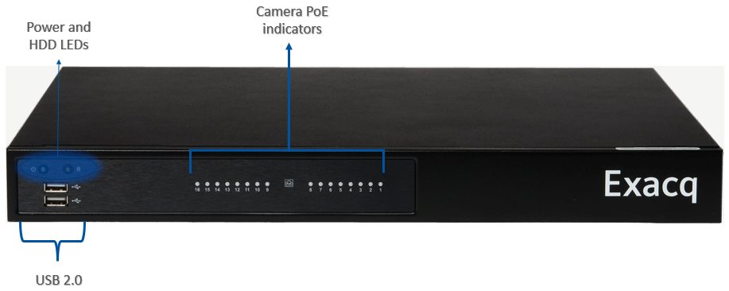
G-Series, 2nd Generation

Slide 19
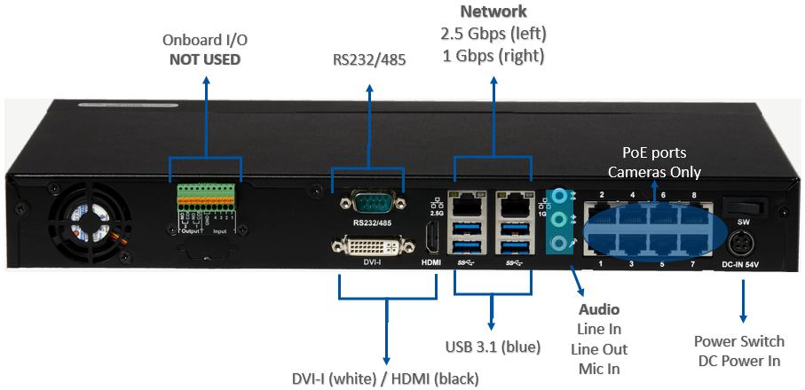
G-Series, 2nd Generation

Slide 20
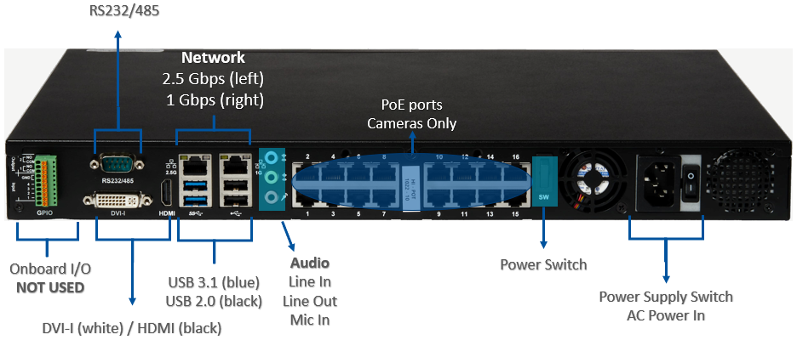
G-Series, 2nd Generation

Slide 21
G-Series, 2nd Generation
G-Series PoE | 8-Port | 16-Port
Maximum PoE Cameras | 8 | 16
Included IP Licenses | 4 PRO | 4 PRO
PoE Power | 15 W (all ports simultaneously) | 15 W (all ports simultaneously)
 | 30 W max (individual port) | 30 W max (individual port)
 | 120 W (total) | 240 W (total)
Pre-loaded VMS Software | Professional | Professional
 | Enterprise (Optional) | Enterprise (Optional)
Include SSA | 3 Years | 3 Years
Operating System | Linux Ubuntu 22.04 | Linux Ubuntu 22.04
Maximum Storage | 12TB | 12 TB
Maximum Hard Drives | 1 | 1
Typical Video Storage Rate | 120 Mbps | 120 Mbps
Local Client Display Rate (1080p) | 8 streams @ 15 FPS each | 16 streams @ 15 FPS each
CPU | 12th Gen Intel® Celeron | 12th Gen Intel® Celeron
RAM | 4 GB | 4 GB
Monitor Output | DVI-I, HDMI | DVI-I, HDMI
 | 2 Simultaneous | 2 Simultaneous
NIC | 1 x 2.5 Gbps + 1 x 1 Gbps | 1 x 2.5 Gbps + 1 x 1 Gbps
USB | 2 USB 2.0 Front, 4 USB 3.1 Rear | 2 USB 2.0 Front + 2 USB 2.0 Rear, 2 USB 3.1 Rear
Audio Inputs | 1 | 1
Audio Outputs | 1 | 1
DVD | External (Optional) | External (Optional)
Accessories | Keyboard (on-screen), Mouse | Keyboard (on-screen), Mouse
Dimensions (H x W x D) | 1.92 in x 14.17 in x 8.83 in | 1.75 in x 16.92 in x 13.70 in
 | 4.9 cm x 36 cm x 22.45 cm | 4.45 cm x 43 cm x 34.8 cm
Weight | 6 lbs | 10 lbs
 | 2.72 kg | 4.54 kg
Certifications | UL, CE, FCC | UL, CE, FCC

Slide 22
Illustra

Slide 23
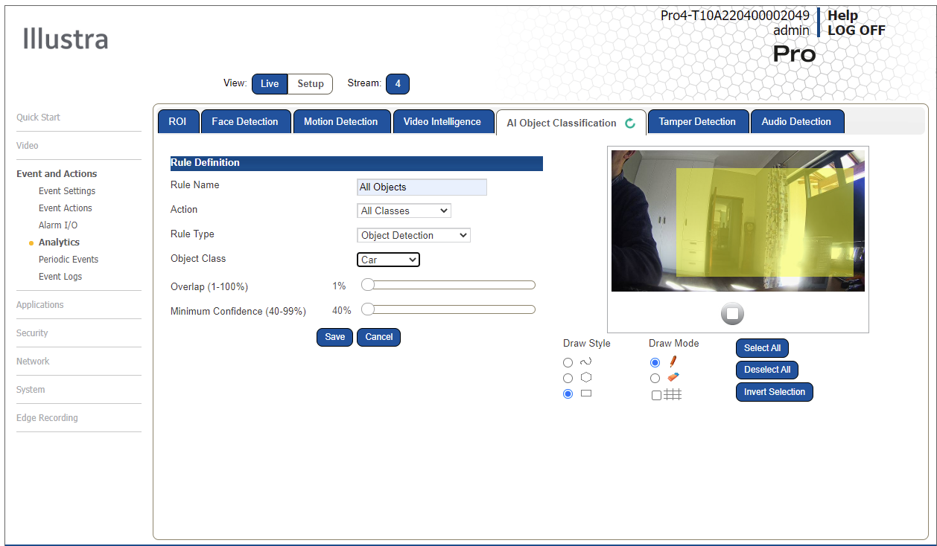
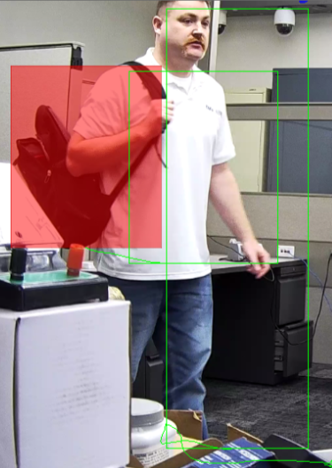

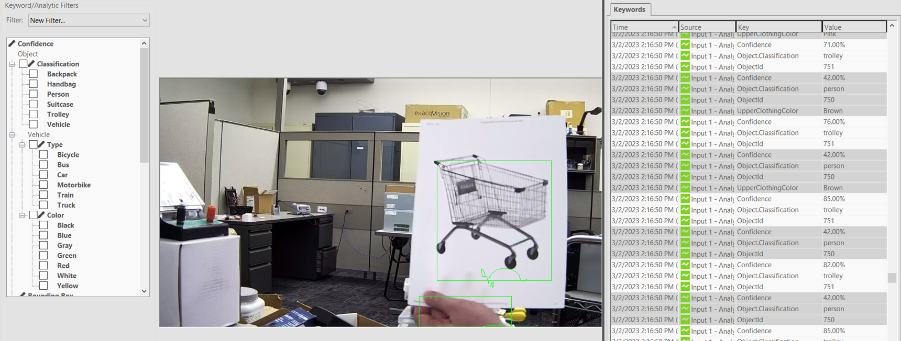
Illustra AI Gen4 Analytics
Video Intelligence Rules
  Linger
  Dwell
  Perimeter
  Object Detection
  Abandoned/Removed Objects
  Direction
  Entry
  Exit
  Crowd
  Queue Areas
AI Objects Detection
  Person
  Bicycle
  Motorcycle
  Cars
  Bus
  Truck
  Train
  Trolley
  Backpack
  Handbag
  Suitcase
Colors
  Vehicle
  Person Clothing
NEW

Slide 24
Enhancements & Life Cycle Changes
New AI Object Classes
  Trolley (Shopping Cart)
  Backpack
  Handbag
  Suitcase
Enhanced Face Detection
Final Color enhances forensic search on color
Pro Gen3 Bubbless Domes have gone EOL
Pro Micro has gone EOL

Slide 25

Questions

Slide 26
Appendix

Slide 27
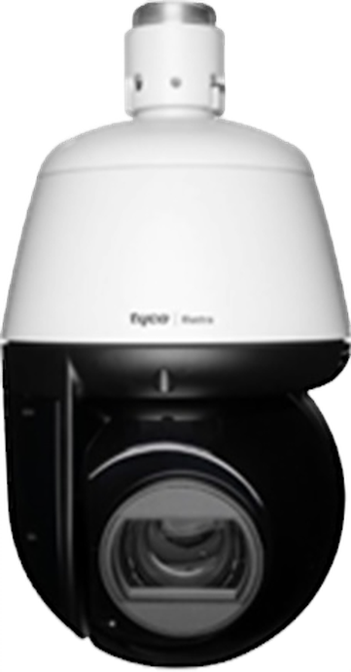
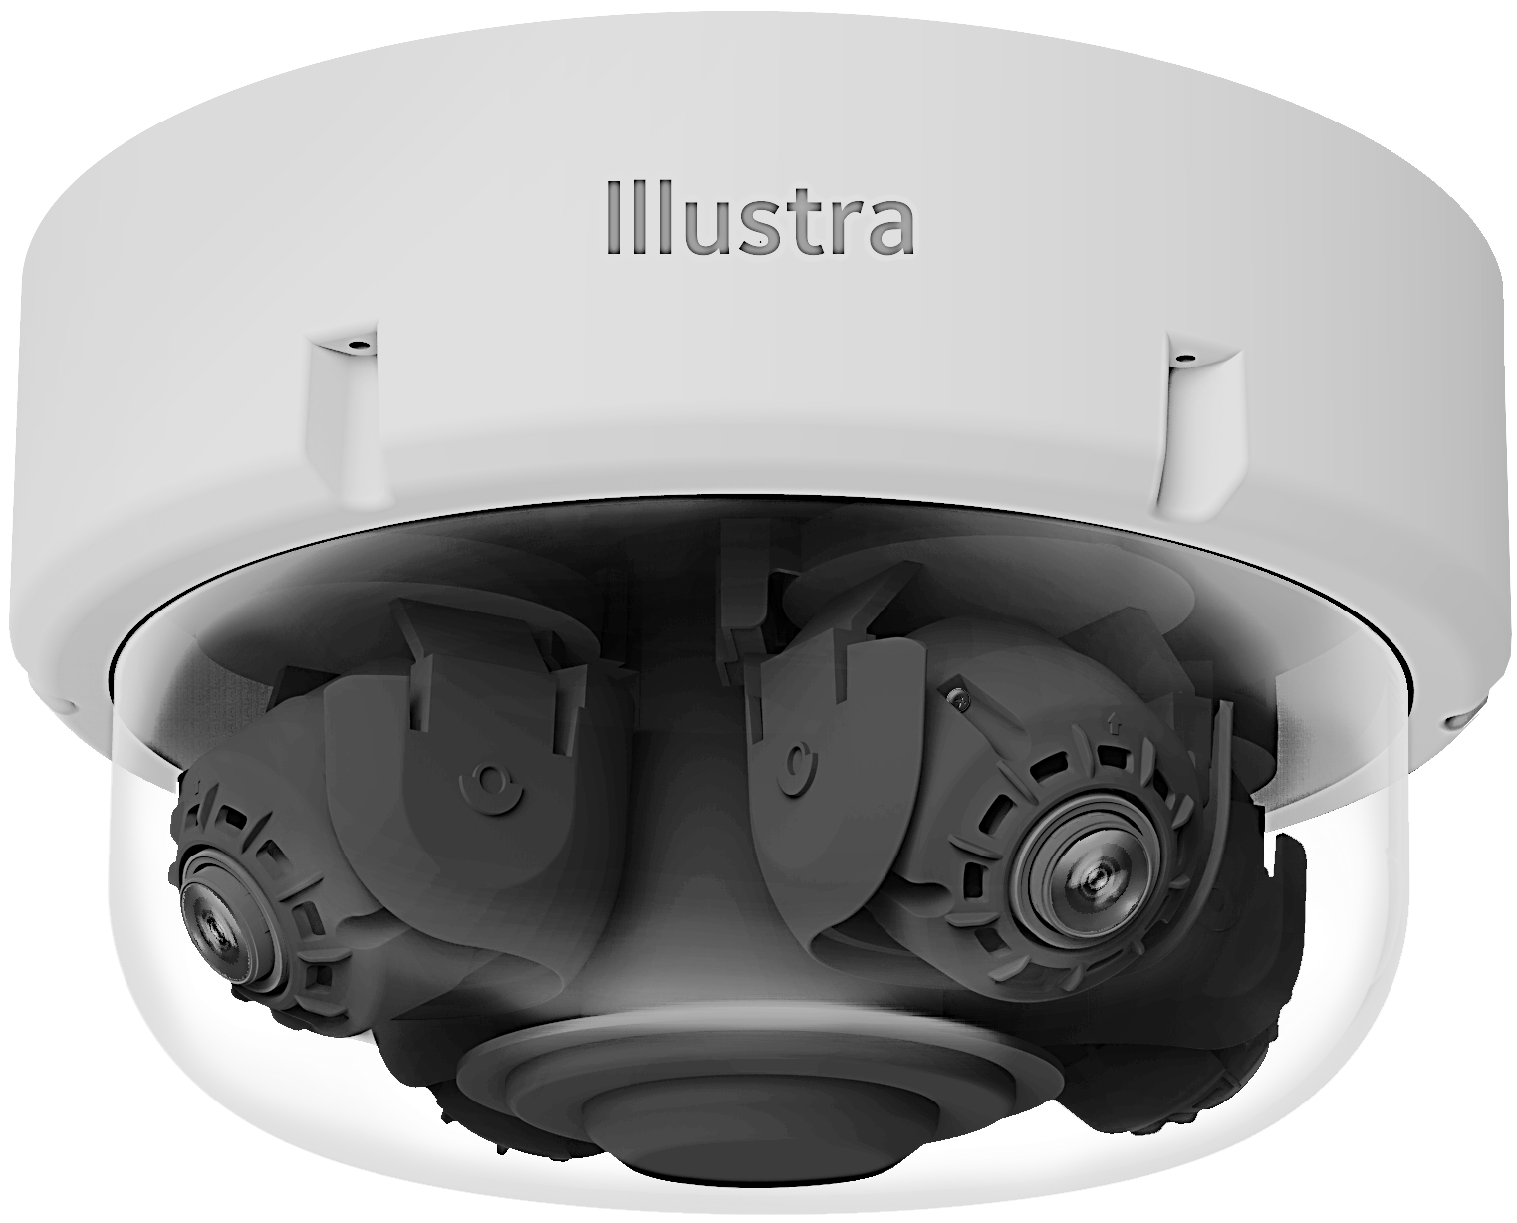
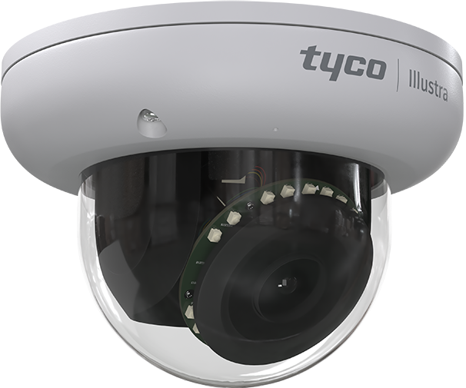
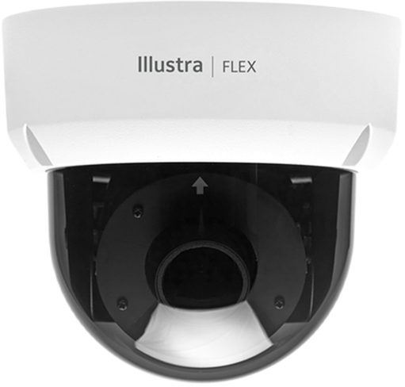
Illustra Cameras – On-Board EDGE AI Today
v
Pro Pan Tilt Zoom – 2 & 8 MP
Object Detection Types/Rules | Object Classifications | Internal Pro G4 PTZ | External Pro G4 PTZ | Pro Multi-Sensor | Pro Mini Dome | Flex Mini Dome
Person | Person | ✓ | ✓ | ✓ | ✓ | ✓
Clothing Upper & Lower Colors | Black, Blue, Brown, Gray, Green, Orange, Pink, Purple, Red, White & Yellow | ✓ | ✓ | ✓ | ✓ | ✓
Vehicles | Bicycle, Bus, Car, Motorbike, Truck & Train | ✓ | ✓ | ✓ | ✓ | ✓
Vehicle Color | Black, Blue, Green, Gray, Red, White & Yellow | ✓ | ✓ | ✓ | ✓ | ✓
Rules | Linger, Dwell, Perimeter, Object, Detection Abandoned/Removed Objects, Direction, Entry, Exit, Crowd, Queue & Areas | ✓ | ✓ | ✓ | ✓ | ✓
Tamper | Blur & Brightness | ✓ | ✓ | ✓ | ✓ | ✓
Person Re-ID | Person Characteristics Search | Full Edge Processing & Partial | Full Edge Processing & Partial | Full Edge Processing & Partial | Full Edge Processing & Partial | Partial Edge Processing
Pro Multi-Sensor – 20 & 32 MP
Pro Mini Dome - 2, 4 & 8 MP
Flex Mini Dome - 2, 4 & 8 MP
Notes:
.

Slide 28
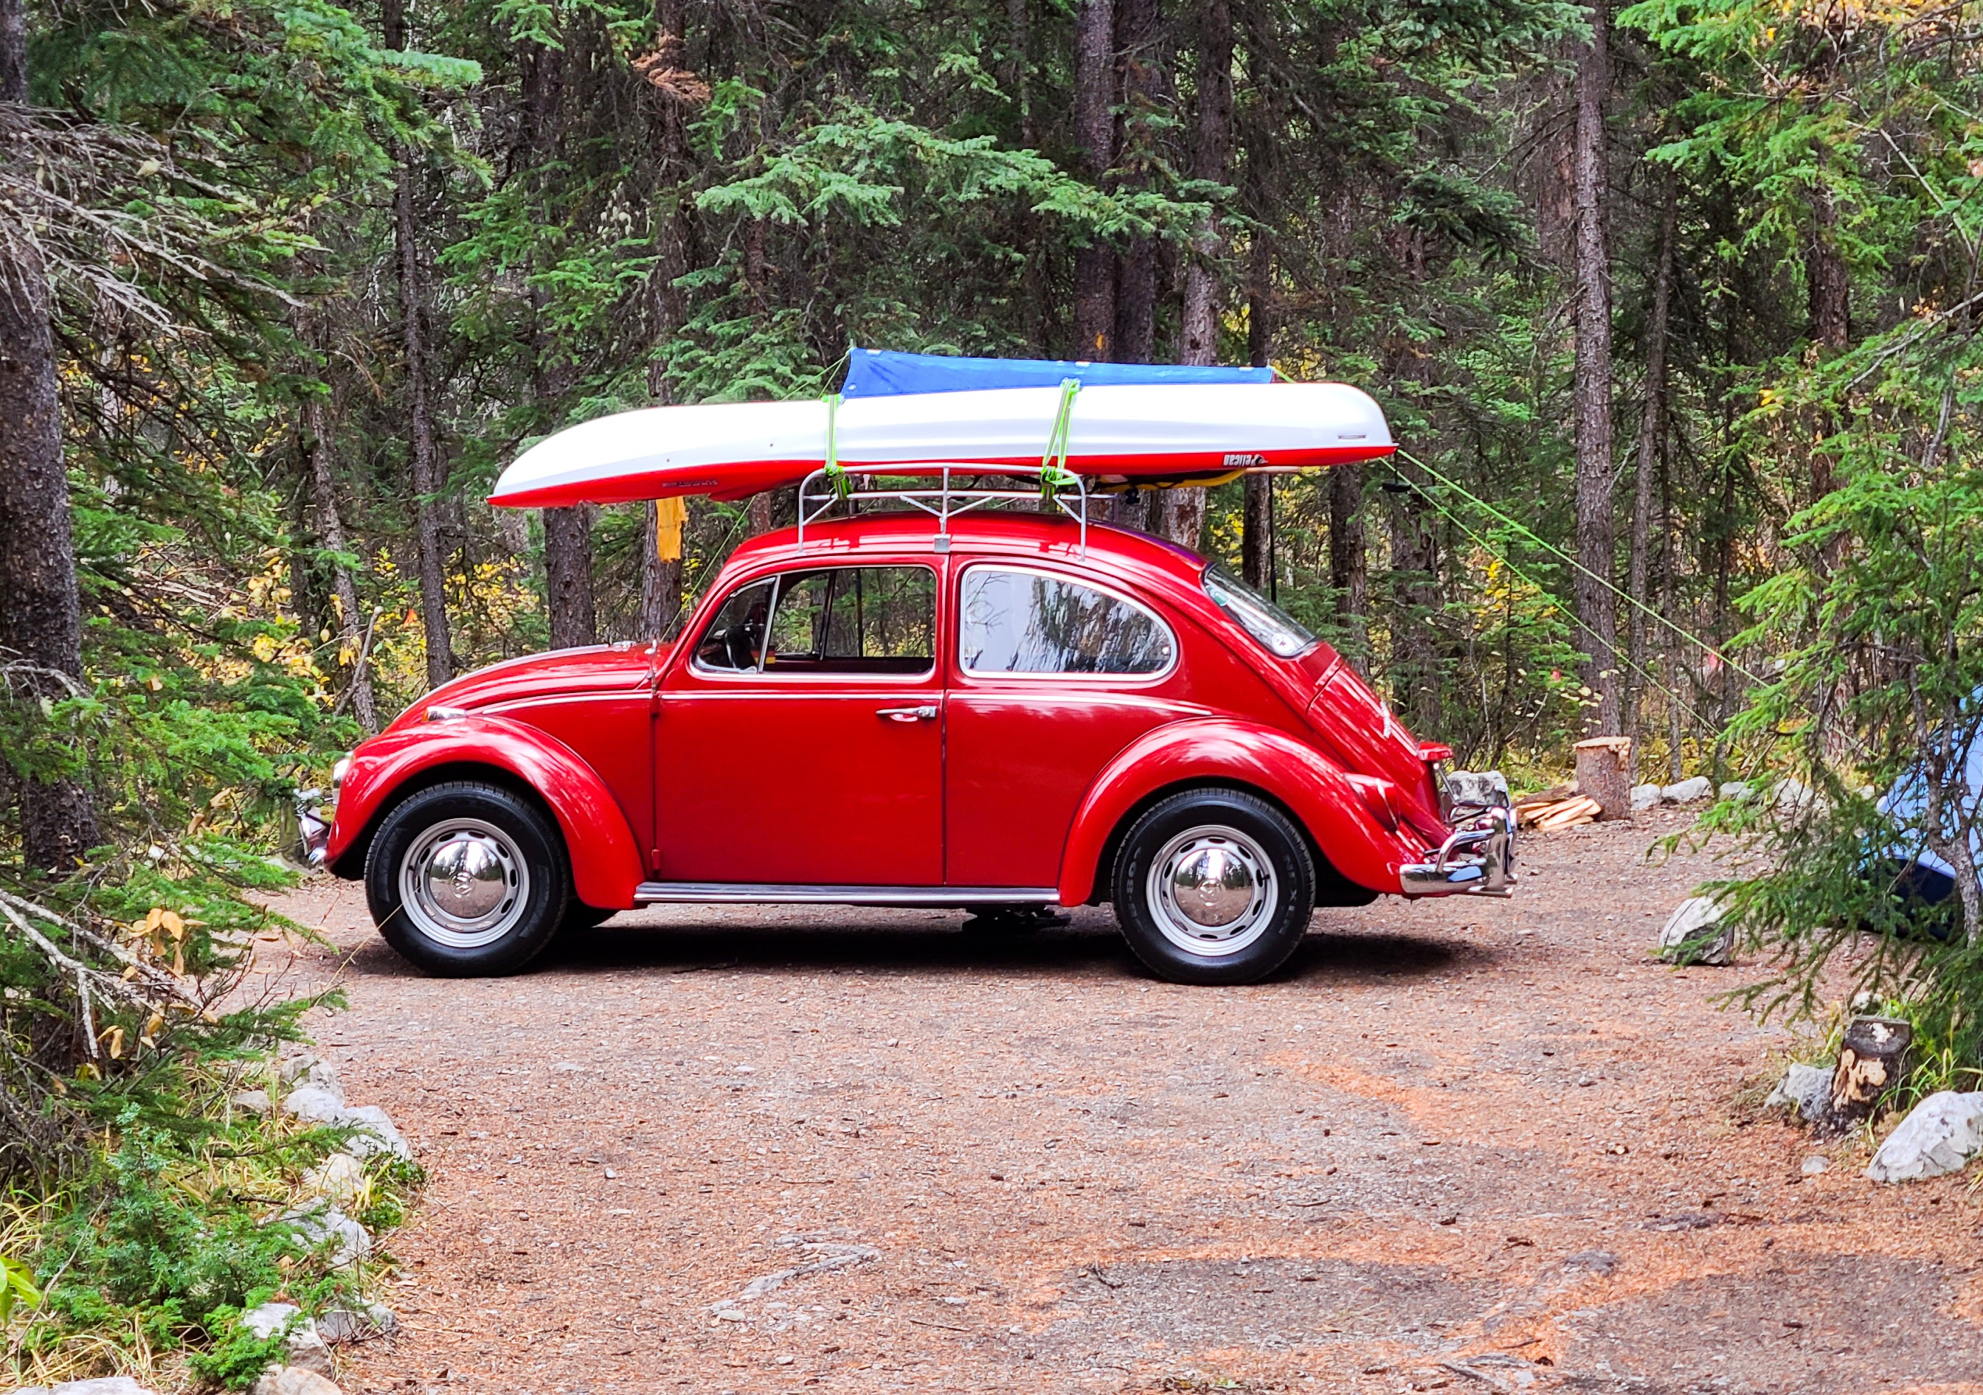
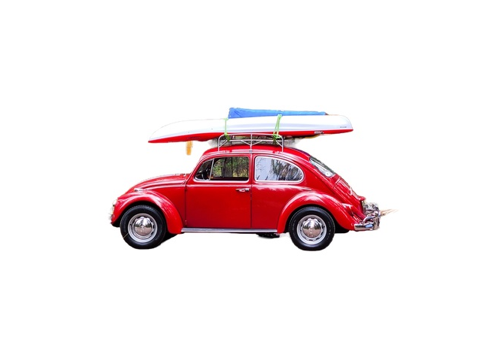
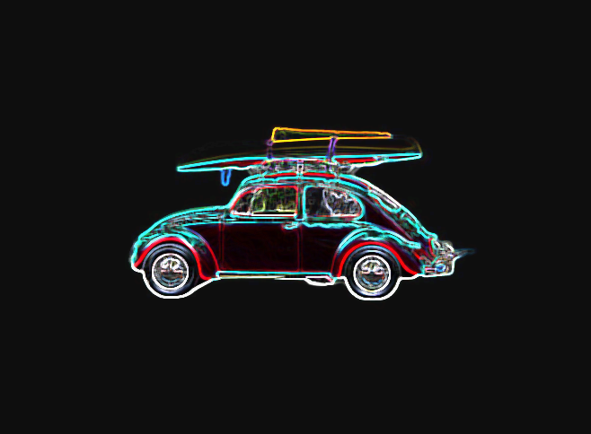
Illustra Cameras AI Processing Stages
v
Capture
Process
Classification
Rules & Notification

Slide 29
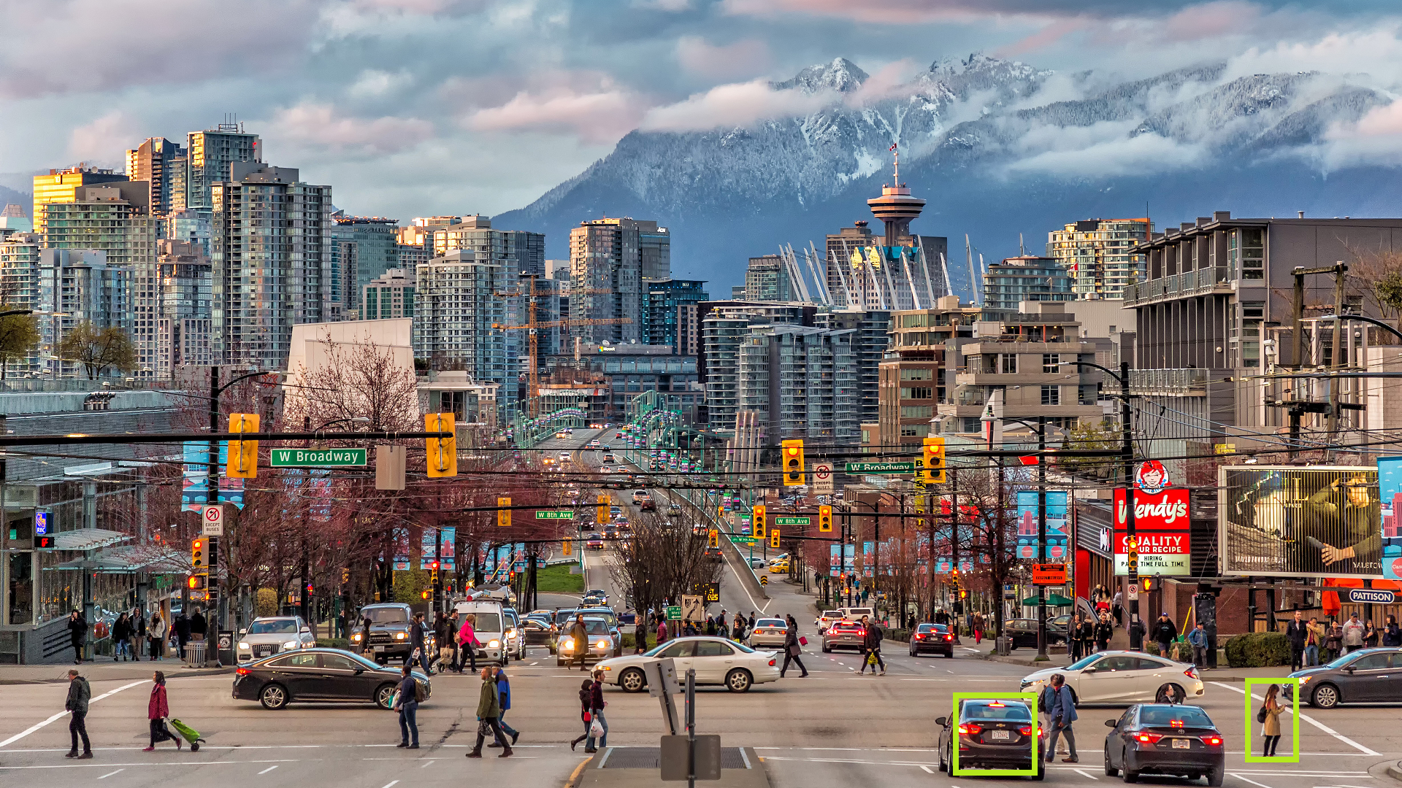
Illustra Cameras – Pixels On-Target Detection Requirements
Example Based on 2-MP Image
with Minimum Height of 108 Pixels
Up to 30 Edge Objects Detected
  Multi-Sensor supports a total of 120 Objects
  4x Cameras - 30 Objects Per Camera FOV
Detection for the Minimum Pixels-on-Target
MegaPixel Chart Showing Pro and Flex Pixels-on-Target
  Pro requires approx. 10% of the total image view
  Flex requires approx. 15% of the total image view
People Vehicles and Color Passed as Metadata
Height 108
Pixels
Height 108
Pixels
Note: Higher MegaPixel images require more pixels for height, as AI classification models rescale prior to processing the video.

