Slide 1
Technical Support Training
22.12 Quarterly Training
Ross White
2022-12

Slide 2
Sections
Server
Client
Web Service
Mobile
Enterprise Manager
Exacq Hardware

Slide 3
Server

Slide 4
Bug Fixes
Fixed issue preventing the archiving of analog video to Cloud Drive (AES-74, AESW-1395)
Motion Detection not working on Holis cameras (AES-121, AESW-2947)
Corrected issue setting NTP server for illustra3pi and illustramultipi plugins (AESW-2546)
Fixed issue with missing frames from PTZ cameras causing image “tearing” in recorded video files (AES-30, AESW-1767)
Fixed issue with core hanging when attempting to stop server service (AESW-2211)
Addressed issue with high memory usage (AESW-558)
Fixed logging issue with potential to cause crash, re: LDAP (AESW-2431)
Corrected reporting issue for object classification from all sensors when using the illustramulti camera plugin (AESW-2174)
Fixed issue reading blur and tamper detection for individual sensors, illustramulti (AESW-2074)
Fixed handling of metadata/motion timeouts on Samsung, Illustra… manifested as motion detection that would cease working (AESW-517)

Slide 5
Enhancements
Support added for Axis’ new Time API calls (AESW-1726)
Support added for Arecont Contera series
Support added for Protego devices, alias of Sunell
Added support for ACTi Z94 camera
Added JSON support for Dahua DH-IPC-HFW1230S-S5, DH-IPC-HDBW1230E-S5
evAPI changes made to support sustained soft triggers (AESW-2127)
Added support for Illustra metadata with HTTPS, phase 1 of enhanced support with Illustra Enhanced Security mode (AESW-3260)

Slide 6
Client

Slide 7
Bug Fixes
Corrected issues with keyword tree resetting the scroll position (AESW-3236)
Fixed issue saving edits to Event Monitoring profile when Source Name begins with the system name (AESW-3099)
Prevent client crash when clicking Show Keywords checkbox (AESW-3240)
Fixed issue where event metadata fails to be included for first selected device with certain Access Control integrations (AESW-2083)
Fixed issues where client did not display keywords when more than 20 values are returned (AESW-3134)
Fixed icon display issue on Storage > Hardware tab device tree (AESW-1861)

Slide 8
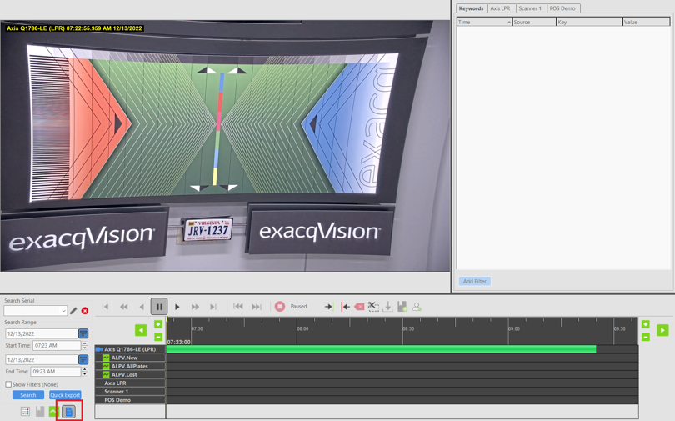
Enhancements
Hide metadata keywords grid by default, user will click Show Keywords to toggle display of the keywords grid (AESW-2842)
Cloud Drive integration enhancement to only list cameras from the systems in the systems list (AESW-1971)
Improvements made to reduce false positives based on color filtering for people and vehicles (AESW-2436)
Hide the conditions panel when not needed (AESW-2843)

Slide 9
Web Service

Slide 10
Bug Fixes
Fixed potential gateway deadlock from closing streams (AESW-3119, AESW-3120)

Slide 11
Mobile

Slide 12
Features
Update for SDK for Android 12 support (AESW-2593, AESW-3330)
New Scrollable timeline for search (AESW-272)

Slide 13
Enterprise Manager

Slide 14
Bug Fixes
Fixed infinite camera permissions from bad user roles (AESW-1723, AESW-2013) A user role can only enter the ‘managed’ state on the server if that server is in the same group as the user role on EM. So, if the server and user role are not in the same group, we will get mismatched data on what is considered ‘managed’ resulting in the infinite permission growth.

Slide 15
Exacq Hardware

Slide 16
G-Series, 2nd Generation
2nd Gen
16 PoE ports with 240W total budget
4 PRO licenses
1st Gen
16 PoE ports with 240W total budget
12TB max storage
120Mbps video rate
2 monitors, 480 fps @ 1080p
Ubuntu 22.04, 12th Gen Intel Celeron, 4 GB RAM
OS on SSD
4 PRO licenses
OS on SSD
12TB max storage
120Mbps video rate
2 monitors, 240 fps @ 1080p
Ubuntu 18.04, Intel Atom, 4 GB RAM

Slide 17
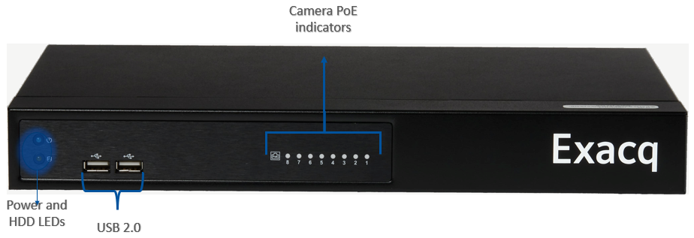
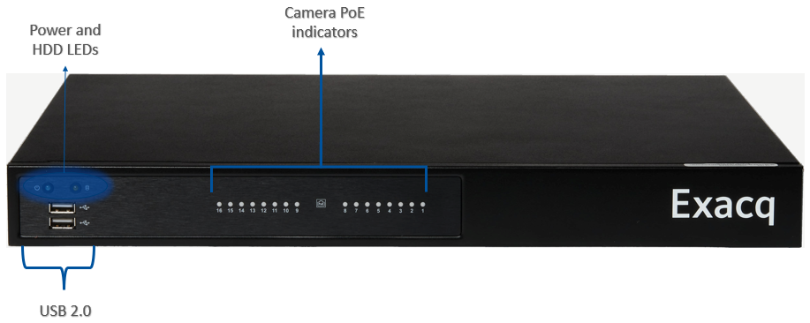
G-Series, 2nd Generation

Slide 18
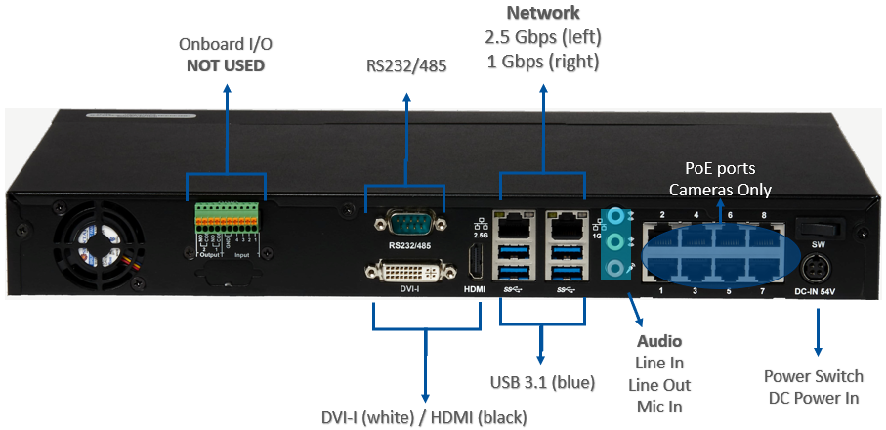
G-Series, 2nd Generation

Slide 19
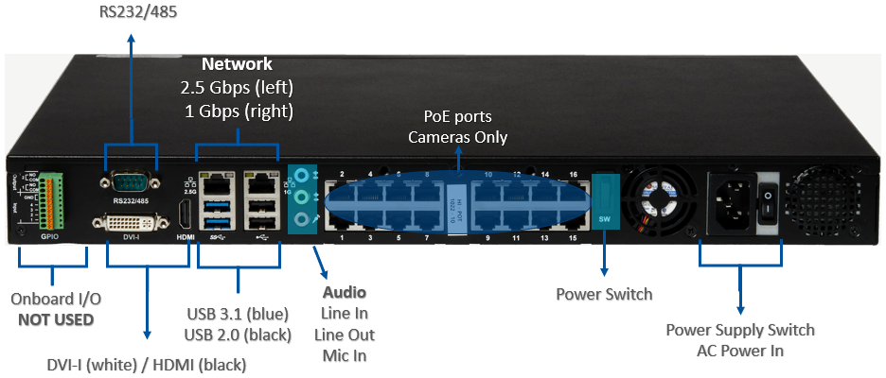
G-Series, 2nd Generation

Slide 20
G-Series, 2nd Generation
G-Series PoE | 8-Port | 16-Port
Maximum PoE Cameras | 8 | 16
Included IP Licenses | 4 PRO | 4 PRO
PoE Power | 15 W (all ports simultaneously) | 15 W (all ports simultaneously)
 | 30 W max (individual port) | 30 W max (individual port)
 | 120 W (total) | 240 W (total)
Pre-loaded VMS Software | Professional | Professional
 | Enterprise (Optional) | Enterprise (Optional)
Include SSA | 3 Years | 3 Years
Operating System | Linux Ubuntu 22.04 | Linux Ubuntu 22.04
Maximum Storage | 12TB | 12 TB
Maximum Hard Drives | 1 | 1
Typical Video Storage Rate | 120 Mbps | 120 Mbps
Local Client Display Rate (1080p) | 8 streams @ 15 FPS each | 16 streams @ 15 FPS each
CPU | 12th Gen Intel® Celeron | 12th Gen Intel® Celeron
RAM | 4 GB | 4 GB
Monitor Output | DVI-I, HDMI | DVI-I, HDMI
 | 2 Simultaneous | 2 Simultaneous
NIC | 1 x 2.5 Gbps + 1 x 1 Gbps | 1 x 2.5 Gbps + 1 x 1 Gbps
USB | 2 USB 2.0 Front, 4 USB 3.1 Rear | 2 USB 2.0 Front + 2 USB 2.0 Rear, 2 USB 3.1 Rear
Audio Inputs | 1 | 1
Audio Outputs | 1 | 1
DVD | External (Optional) | External (Optional)
Accessories | Keyboard (on-screen), Mouse | Keyboard (on-screen), Mouse
Dimensions (H x W x D) | 1.92 in x 14.17 in x 8.83 in | 1.75 in x 16.92 in x 13.70 in
 | 4.9 cm x 36 cm x 22.45 cm | 4.45 cm x 43 cm x 34.8 cm
Weight | 6 lbs | 10 lbs
 | 2.72 kg | 4.54 kg
Certifications | UL, CE, FCC | UL, CE, FCC

Slide 21
Questions

