Slide 1

Technical Support Training
22.09 Quarterly Training
Ross White
2022-09

Slide 2
Sections
Server
Client
Web Service
Mobile
Enterprise Manager
Illustra
Appendix

Slide 3
Server

Slide 4
Bug Fixes
Removed limit of 256 devices displayed for Access Control plugins, only visible when using Access Control with Associations or Maps (AESW-1208)
Fixed issue with Illustra3 and Illustramultipi that could cause cameras to be stuck in a Connecting state after reboot (AES-22, AESW-1644)
Fixed issue where Edgestor was not backfilling data from Illustra3pi cameras due to Edgestor crash, leaving gaps on server recordings (AES-35, AESW-1822)
Fixed quality setting for Illustramultipi (AESW-1128)
Fixed issue with trigger inputs/alarm outputs for Illustramultipi (AESW-1306)
Added retry logic on API errors for napcopi, Napco uses IIS which has a recycle time that caused authentication to fail, fix adds retry logic if error received (AESW-1591)
Fixed issue causing credentials for RTSP Server not to be updated properly (AESW-412)
Corrected issue where Date/Time page was greyed out on Win7 machines (AESW-387)
Fixed issue where Dynacolor devices may repeatedly reset after user presses Reset button on PoE port in Client. (AESW-2125)

Slide 5
Bug Fixes
Fixed viewing Live Analytics for Flex3 cameras (None)
Fixed issue where closing video stream did not close metadata stream from Illustra3pi
(AESW-1120)
Fixed propagating motion alarms on disabled context streams on Illustra3pi (AESW-740)
Fixed setting transport and re-reading URL for continuous metadata from Illustra3pi (AESW-583)
For Illustra3pi and Illustramultipi, use friendly name for analytics that provide bounding box (AESW-158)

Slide 6

Enhancements
Added motion support for March Network cameras using Onvif (AESW-841)
Support for Redvision RVX2 added to Onvif plugin (AESW-843)
Support for Sunell with transport RTSP added for Onvif (None)
Improvements made for Last Motion event on context streams (AESW-1139)
Adjustments made to parsing Audio Output name for Illustramultipi (AESW-1369)
Removed eDVR and XDVAPI license handling (AESW-1922)
Homogenized analytic values for Axis, Samsung/Hanwha, Tycodlpi (AESW-1687)
Presents “Person” instead of “Human”, “Bicycle” instead of “Bike”
Added support for Axis’ new metadata style used in their 11.0 firmware (AESW-1154)

Slide 7

Features
Added support for vehicle and clothing color provided by Illustra3pi and Illustramultipi cameras (AESW-1471)

Slide 8
Client

Slide 9
Bug Fixes
Reset search item flags when sending new search requests, fixes issue when Search stops working if server connection lost mid-search (AESW-921)
Don’t send scrub request if waiting for summary response (AESW-921)
Prevent potential crash on Association config page if a camera with associations was deleted (AESW-1833)
Initialize Digital PTZ settings to Client settings when plugin does not send them, related to changes made for body worn cameras (AESW-1787)
Prevent toast messages for streaming BWCs on system disconnect (AESW-1787)
Reset camera connection status on system disconnect (AESW-1787)
Disabled BWC audio devices on Audio configuration page (None)
Prevent security integration sources from being displayed twice in bookmark editing tree (None)
Fixed potential crash when adding new IP serial port and config update occurs (AESW-1384)

Slide 10
Bug Fixes
Prevent client crash with double-clicking on grid divider in List View (AESW-2132)
Prevent client crash on OSX when clicking calendar controls (AESW-2143)
Fixed issue with export failure if config page options in settings file (AESW-2170)

Slide 11
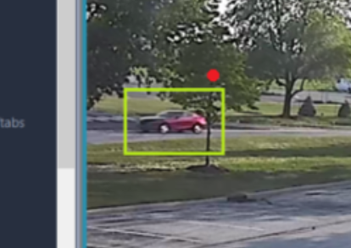
Enhancements
Prevent some analytic search filters that didn’t make sense, non-sensical combinations of operator logic (AESW-1095)
Don’t request event data in response to Show Conditions panel, caused Search to stop working when connection to Server was lost mid-search (AESW-921)
Display analytic colors above bounding boxes (AESW-1694)
Red dot above bounding box,
indicates Red car

Slide 12
Web Service

Slide 13
Bug Fixes
Added libreadline8 dependency for the Ubuntu 22.04 installer (AESW-876)
Fix made to data races related to search and discovery (AESW-1533, AESW-1534)
Update search session keep alive when search frame is retrieved (AESW-1920)

Slide 14
Enhancements
Add search only status to cameras and audio streams (AESW-1743)

Slide 15
Mobile

Slide 16
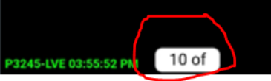
Bug Fixes
Fixed issue where Number of Servers Connected displayed in menu bar was incorrect (AESW-1168)
Disable Autocorrect for Add Server page (AESW-1310)
Removed Delete icon from Focus View mode (AESW-259)
Accidental scrub bar touches open Focus View (AESW-207)
Fixed issue with truncated camera pagination (AESW-929)
Fixed issue where rotating to landscape display and back made bottom row OSDs disappear (AESW-1848)
Fixed issue where software was crashing when searching using server time (AESW-1203)
Corrected issue where Views on iOS were not loading video (AESW-1373)
Case sensitive issue on Add Server page, client did not handle adding system with capital letters in address (AESW-1213)
Mobile app Login button not responding to EM sync login (AESW-1692)

Slide 17
Enhancements
Hide Search Only cameras from Live (AESW-1744)

Slide 18
Features
Remove the data usage prompts and data collection, temp removal for launch due to requirements by Apple (AESW-1415)

Slide 19
Enterprise Manager

Slide 20
Bug Fixes
Fixed showing deleted servers in the search results (AESW-1840)
Fixed server configs from being checked for failover or updates
(AES-70, AESW-1321, AESW-2113)

Slide 21
Illustra

Slide 22
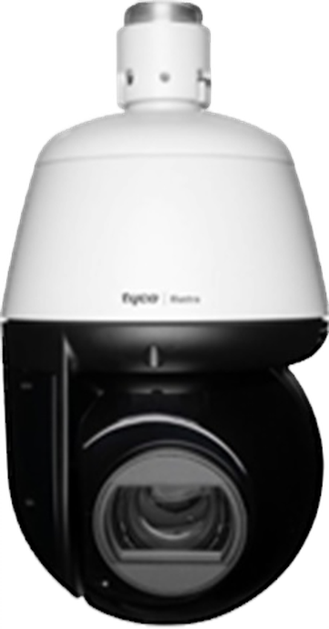
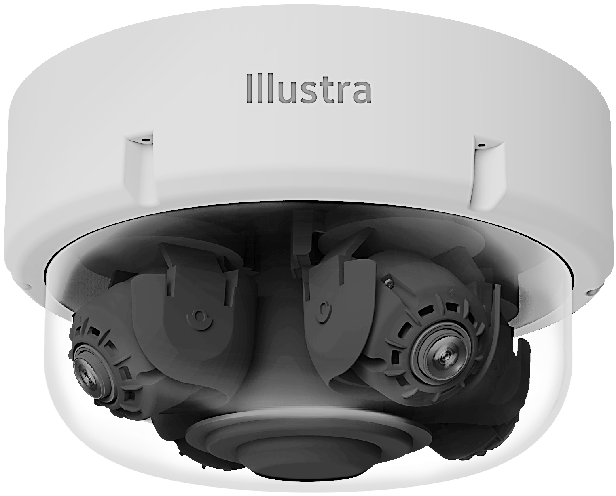
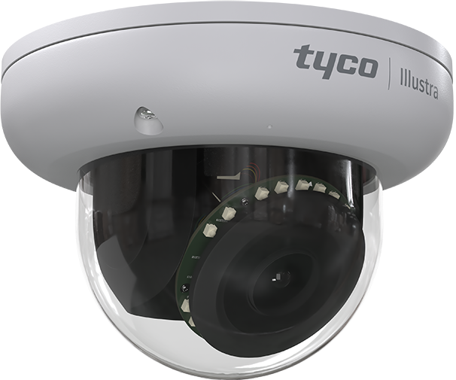
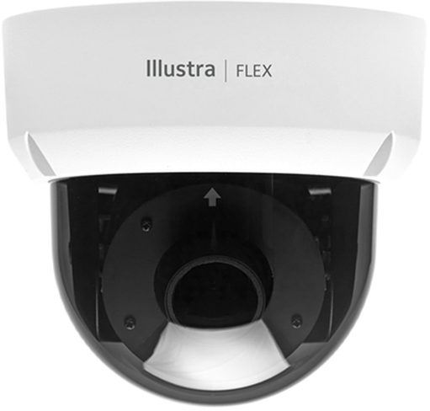
Illustra Cameras – On-Board EDGE AI Today
v
Pro Pan Tilt Zoom – 2 & 8 MP
Object Detection Types/Rules | Object Classifications | Internal Pro G4 PTZ | External Pro G4 PTZ | Pro Multi-Sensor | Pro Mini Dome | Flex Mini Dome
Person | Person | ✓ | ✓ | ✓ | ✓ | ✓
Clothing Upper & Lower Colors | Black, Blue, Brown, Gray, Green, Orange, Pink, Purple, Red, White & Yellow | ✓ | ✓ | ✓ | ✓ | ✓
Vehicles | Bicycle, Bus, Car, Motorbike, Truck & Train | ✓ | ✓ | ✓ | ✓ | ✓
Vehicle Color | Black, Blue, Green, Gray, Red, White & Yellow | ✓ | ✓ | ✓ | ✓ | ✓
Rules | Linger, Dwell, Perimeter, Object, Detection Abandoned/Removed Objects, Direction, Entry, Exit, Crowd, Queue & Areas | ✓ | ✓ | ✓ | ✓ | ✓
Tamper | Blur & Brightness | ✓ | ✓ | ✓ | ✓ | ✓
Person Re-ID | Person Characteristics Search | Full Edge Processing & Partial | Full Edge Processing & Partial | Full Edge Processing & Partial | Full Edge Processing & Partial | Partial Edge Processing
Pro Multi-Sensor – 20 & 32 MP
Pro Mini Dome - 2, 4 & 8 MP
Flex Mini Dome - 2, 4 & 8 MP
Notes:
.

Slide 23
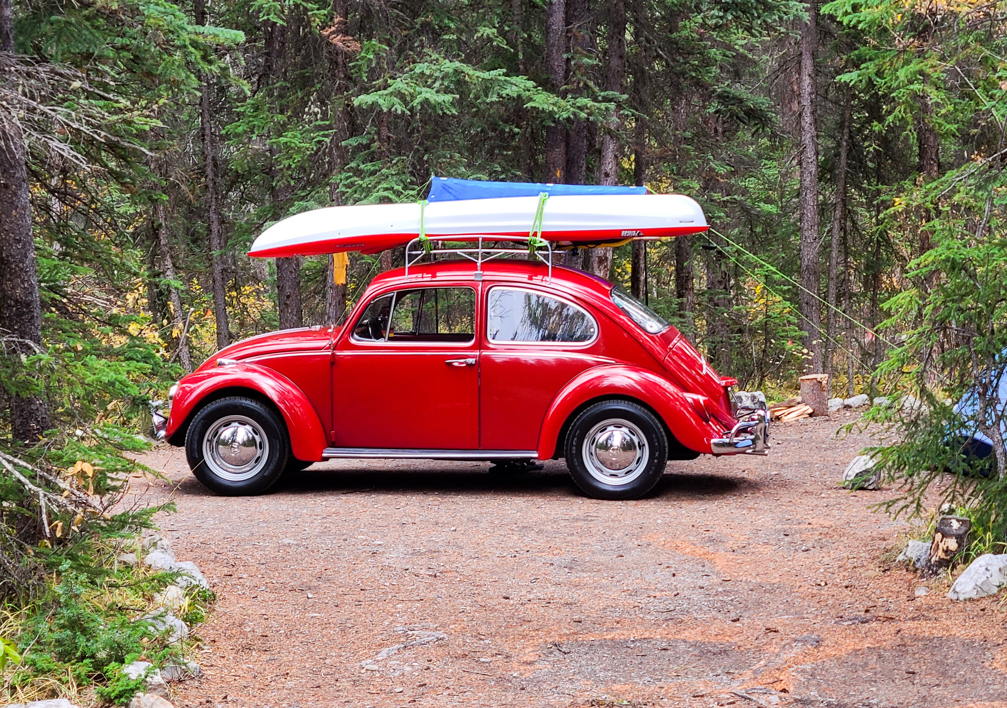
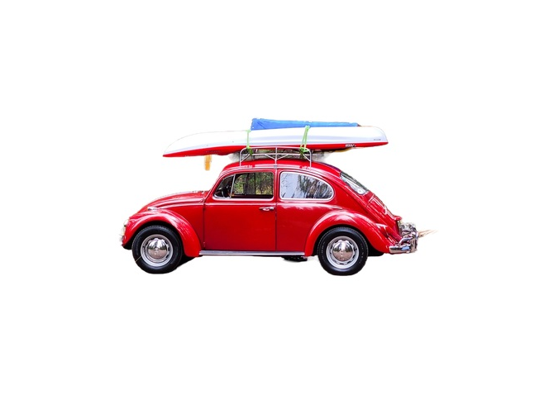
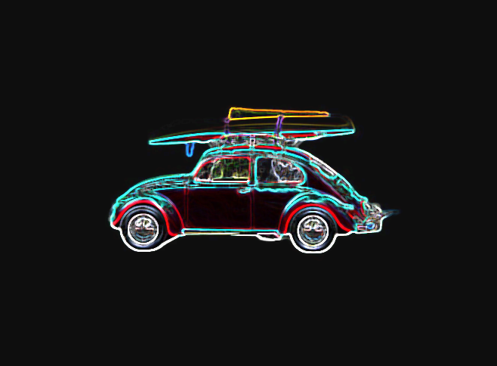
Illustra Cameras AI Processing Stages
v
Capture
Process
Classification
Rules & Notification

Slide 24
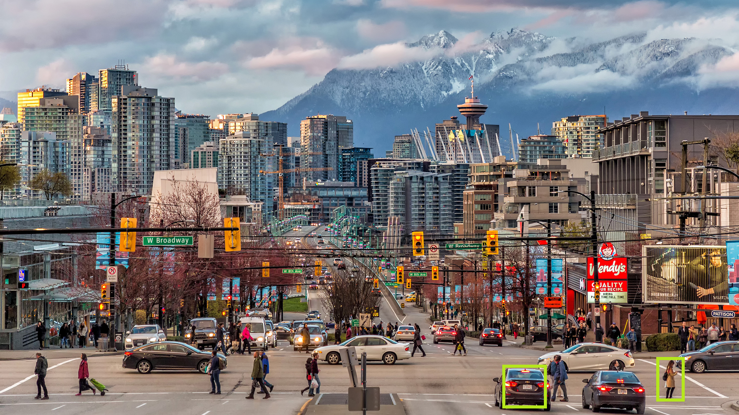
Illustra Cameras – Pixels On-Target Detection Requirements
Example Based on 2-MP Image
with Minimum Height of 108 Pixels
Up to 30 Edge Objects Detected
  Multi-Sensor supports a total of 120 Objects
  4x Cameras - 30 Objects Per Camera FOV
Detection for the Minimum Pixels-on-Target
MegaPixel Chart Showing Pro and Flex Pixels-on-Target
  Pro requires approx. 10% of the total image view
  Flex requires approx. 15% of the total image view
People Vehicles and Color Passed as Metadata
Height 108
Pixels
Height 108
Pixels
Note: Higher MegaPixel images require more pixels for height, as AI classification models rescale prior to processing the video.

Slide 25

Questions

Slide 26
Appendix

Slide 27
Cloud Drive vs. Cloudvue
Cloud Drive is subscription plan to archive recorded data in the cloud
Cloud Drive uses Cloudvue’s API to store data on their servers
The two services are completely separate products from JCI
Cloud Drive | Cloudvue
Archive Only | Live and Recorded Viewing
ExacqServer sends data to cloud | Gateway or C2C sends data to cloud
Config on Archiving page | Config by a dealer
Uses Cloudvue API | -
Subscription plan | Subscription plan
Cloud Drive
Cloudvue

