Slide 1
Technical Support Training
22.06 Quarterly Training
Ross White
2022-06

Slide 2
Sections
Server
Client
Web Service
Mobile
Enterprise Manager
Illustra
Appendix

Slide 3
Server

Slide 4
Bug Fixes
Fixed issue preventing DMP device from being deleted (AESW-869)
Fixed a few plugins that could potentially cause system stall during shutdown (AESW-711)
Fixed problem wherein adding Illustra devices with Onvif rather than proper plugin caused flood of configuration messages to logs (AESW-146)
Fixed problem with SSO if AES encryption is enabled on Active Directory, Added sAMAccountName since used as part of encryption key, change bind user query all of these are involved in resolving issue using AES encryption with AD (AESW-79)
Fixed issue with motion window coordinates on ACTi platform C cameras to account for mirror/flip (AESW-99)
Fixed issue on disk prep issue on zero drive systems with RAID, disk prep was not partitioning correctly on the RAID units (AESW-468)
Fixed issue parsing analytic configuration from Illustra3 plugin (AESW-68)
Fixed issue showing WDR for Axis devices with firmware 6.5+ (AESW-142)
Fixed invalid time handling for edgestor on Axis cameras (AESW-65)

Slide 5
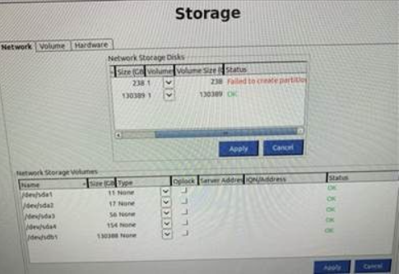
Bug Fixes
Fixed problem wherein the OS volume was appearing in the Network Storage (AESW-172)
Fixed issue preventing ACTi plugin from receiving all device settings (AESW-154)
Fixed an issue with Kantech reporting of event times, was using Kantech time, not time of event

Slide 6
Enhancements
Encrypt Dahua device passwords stored in config (AESW-70)
Encrypt Hikvision passwords stored in config (AESW-69)
Update to show “Panasonic/i-PRO” for device plugin name/discovery (AESW-573)
Prevent licensing systems with locally administered MAC addresses or virtual devices (AESW-648)
Intended to prevent license theft/reuse on VM’s, Containers, and locally spoofed MACs
Upgraded SysmgmtPI to support disk monitoring on NVMe drives (AESW-17)
Improved plugin responsiveness for several access control plugins
Standardized object classification naming (axispi, illustra3pi, samsungpi, tycodlpi)
Export server, camera, integration, and association details on single report as CSV or PDF.
Professional and Enterprise only

Slide 7
Features
Removed support for no-longer-supported eDVR capture boards (AESW-581)
Object Classification Search (AESW-87)
Illustra Body Worn Camera Support (AESW-26) *
Illustra Pro Multisensor support (AESW-102)
New illustramultipi plugin
Audio out functionality added (AESW-852)
* Removed from marketing for 22.06 release, pushed to 22.09. Still available to those with the equipment and assistance with setup from Product Management

Slide 8
Client

Slide 9
Bug Fixes
Fixed potential crash if selecting keyword from filters, then hide and show filters again, forward and event back buttons did not work (AESW-920)
Fixed issue with stalling Exports on Linux machines (AESW-1109)
Fixed issue sizing bounding boxes for analytic searches (AESW-922)
Fixed issue where clearing search cache, started download again (AESW-1117)
Fixed issue regarding warning message when searching for analytics on system that doesn’t support object classification (AESW-1106)
Fixed issue where one person key appeared in results event if multiple persons matched (AESW-899)
Caused by multiple matches becoming filtered (i.e. Michael, George Michael)
Fixed client issue where a client would disconnect if server too busy to reply with heartbeat
Fixed issue with selectable fields on Enterprise > Notifications page (#23448)
Fixed issue with hang during video preview on Mac’s with M1 chip (AESW-266)
Fixed issue with error message for displaying web panel camera config pages, caused by failing page cert validation (AESW-264)

Slide 10
Bug Fixes
Fixed issue after changing to Group by Device when trying to right-click would cause error saying no cameras were selected when right-clicking to search from Live panel (AESW-1113)
Fixed issue where LDAP users were unable to create a User View (#23444)
Show LDAP user name rather than GUID under username for View (#23444)
Resolved issue with client crashes caused by other software on machine using Boost libraries. (#23413)

Slide 11
Enhancements
Added support for Raw PCM16 audio encoding, used by Illustra Body Cam
New installs group sources by device
Last motion status added to camera grid
Improvements to UI for analytic search
Ability to enable/disable specific analytic overlays
Added CSV support for system report generation, much of this work helps dealers/integrators when ordering/setting up Cloud Drive integration

Slide 12
Enhancements
Filter for analytics based on specific object types within the search timeframe
Reduce search times by filtering for specific objects (person, cars, truck, etc.)
Depends on the metadata specific AI camera models are able to send

Slide 13
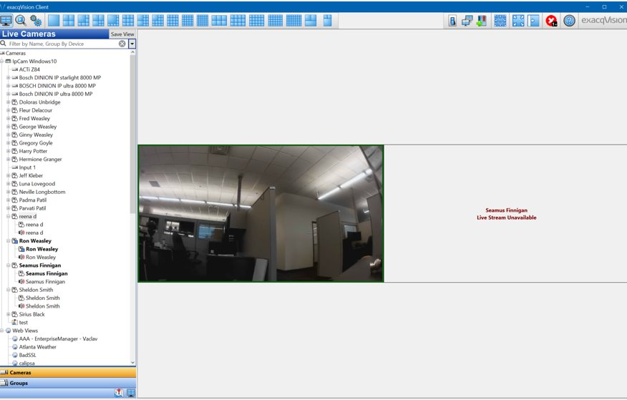
Features
Configuration for Illustra Body Worn Cameras
Allow live streaming from Illustra Body Worn Cameras
On Hold 22.09

Slide 14
Web Service

Slide 15
Bug Fixes
Fixed problem where enabling HTTP redirect to HTTPS provided an internal IP address, now provides external URL (AESW-620)
Note: requires a valid domain name to be configured which is externally reachable
Fixed problem displaying groups or maps from different systems when groups or maps had same names (AESW-88, AESW-77)
Ensure frpc is properly restarted after an authorization failure, should improve stability of the web relay connection (AESW-78)
Removal of token exchange with web relay, should also help with customer issues using web relay and should not affect security (AESW-186)

Slide 16
Mobile

Slide 17
Bug Fixes
Fixed issue with app crashing on Android when resetting all app data (AESW-13)
Disable navigation “drawer” slide if no servers added (AESW-900)
Fixed issue with views created in mobile which weren’t updating to proper cameras (AESW-845)
Fixed back button action from Doors page (AESW-499)
Fixed time selection issue where calendar incorrectly adjusts for DST (AESW-206)
Disable the Full Screen button for Video Push if pushing is not possible (AESW-211)
Only allow video push of currently displayed cameras (AESW-211)
Fixed an issue with mobile notifications from Event Monitoring or Analytics (AESW-43)

Slide 18
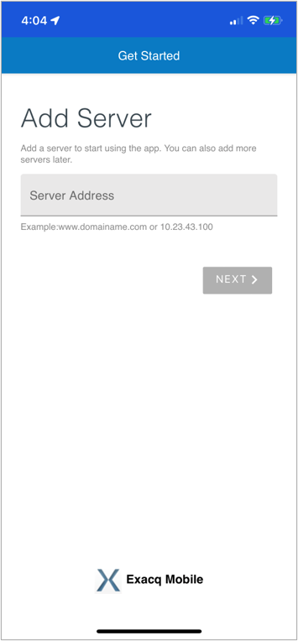
Enhancements
Login page UI changes
Live scroll view
Reorganization of configuration pages
Search page will show ‘No Video Available’ instead of ‘Unknown Error’

Slide 19
Enhancements
Swipe navigation
Next view button to Right/Left swipes

Slide 20
Features
Edit Panels
Added Edit Panels button to allow rearranging live camera panels in view

Slide 21
Features
Added Search to context menu
Added Overflow menu to app bar
Disable zoom when viewing a 1x1 panel
Keep track of scroll position
Added support for multitasking on latest iOS devices

Slide 22
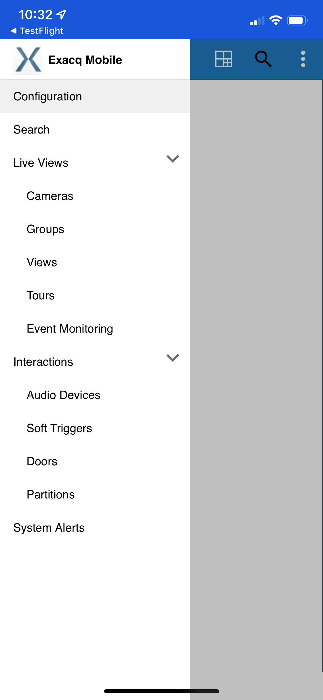
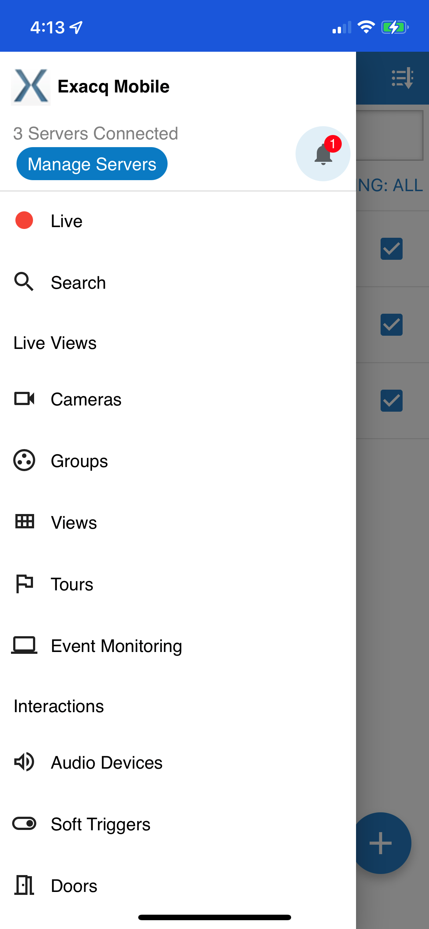
Features
Reorganization of menus and made menus collapsible
Old Home Menu
New Home Menu
Home Menu Demo

Slide 23
Enterprise Manager

Slide 24
Bug Fixes
Fixed LDAP user authentication
Updated server license requests to avoid error caused by length of URL
Remove password complexity requirement for SMTP
Fixed issue opening EM Shell on Ubuntu due to missing module (AESW-294)
Fixed issue where checking for server updates with no servers caused 500 error (AESW-224)

Slide 25
Enhancements
Improved efficiency of assigning servers to importers
Automatic SSL migration support for .deb installer
Clean up orphaned server configs more often
Replacement of Apache Solr with Elastic

Slide 26
Illustra

Slide 27
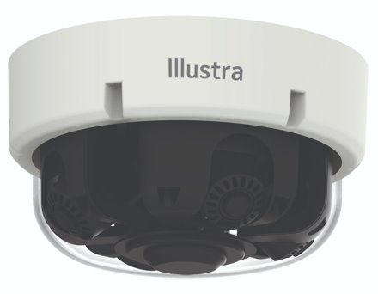
Illustra Pro Multisensors
Staged release of multiple models
Model | Description
IPR32-M13-OIA4 | 32MP (4x8MP), 3.6-11mm, Motorized, Indoor/Outdoor, IR
IPR20-M12-OIA4 | 20MP (4x5MP), 2.7-13.5mm, Motorized, Indoor/Outdoor, IR
IPS32-M13-OIA4 | 32MP (4x8MP), 3.6-11mm, Indoor/Outdoor, IR
IPS20-M12-OIA4 | 20MP (4x5MP), 2.7-13.5mm, Indoor/Outdoor, IR
IPS32-M13-OTA4 | 32MP (4x8MP), 3.6-11mm, Indoor/Outdoor
IPS20-M12-OTA4 | 20MP (4x5MP), 2.7-13.5mm, Indoor/Outdoor

Slide 28
Illustra Pro Multisensors
32MP & 20MP options
IPR models have motorized repositionable lenses
Install, then precisely reposition each lens remotely
AI object classification can be enabled on all 4 lenses
Single IP address with only single channel license needed

Slide 29
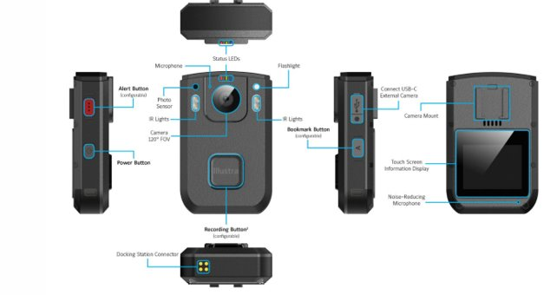
Illustra Body Worn Cameras
Integration with ExacqVision VM *
Kiosk software manages check-in/check-out
Live streaming capabilities
Panic button or event based live streaming
When docked, off-loads stored video to ExacqVision
On Hold 22.09
* Removed from marketing for 22.06 release, pushed to 22.09. Still available to those with the equipment and assistance with setup from Product Management

Slide 30
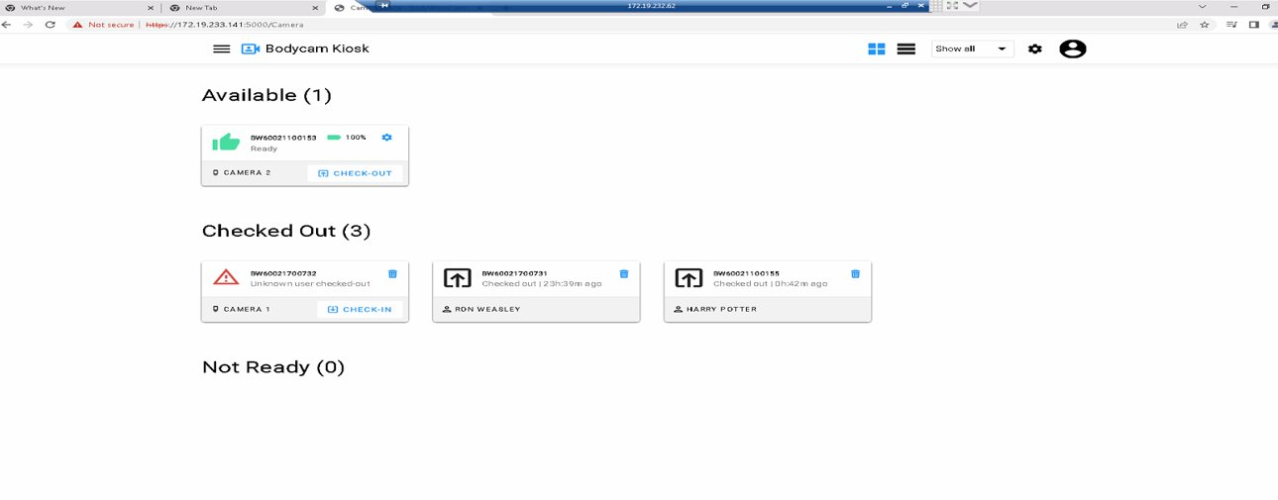
Illustra Body Worn Cameras
Kiosk software
On Hold 22.09

Slide 31
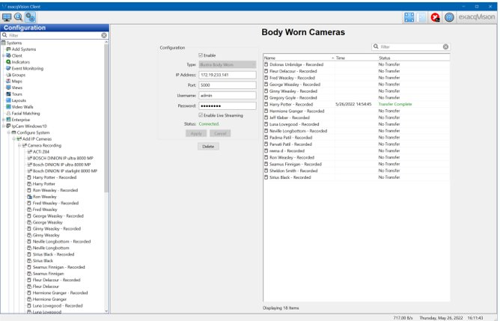
Illustra Body Worn Cameras
On Hold 22.09

Slide 32
Illustra Body Worn Cameras
On Hold 22.09

Slide 33
Questions

Slide 34
Appendix

Slide 35
Cloud Drive vs. Cloudvue
Cloud Drive is subscription plan to archive recorded data in the cloud
Cloud Drive uses Cloudvue’s API to store data on their servers
The two services are completely separate products from JCI
Cloud Drive | Cloudvue
Archive Only | Live and Recorded Viewing
ExacqServer sends data to cloud | Gateway or C2C sends data to cloud
Config on Archiving page | Config by a dealer
Uses Cloudvue API | -
Subscription plan | Subscription plan
Cloud Drive
Cloudvue

