Slide 1
Technical Support Training
22.03 Quarterly Training
Isaac Penrod and Ross White
2022-03

Slide 2
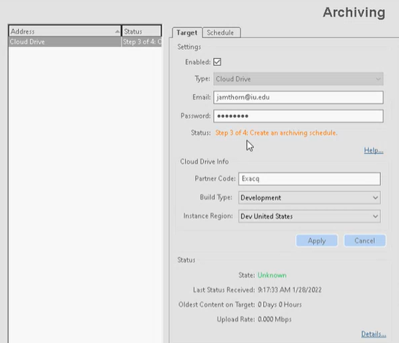
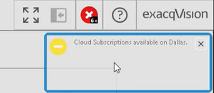
Feature – Cloud Drive 2.0
Client - Enhancement - Updated status text for cloud drive 2.0 configuration process
Step 1 - Add a User to the NVR
Step 2 – Apply Subscriptions
Step 3 - Create an Archiving Schedule
Step 4 – Create an Archiving Task
Client - Enhancement - Added indicator for new cloud drive camera subscriptions available
Client - Enhancement - cloud drive help hyperlink on Archives page navigates to user manual

Slide 3
Feature – Cloud Drive 2.0
Server
Enhancement - archivepi - Updated to Smartvue SDK 22.1.0 and latest bundle.crt
Enhancement - archivepi - Cloud drive related certificate is no longer removed during restart
Mobile
Enhancement - Added support for searching cloud drive 2.0

Slide 4
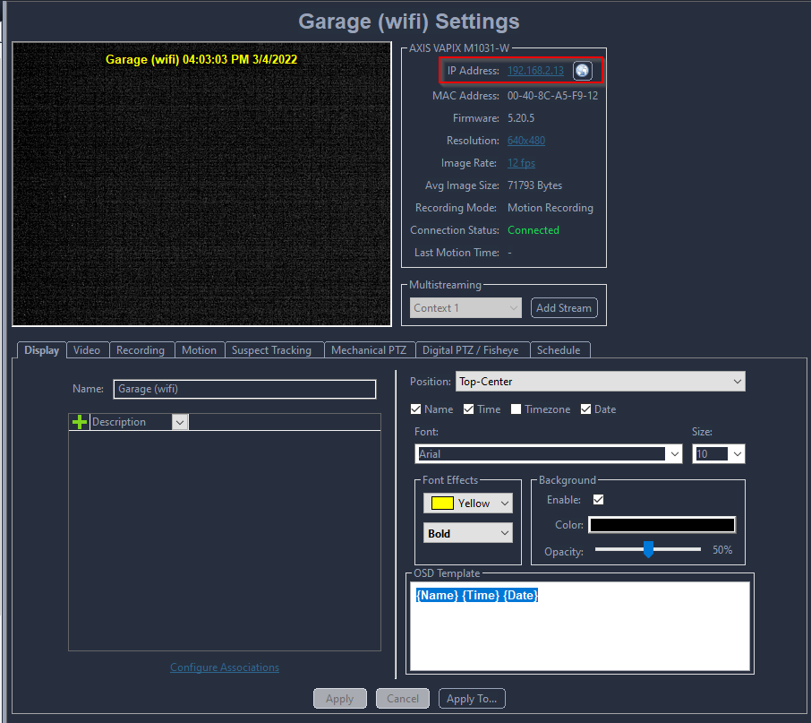
Feature – Web Configuration Page
Enhancement - Add camera web configuration page within the client.

Slide 5
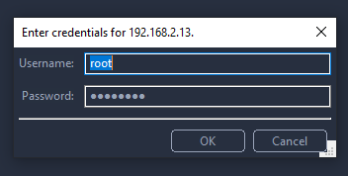
Feature – Web Configuration Page
Enhancement - Add camera web configuration page within the client.

Slide 6
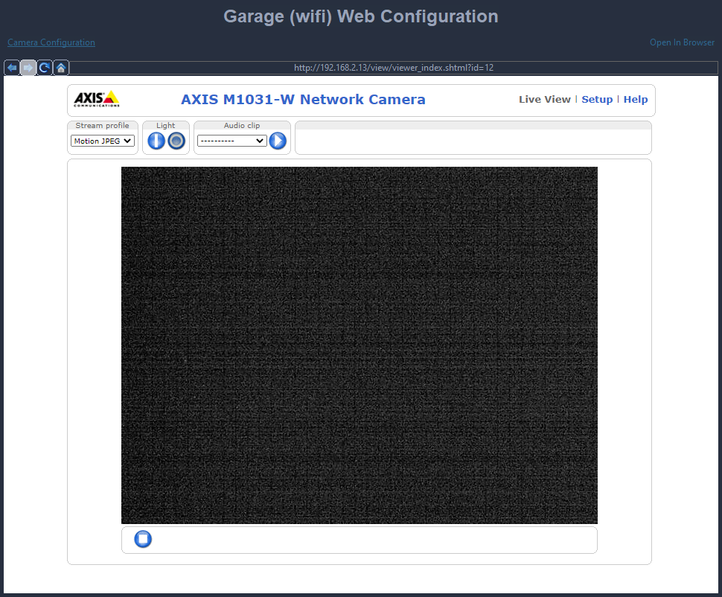
Feature – Web Configuration Page
Enhancement - Add camera web configuration page within the client.

Slide 7
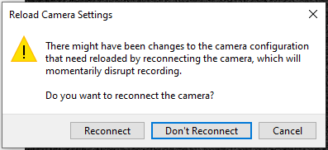
Feature – Web Configuration Page
Enhancement - Add camera web configuration page within the client.

Slide 8
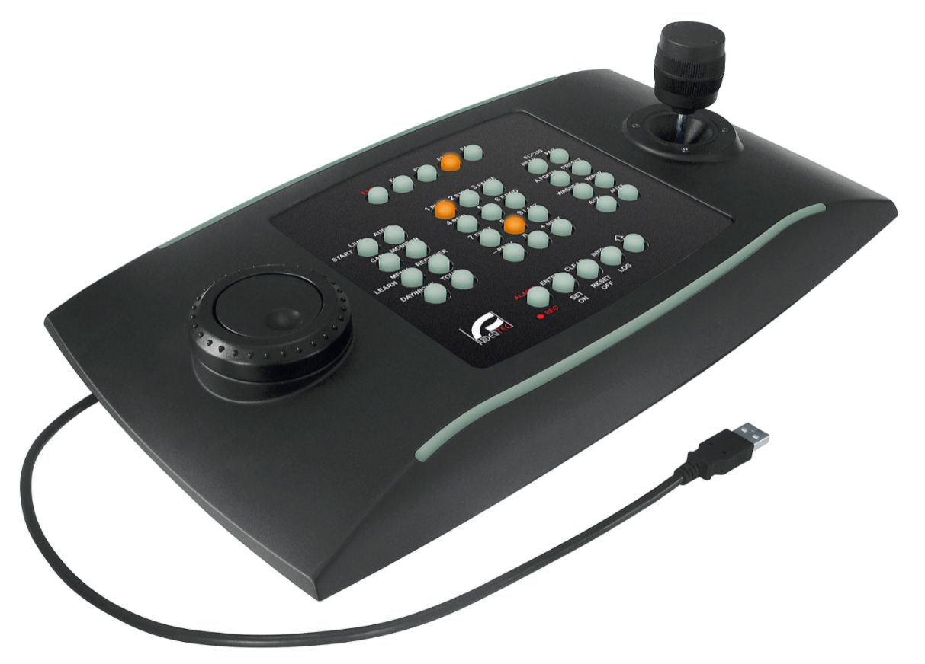
Client
Enhancement - Add Enter to the default DCZ joystick profile
Enhancement - Added Select Camera joystick button action
Enhancement - Added numeric key joystick button actions
Enhancement - Support up to 128 joystick buttons on Windows

Slide 9
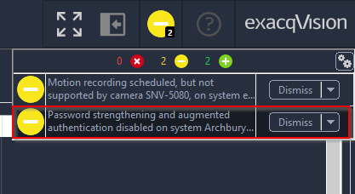
Client
Enhancement - Added new indicator to suggest enabling password strengthening and augmented authentication.

Slide 10
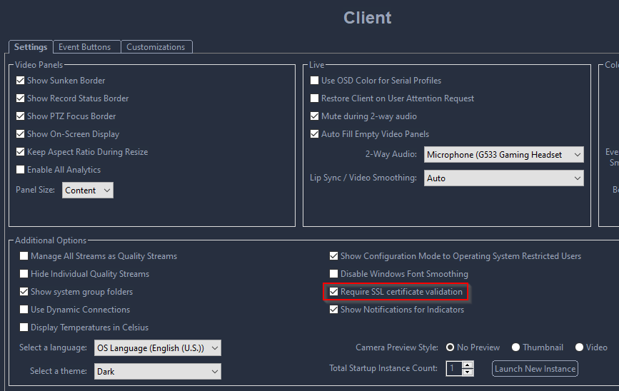
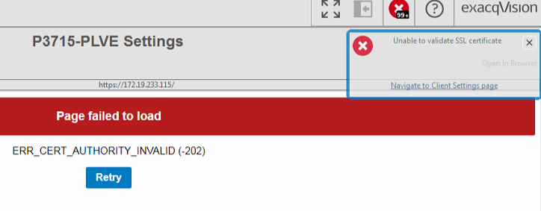
Client
Enhancement - Show toast for all web panels that fail cert setting checks.

Slide 11
Client
Enhancement - Added separate archive rate and upload rate fields for archive targets that report them.
Upload Rate: How fast video can be uploaded.
Archive Rate: How fast video is being transmitted, averaged over time.
For instance, a customer may only be archiving Motion video, so video is not always being uploaded.

Slide 12
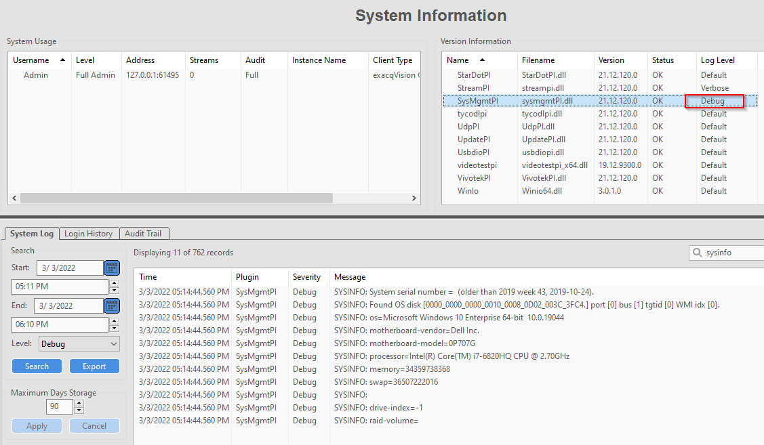
Server
Enhancement - SysmgmtPI - Include raw output from sysinfo script in server log at LOG_DEBUG level, to include in support exports.

Slide 13
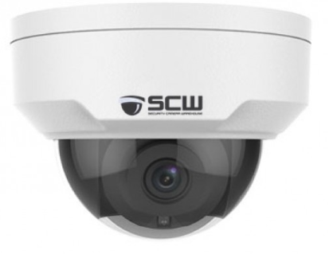
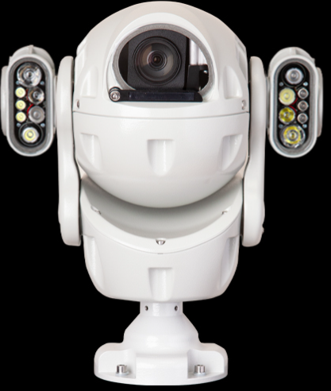
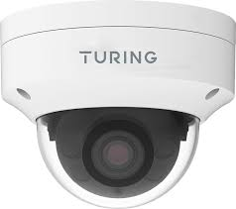
Server - Onvif
Enhancement - onvifnvcpi - Add Motion topics for X2 Redvision cameras.
Enhancement - onvifnvcpi - Add support for Turing-U motion and analytics.
Enhancement - onvifnvcpi - Add support for SCW uniview alias

Slide 14
Server - Onvif
Enhancement - ActiPI, AxisPI, SamsungPI, illustra3PI, onvifnvcpi, panasonicpi, SonyPI, VivotekPI, ccurePI, kantechpi - Encrypt passwords stored in config. In windows we use CryptProtectData, which is Microsoft DPAPI - the same algorithm that Microsoft’s own apps use (3DES-CBC + SHA1 + PBKDEF2). In Linux, we use the machine ID (which only root has access to) as a key, with AES (the same way we encrypt useraccounts.xml)

Slide 15
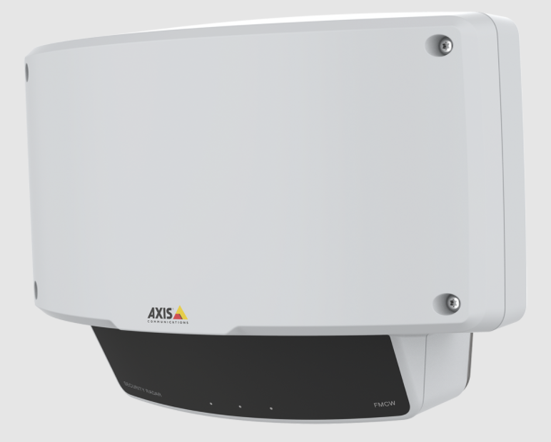
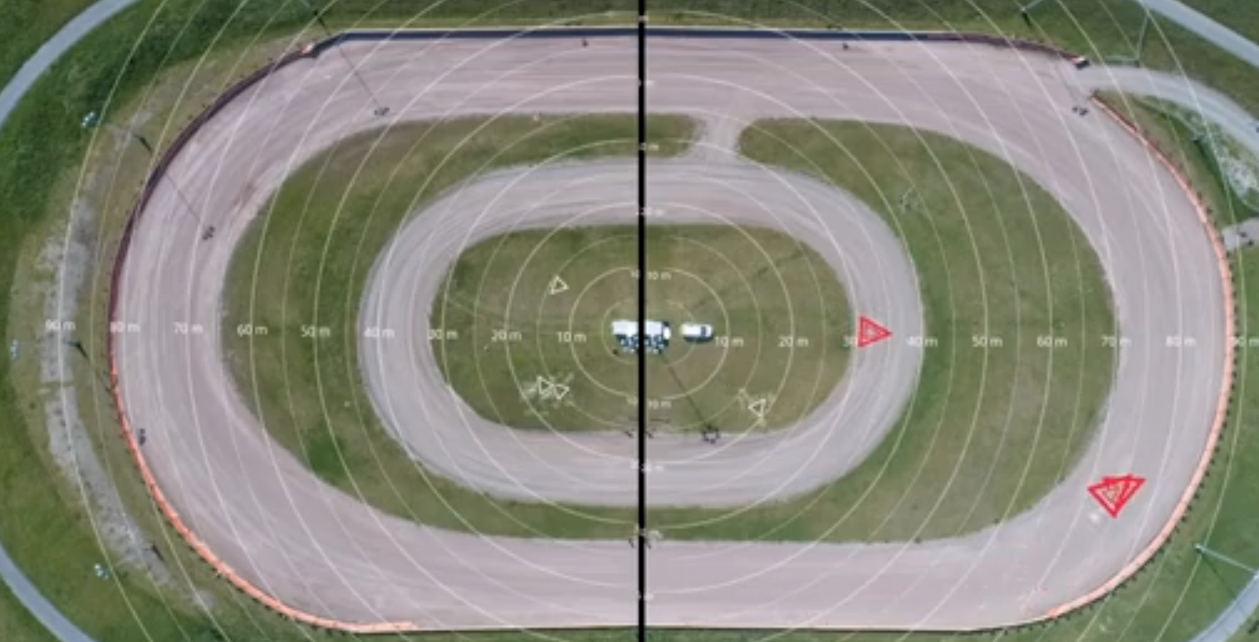
Server
Enhancement - axispi - Support radar detection events

Slide 16
Server – IP Plugins
Enhancement - illustra3pi - Add support for the queue analytic
Enhancement - hikvisionpi - Support displaying and modifying motion mask when camera is in corridor mode.
Enhancement - illustra3pi - Support Tamper detection.
Enhancement - samsungpi - Add override for using the camera timezone
#timezone=camera

Slide 17
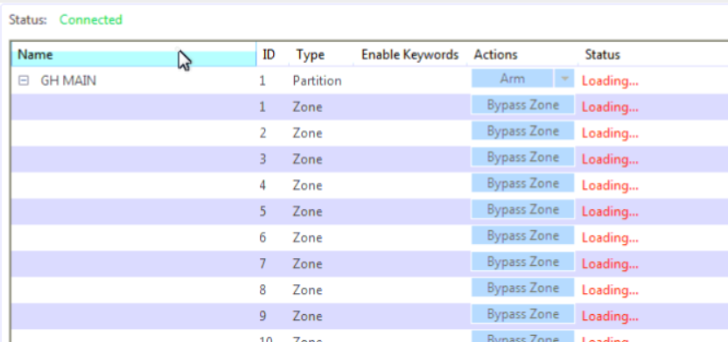
Server – IP Plugins
Enhancement - itv2pi - Add the option to filter out null zones since they can cause confusion for users.
Zones that are not assigned to partitions are now removed from the module list

Slide 18
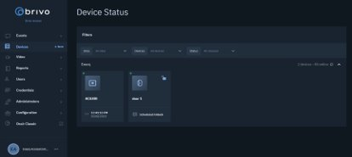
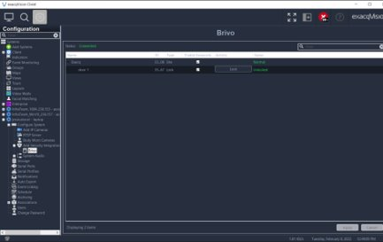
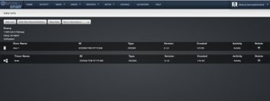
Server
Enhancement - brivopi - Support Brivo access control system Integration with Brivo OnAir​
Customers with Exacq and Brivo can now connect to Brivo's cloud-based OnAir access control platform from Exacq.​
By adding Brivo into Exacq, customers are now able to see the status of doors and unlock them from the exacqVision Client. This is most effectively done using Associations.​
Additionally, customers can access the Brivo webpage from the exacqVision Client using Web Panels. ​

Slide 19
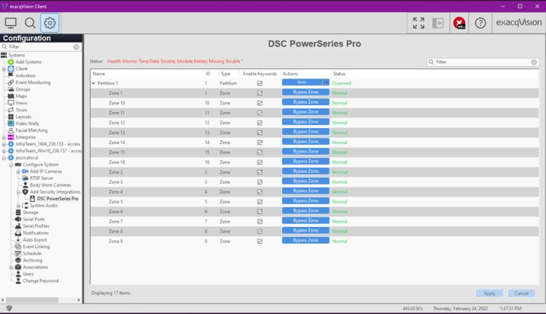
Server
Enhancement - itv2pi - Add support for DSC PowerSeries Pro
Customers with Exacq and DSC can now connect to DSC's Pro series intrusion panels from Exacq.​
Like DSC Neo before it, customers accessing a Pro panel from within the exacqVision Client can observe and bypass zones, get health status updates from the panel, and filter for specific intrusion events when searching.​

Slide 20
Server
Enhancement - psfpi - Throttle audio as well as video when the system is throttling.
Bug Fix - psfpi - Changed to time based cache rather than packets to address an issue related to push to talk

Slide 21
Server
Bug Fix - SoundPI - Fix crash on opening input stream in Linux.
Bug Fix - SoundPI - Fix config shifting in both Windows and Linux that broke recording and event linkages with record audio target.
Bug Fix - SoundPI - Eliminate low-level PortAudio, PulseAudio, and libasound warnings.
Bug Fix - SoundPI - Improve inconsistent number of detected devices, and ambiguous naming. https://trac.exacq.com/DVR/ticket/23306#comment:6

Slide 22
Server
https://trac.exacq.com/DVR/ticket/23306#comment:6
Now, XML always wins. Whatever you had in legacy XML will remain true. So that means we control and maintain consistent input numbers, regardless what PortAudio? reports. So no more config shifting.
Now we only report "pulse" and "default" devices in Linux, which are the only ones that ever worked anyway. All Windows devices did work.
We also default-name everything with PortAudio? names, so instead of "Audio Input 1", you see clear names like "Microphone", "Speakers", "Microsoft Sound Mapper - Output", "pulse", "default", etc. So no more hunting around to figure out which device to use.
Fixed system audio device alarms to properly fire on missing device(s) or stream failures.
On upgrade:
We have to assume that no device changes happen at the same time as evServer upgrade, which is reasonable. Customers were either using SoundPI or they weren't.
We match XML to PortAudio? devices by legacy input number, because that's how it used to be.
We then persist a definitive "OsName?" in XML for each object, so that henceforth, we match on something consistent, so even if PortAudio? shuffles order or reports new devices, everything correctly syncs up.

Slide 23
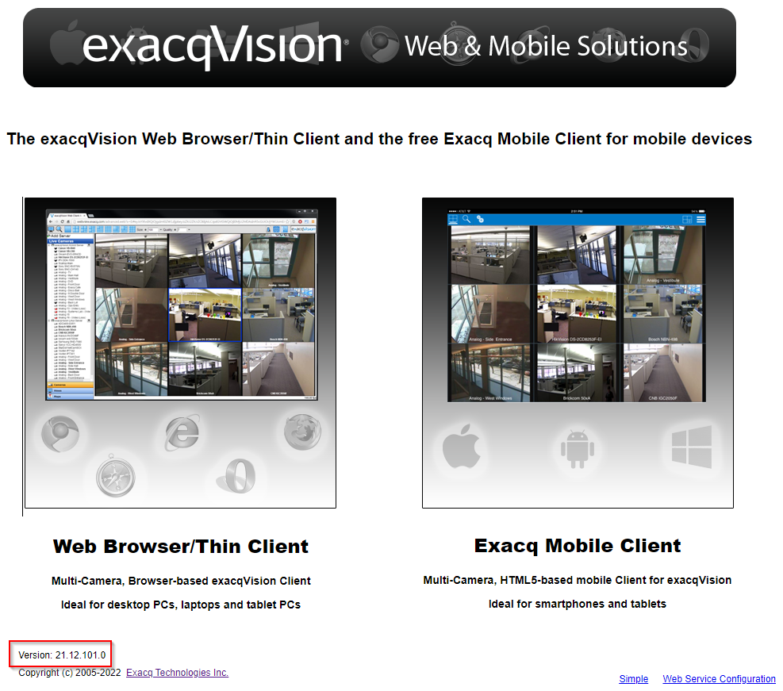
Web Service
Bug Fix - Corrected version of mobile interface that is packaged.

Slide 24
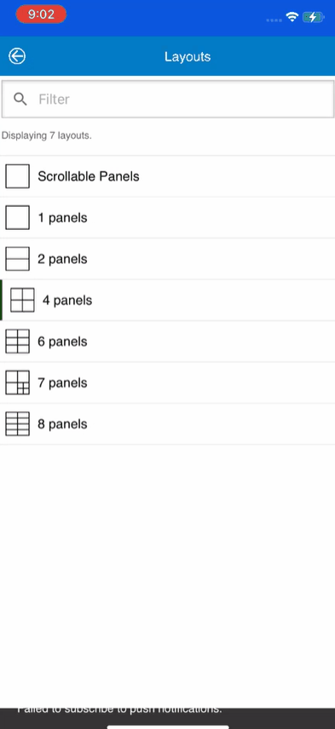
Mobile
Enhancement - Live scroll view.
Landscape mode switches to fullscreen
Not available on Tablets

Slide 25
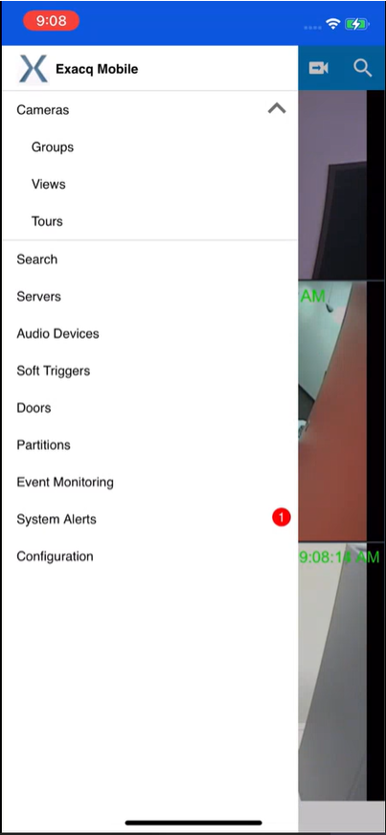
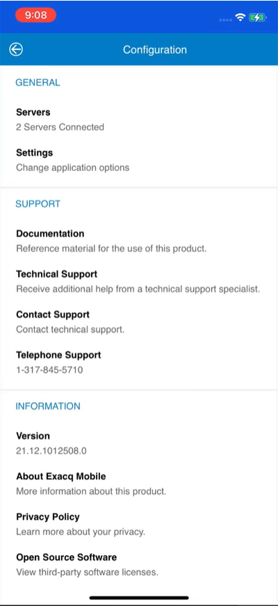
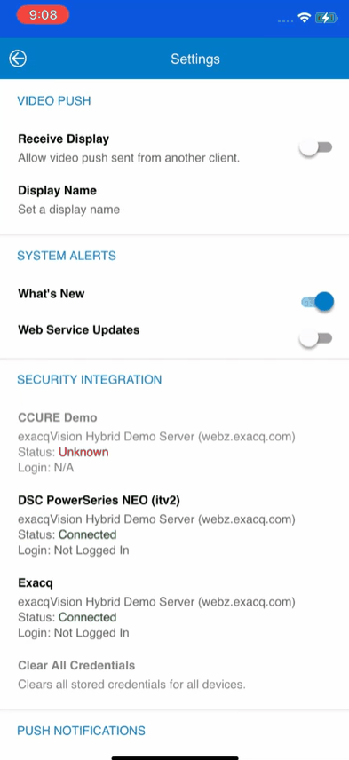
Mobile
Enhancement - Reorganize configuration pages
Old

Slide 26
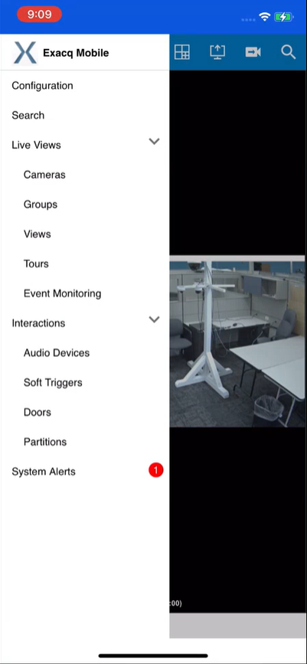
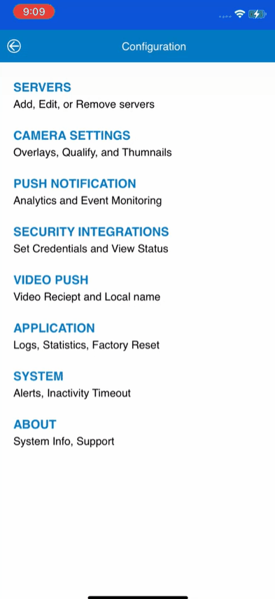
Mobile
Enhancement - Reorganize configuration pages
New

Slide 27
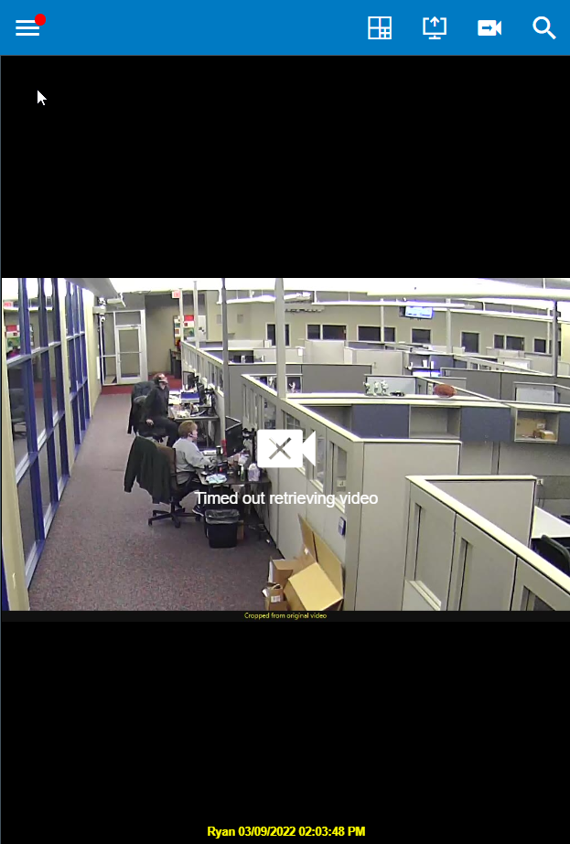
Mobile
Enhancement - Display messages below icons on video error

Slide 28
Mobile
Enhancement - For Search Only, display No Video Available instead of Unknown Error
Bug Fix - Search Timeline metadata should be displayed by default
Bug Fix - Attempt to reconnect to web servers when internet connection comes back
Bug Fix - Stop resubscribe to video on layout change
Bug Fix - Added space for the iOS home bar

Slide 29
Enterprise Manager
Enhancement - Add Reset importer failure counter after some time
Enhancement - Update JQuery to 3.6.

Slide 30
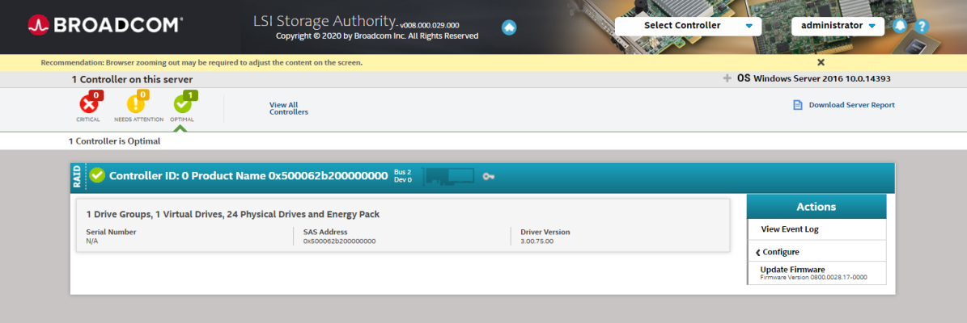
OS Image
Broadcom LSA (LSI Storage Authority) replacing MSM (MegaRAID Storage Manager)… soon
SSH session banner message updated to not include inactive phone number.

Slide 31
What to Expect Next Quarter

Slide 32
Questions

