Slide 1
Technical Support Training
21.09 Quarterly Training
Isaac Penrod
2021-09

Slide 2
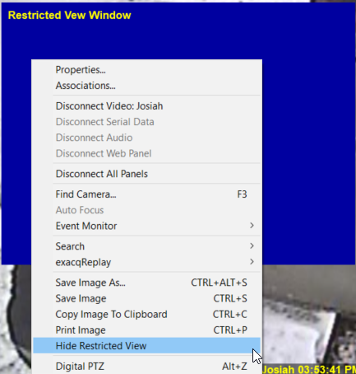
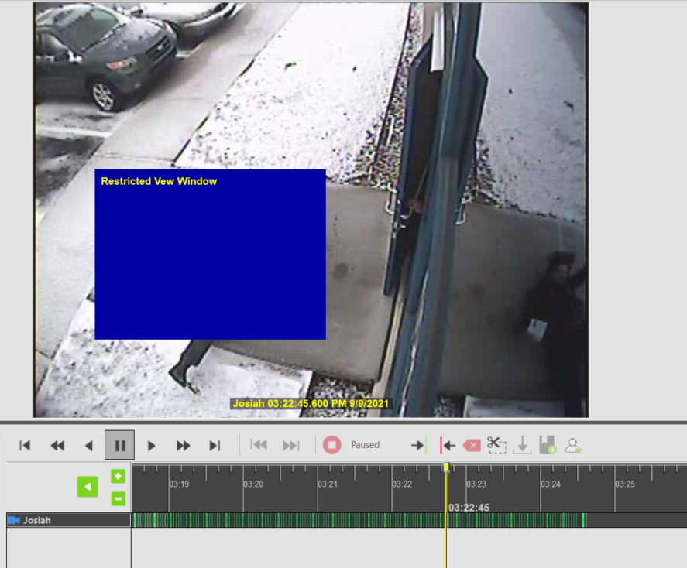
Feature – Restricted View Windows
Client - Enhancement - Restricted view windows. - #21926
Server - Feature - Restricted view windows. - #22863
Notes:
Exports only allowed for .psx and .exe
Requires password to hide - on a timer
5m inactivity timer

Slide 3
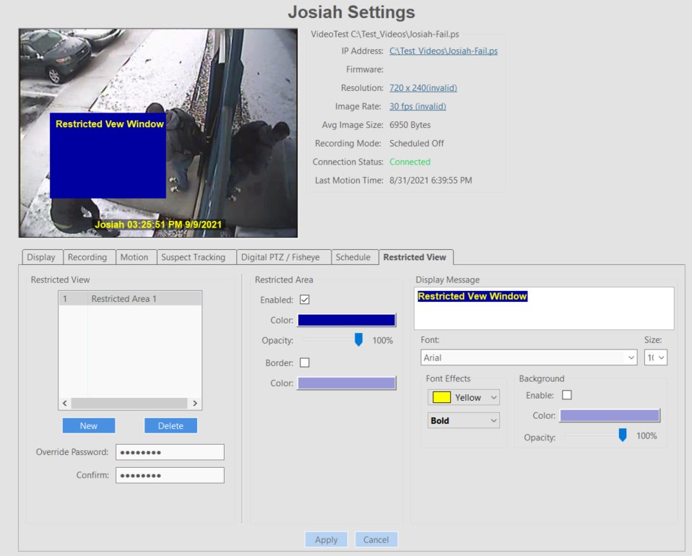
Feature – Restricted View Windows
Client - Enhancement - Restricted view windows. - #21926
Server - Feature - Restricted view windows. - #22863
Exports only allowed for .psx and .exe
Requires password to hide - on a timer
5m inactivity timer
Enabling will block the ability for EM or WebService to request streams from this Server!!!

Slide 4
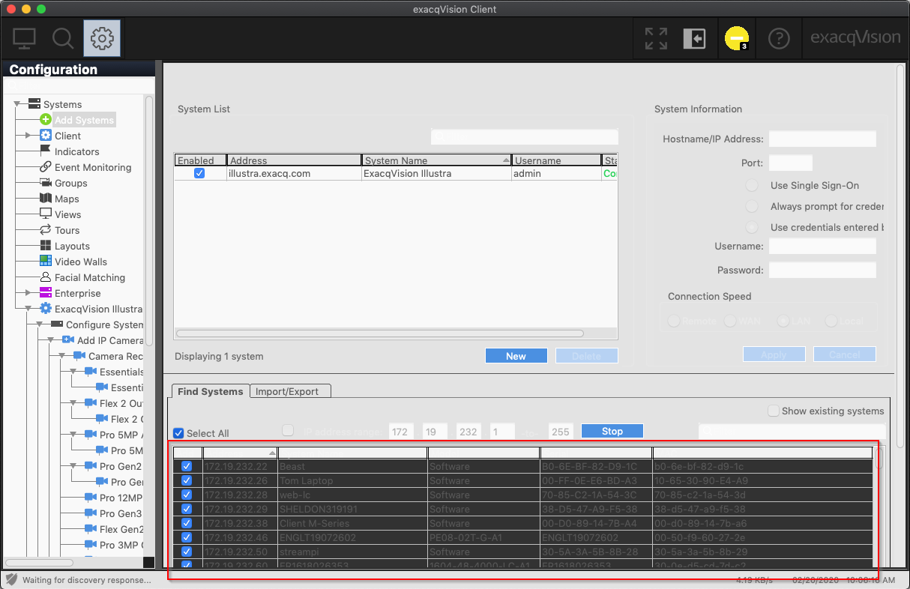
Client
Enhancement - macOS - Force client into dark theme to match OS setting.

Slide 5
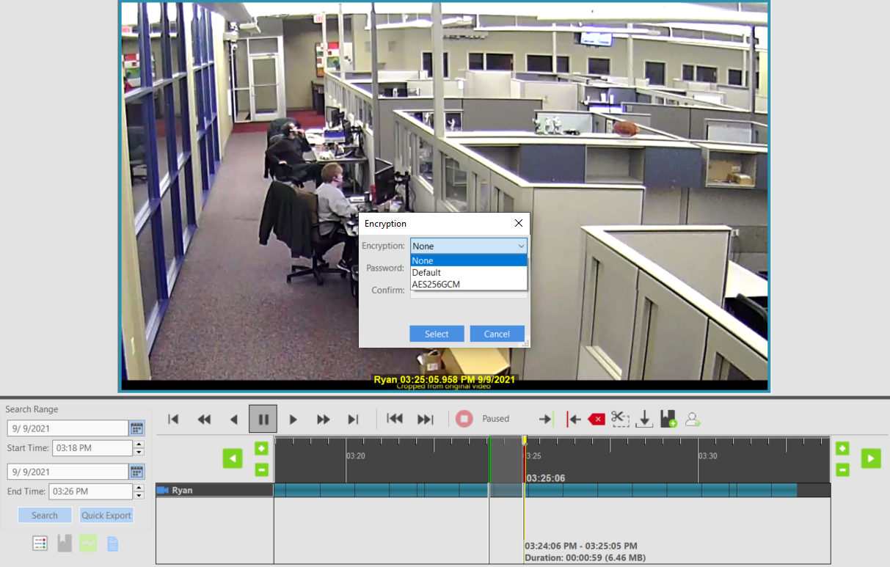
Client
Enhancement - Ability to password protect and encrypt exe and psx exports. - #22461
Change requires xml, so feature not available for .ps, .avi, .mov, etc...
Blocks old Client/ePlayer ability to play new exports with new enhanced features.

Slide 6
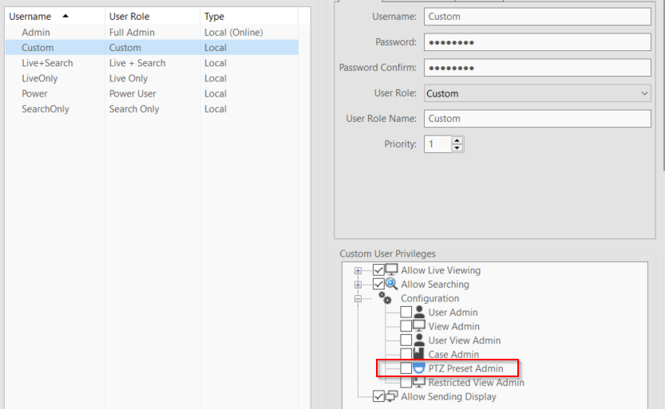
Client
Enhancement - Add ability to create/delete presets from live video. - #21584

Slide 7
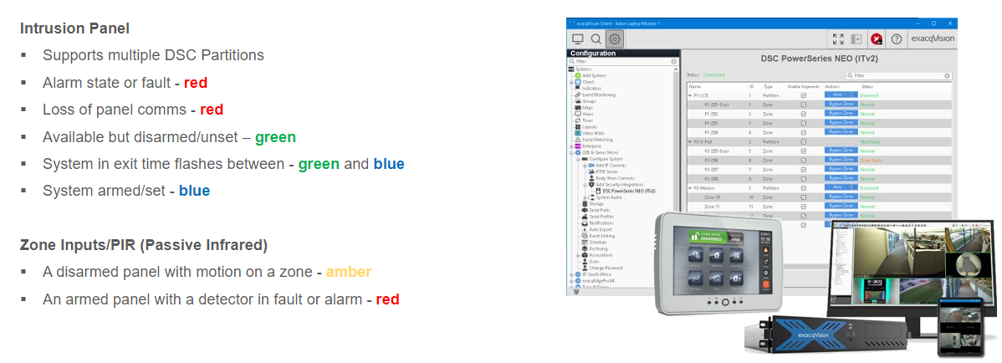
Client
Enhancement - Upgraded oncam dewarping library to add support for C-08 cameras. - #23050
C-12 and C-08 required this change.
Windows and Linux only
Enhancement - new color definition for partition status - #21473
Enhancement - Modified maps to show the same flashing colors from associations for inputs in the arming exit delay state.

Slide 8
Server – Object Analytics
Feature - illustra3pi - Add support for Illustra Object Analytics
Notes:
Transitioned to querying from camera rather than knowing what to request.

Slide 9
Server – Object Analytics
Feature - axispi - Add support for Axis Object Analytics
Notes:
Transitioned to querying from camera rather than knowing what to request.
Some (confusing) elements may show up in the GUI based upon what the camera tells us.
No expected issues with what was working before.

Slide 10
Server – Object Analytics

Slide 11
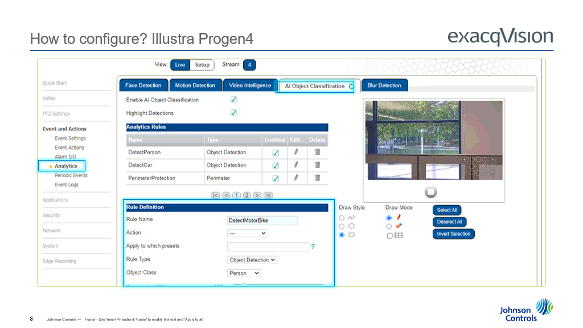
Server – Object Analytics

Slide 12
Server – Object Analytics

Slide 13
Server – Object Analytics

Slide 14
Server – Object Analytics

Slide 15
Server – Object Analytics

Slide 16
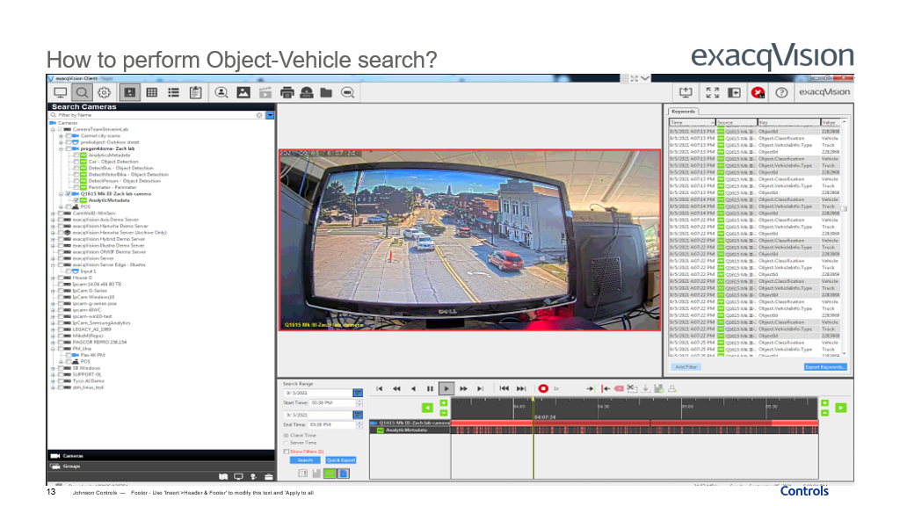
Server – Object Analytics

Slide 17
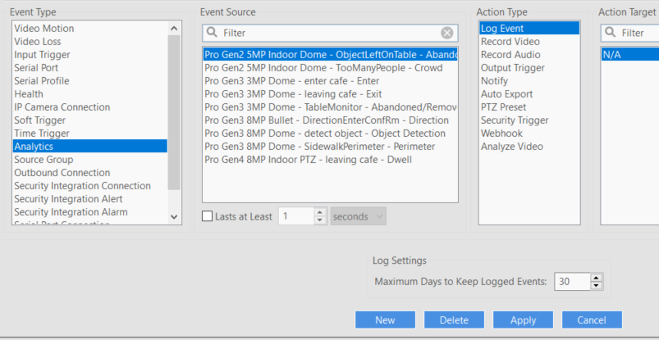
Server
Enhancement - illustra3pi - Update how rule names are displayed in the client
Notes:
Camera name now shows prior to rule.
Whatever the camera tells us is what we display.

Slide 18
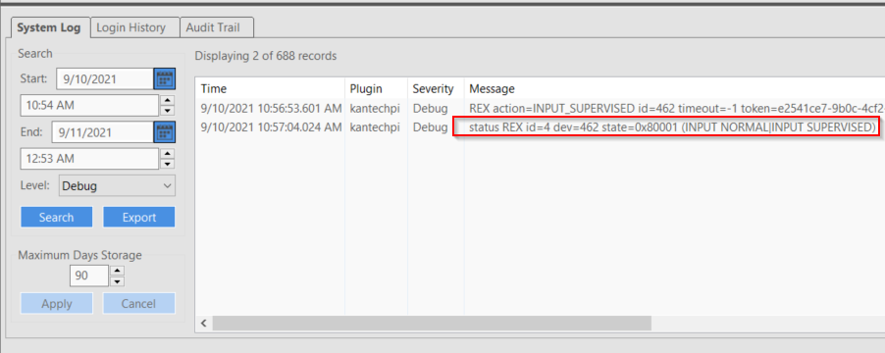
Server
Enhancement - kantechpi - Add metadata to log events - #18476
Door armed/disarmed
Door request to arm granted/denied
Door temporarily unlocked
Door relocked
Door one time access granted
Door timeout on manual unlock
Door contact return to schedule
Door return to schedule
Door contact disabled
Relay activated/deactivated
REX bypassed/alarmed
Input bypassed/alarmed
Reader enabled/disabled

Slide 19
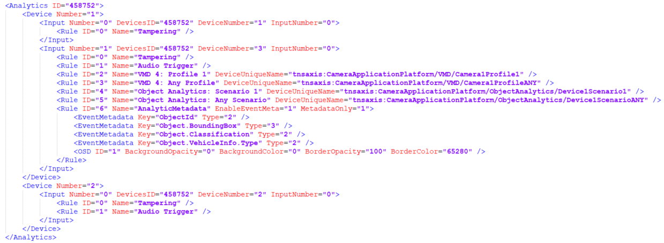
Server
Enhancement - samsungpi - Add the ability to configure more than 8 analytics rules - #22929
Notes:
New limit is ~1000 rules.

Slide 20
Server
Enhancement - streampi - support for PTZ Preset Admin privilege
Enhancement - SysmgmtPI - Removed sensor and watchdog support for X8SIA, DQ67EP, D525MW, D2500CC, RX67Q, D510MO, S1200KP, and Granite Well motherboards. Removed unused support for CNCT6793. Also removed wx usage. - #23125

Slide 21
Server
Enhancement - illustra3pi - Always display temperature overlay for thermal cameras
Enhancement - onvifnvcpi - Add support for SpotterRF and new VICON models - #22792 #23053
Enhancement - rtspserverpi - Provide the ability to search for video with out a specific end date and time. - #22982
​rtsp://{ip}:{port}/recorded/{streamid}?start_time=20210726T140000Z
​rtsp://{ip}:{port}/recorded/{streamid}#start_time=20210726_100000#speed=8.0#end_time=20210726_100500
Enhancement - streampi, common, xml - Flush file contents to disk after saving config. - #23067
Protects against some race conditions
Enhancement - streampi - support for PTZ Preset Admin privilege
Notes:
SysmgmtPI changes only impact Sensor and Watchdog functions.

Slide 22
Web Service
Enhancement - Remove archive credentials from output if passthrough user. - #23119

Slide 23
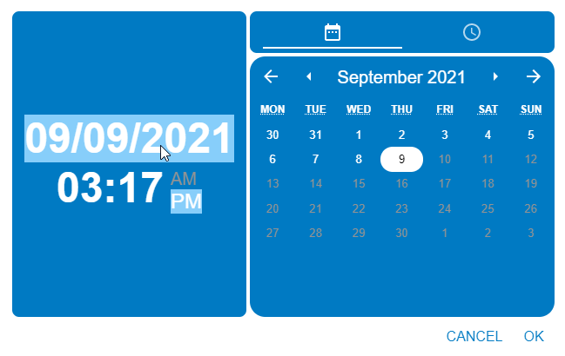
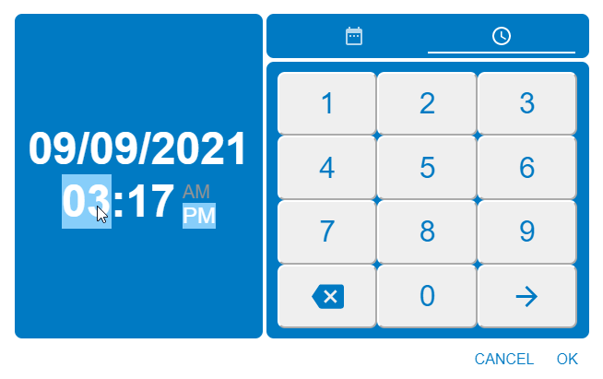
Mobile
Enhancement - Updated search date/time selection dialogs

Slide 24
Enterprise Manager
Enhancement - Migrate rule add/edit page to React - #23087
Enhancement - Migrate rules list page to React - #23087

Slide 25
Enterprise Manager
Enhancement - Improves importer queue efficiency - #17654
Faster DB writing in batches
Not much user impact
Enhancement - Re-added recurring config backups - #22793 #23052
Removed when we adding automatic weekly backups
Enhancement - Add new rule event condition lasted for - #22926
Bug Fix - Fix failover when password strengthening is enabled on protected server - #23102
Apache Solr 7.5 update will likely be backpatched - #23062
Won’t be ready for initial 21.09 release
Will require the installer to be run manually

Slide 26
OS Image
New look and feel for the Field Recovery process

Slide 27
OS Image
Field Recovery now AUTOMATICALLY creates factory restore image

Slide 28
What to Expect Next Quarter
Notes:
Cloud Drive enhancements.
More Analytics features, possible UI change.
Additional Integrations
Illustra Body Worn and >8 analytic rules.
New TycoAI 1.4 and/or 1.5
EM - Updating Postgres

Slide 29
Questions

