Slide 1
Technical Support Training
21.06 Quarterly Training
Isaac Penrod
2021-06

Slide 2
Client - Feature
Enhancement - Added option to group camera items by device. #22651
Enhancement - Infrastructure updates to search check tree logic. #22684

Slide 3
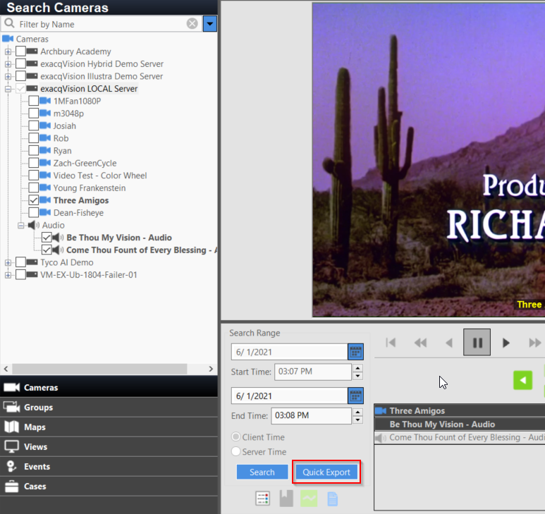
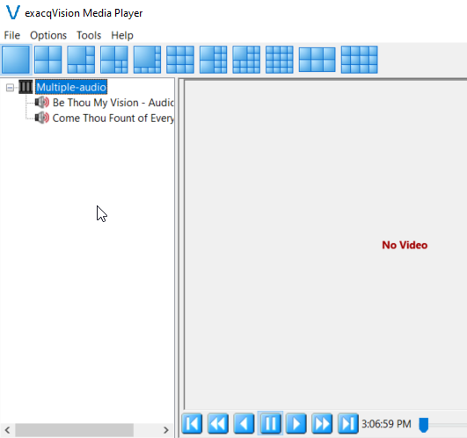
Client
Enhancement - Allow multiple audio streams to be exported with quick export. #22796

Slide 4
Client
Enhancement - Added support for connecting directly to SMB shares as a system. #22768
Not yet in User Manual
Server-side work still to be done
Requires manually exporting a .config or .settings directly to the Archive Target root

Slide 5
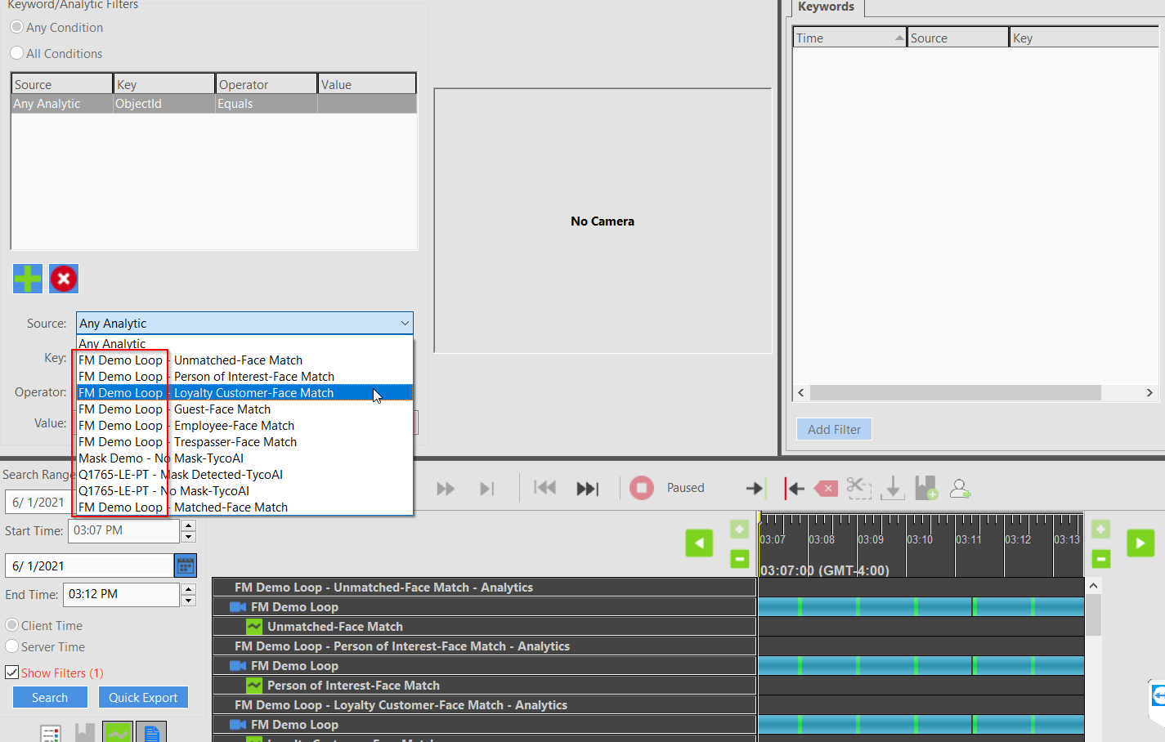
Client
Enhancement - Show camera name in search metadata filters for source #22874
Enhancement - Export temperature label for displaying on top of video in ePlayer. #22887
Enhancement - Export information to tie analytic meta to multiple streams in ePlayer. #22887

Slide 6
Client
Enhancement - Allow showing a map in live and then switching to a camera under the map in the tree by double-clicking #22720

Slide 7
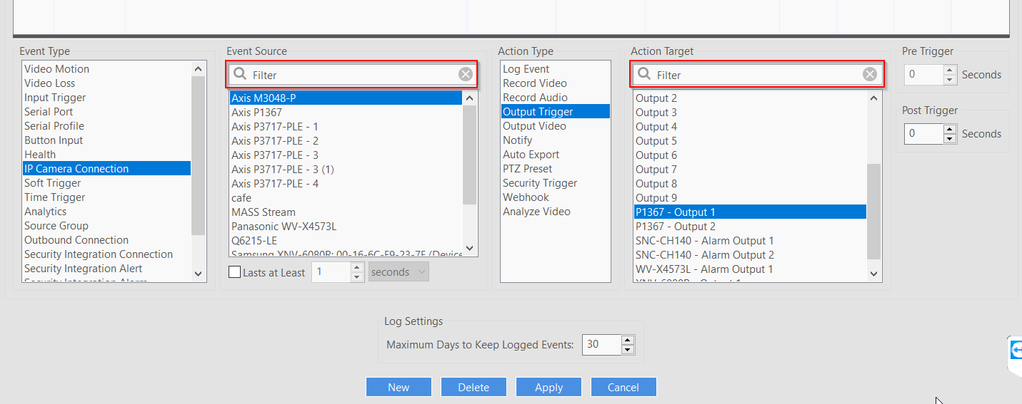
Client
Enhancement - Added search filter for event monitoring sources and targets. #22648
Enhancement - Added search filter for event linking sources and targets. #22648

Slide 8
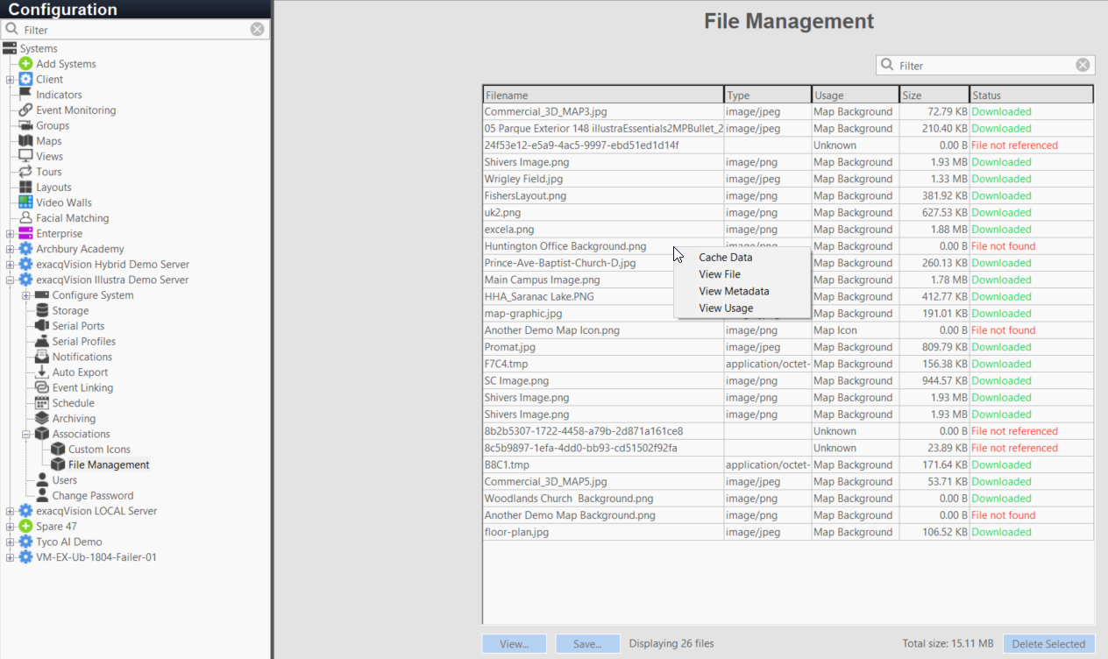
Client
Enhancement - Remove bulk blob caching on File Management page and allow for on-demand caching #22655

Slide 9
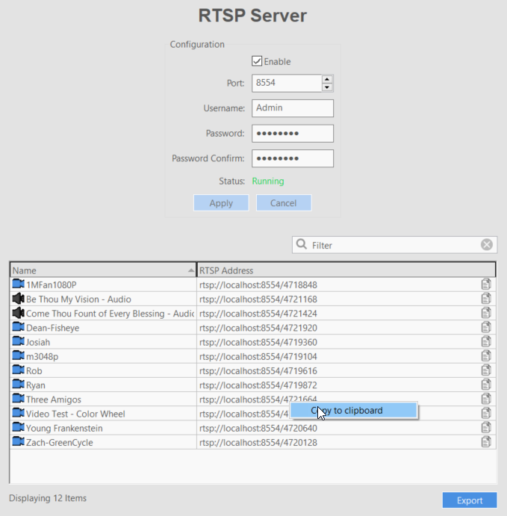
Client
Enhancement - Make rtsp server address cells easily copyable with a click #22824

Slide 10
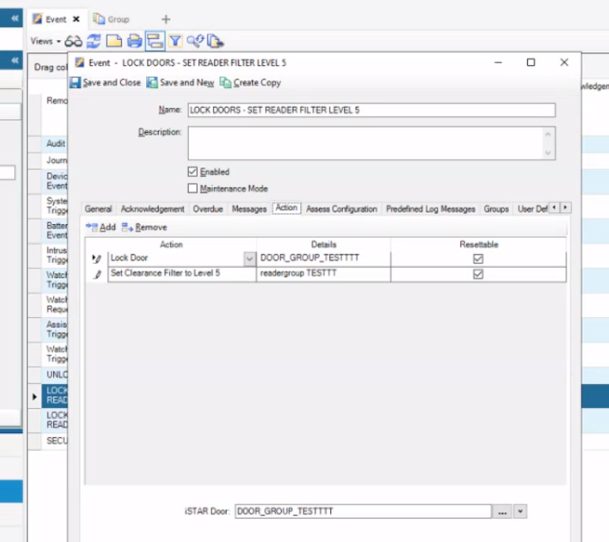
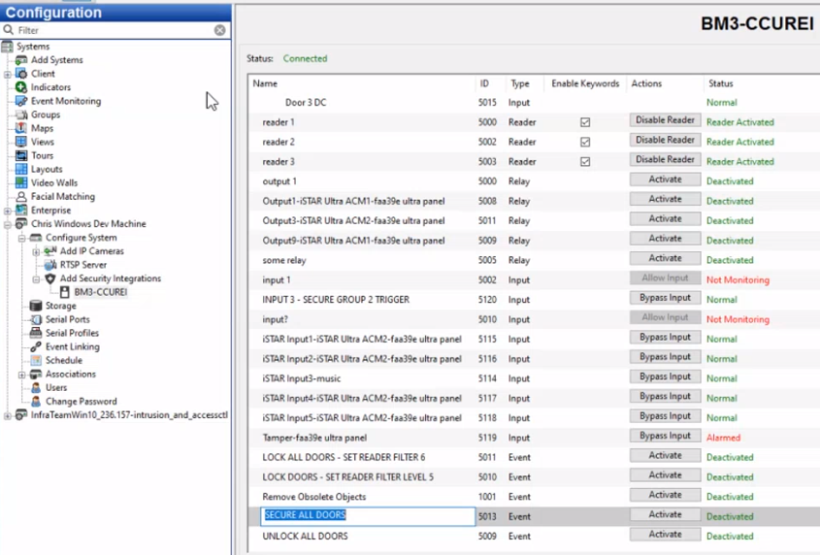
Client
Enhancement - Added new security integration type for generic events. #22702
Initially targeting a CCure feature called ‘Event’ – a triggerable group of actions.
Requires prior configuration on CCure
Notes:
Requires disconnect/reconnect to CCure to pick up new Events.
This is CCure’s version of Event Linking

Slide 11
Client
Enhancement - Added the ability to double click to auto resize the name area on the search timeline.
Notes:
Requires disconnect/reconnect to CCure to pick up new Events.

Slide 12
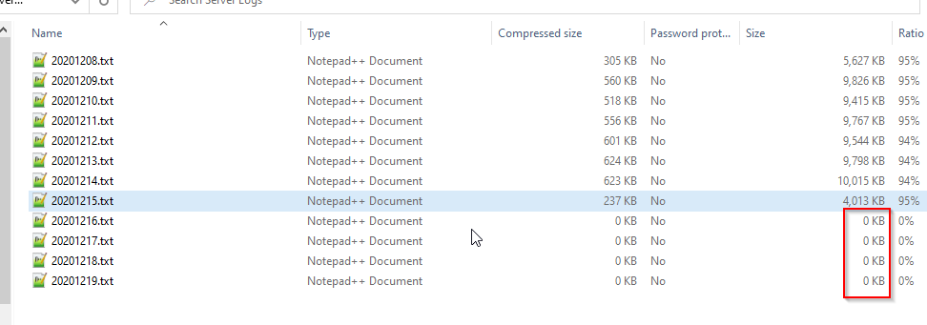
Client
Enhancement - Adding search instance and heartbeat support to support exports. #22763
Enhancement - Increase support export request timeout. #22763

Slide 13
Server
Enhancement - cloud-drive - updated to integration with increased reliability #21902
New Smartvue Library (.dll/.so)
Enhancement - logpi - More efficient log searches #6088
Handles empty results more efficiently

Slide 14
Server – Illustra 3
Feature - illustra3pi - Add support for Perimeter rule to Video Intelligence #21399
Enhancement - illustra3pi - Add support for Gen 4 camera Shake to Dry functionality. #22496
Accomplished with a PTZ Auxilliary command
Enhancement - illustra3pi - Add Support for PTZ-reference window for Privacy Zones #22570
Enhancement - illustra3pi - Add support for mask off events #22756
Enhancement - illustra3pi - Update support for Illustra Thermal camera #22681
New API options for the Thermal camera firmware
Min/Max temperature available
Can now alert if over/under an amount

Slide 15
Server - Onvif
Enhancement - onvifnvcpi - Add support for Mobotix MOVE series cameras #22827
Enhancement - onvifnvcpi - Add support for multi-sensor VICON with analytics #22792
Enhancement - onvifnvcpi - Add RaySharp OEM #22869
Enhancement - onvifnvcpi - Added Alibi and LTS brand support #22870
Enhancement - onvifnvcpi - Update list of Honeywell HC30 and HC60 cameras #22027
Enhancement - onvifnvcpi - Add support for Honeywell H4 performance series #22907
fixes "Motion not supported"

Slide 16
Server – Samsung/Hanwha
Enhancement - samsungpi - Add support for Analytics metadata #22860
Enhancement - samsungpi - Add support for dynamic discovery of analytic events #22686 #22860

Slide 17
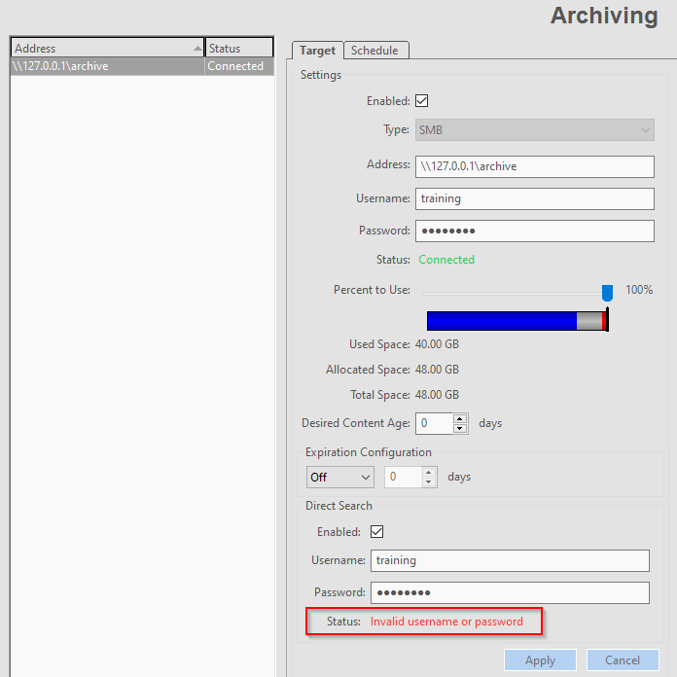
Server
Bug Fix - archivepi - Fix misleading status of Direct Archive search credentials #19578

Slide 18
Server – WebService?
Enhancement - webservice - update exacqVision Web Service with server install package
Addresses customers that rarely update the WebService
Does not help customers who run a stand-alone WebService machine
Installer up from ~57MB to ~130MB!
WebService installer starts after the Server installer completed
Only if there is an existing installation of WebService

Slide 19
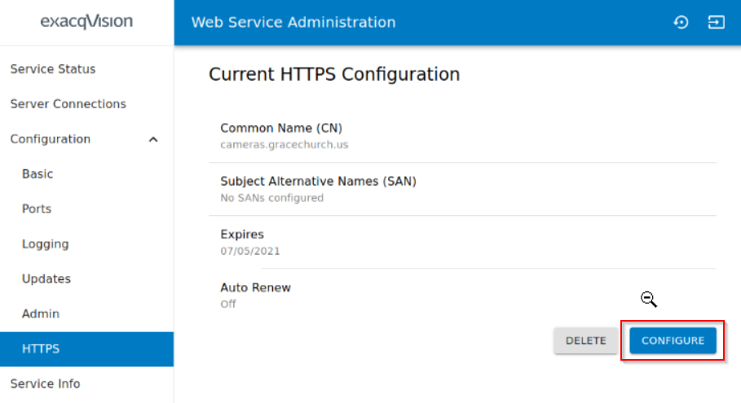
Web Service
Web Service installer still made available – for now
Bug Fix - Fix broken configuration button on HTTPS configuration page #22809
Resolves issue when feature is accessed more than once
Notes:
Several other bugfixes as well.

Slide 20
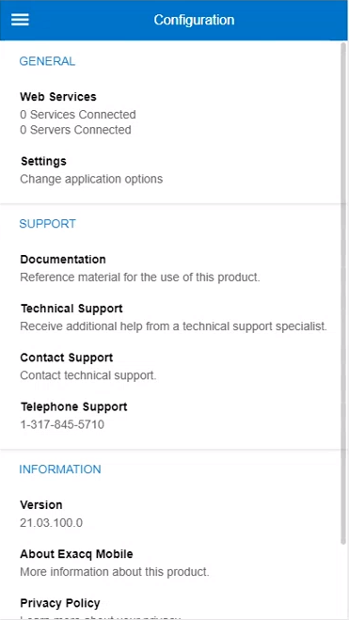
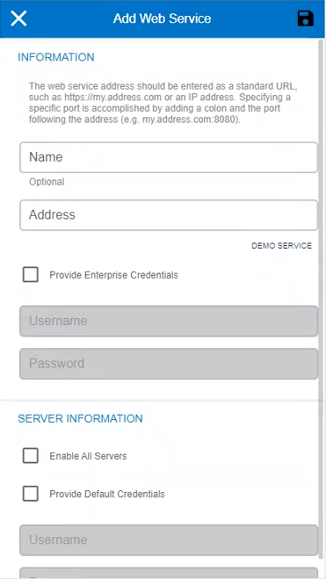
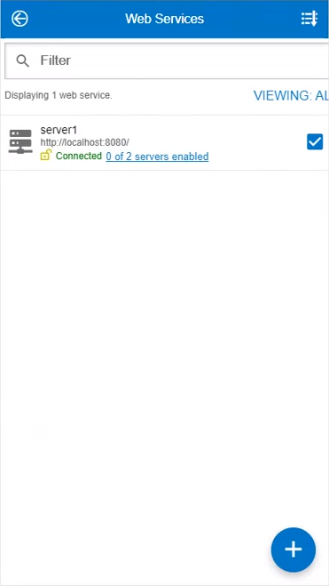
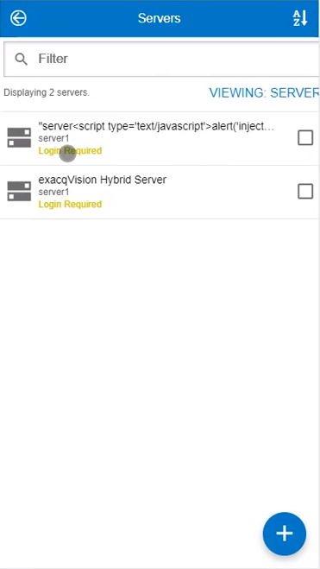
Mobile
Enhancement - Simplify server and web service configuration #22664
Old
Notes:
Attempt to remove the “concept” of Web Services

Slide 21
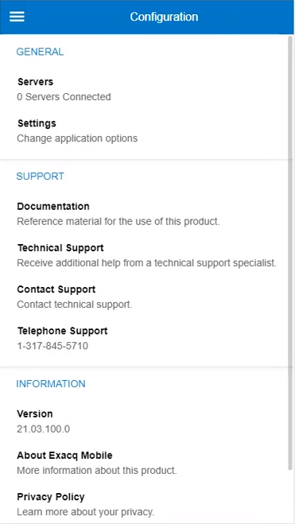
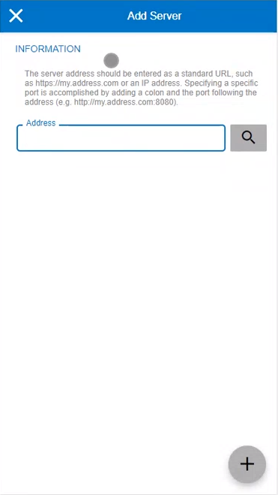
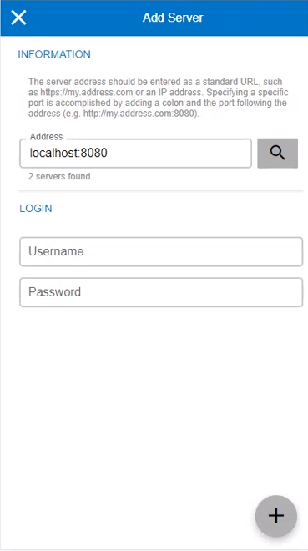
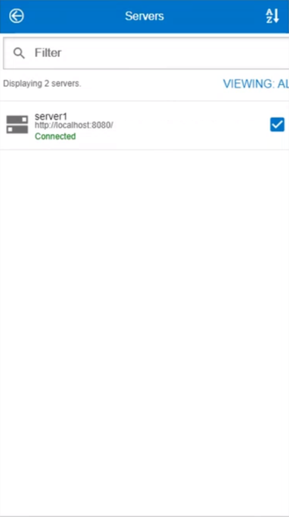
Mobile
Enhancement - Simplify server and web service configuration #22664
New
Notes:
Attempt to remove the “concept” of Web Services

Slide 22
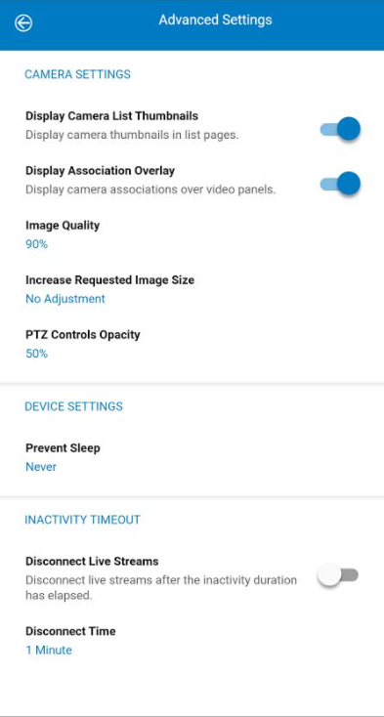
Mobile
Enhancement - Always request native stream resolution when transcoding to ensure maximum image clarity. #22748
Reduces load on WebService hardware
Obsoletes the ‘Increase Requested Image Size’ option under ‘Advanced Settings’
May increase bandwidth usage for some customers

Slide 23
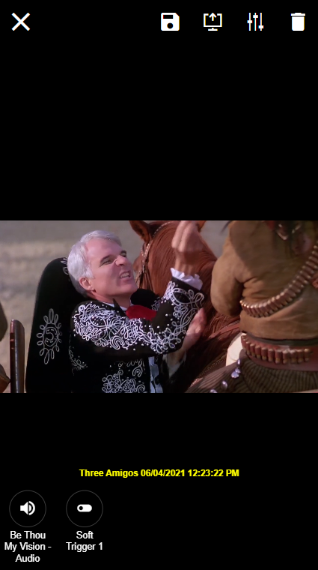
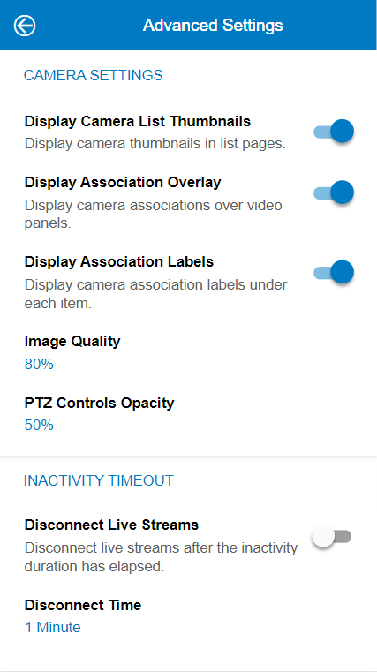
Mobile
Enhancement - Camera association name display can be configured in the advanced settings page. #22820

Slide 24
Mobile
Enhancement - Region of interest reset when leaving focus mode. #22928
Zoom is reset when leaving the focus view after pinch-to-zoom.
Enhancement - Search timeline now appears once metadata for search has loaded. #22821
Notes:
Usability enhancements.
Show live!

Slide 25
Enterprise Manager
Enhancement - Add debug logging capability in production #22650
Will be added to the GUI at a later time
Currently requires editing a config file and restarting services.
<InstallDirectory>\logs\log_settings.yaml
KB forthcoming
Notes:
Changing False’s to True’s

Slide 26
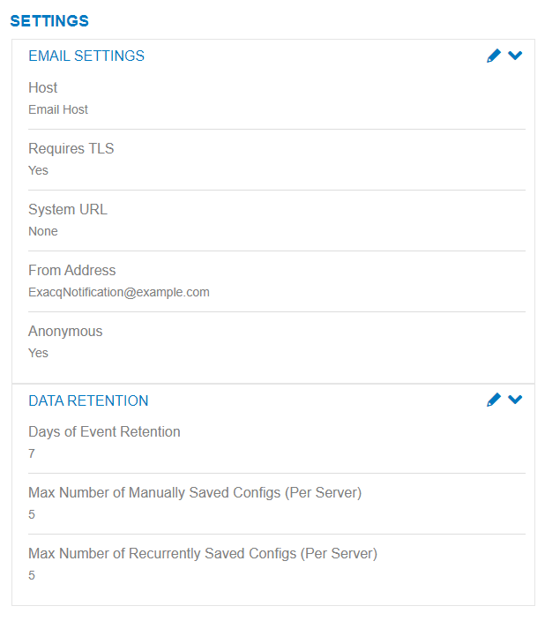
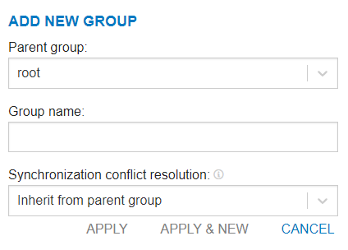
Enterprise Manager
Enhancement - Convert settings page to react #22589
Enhancement - Convert group forms to react #22588

Slide 27
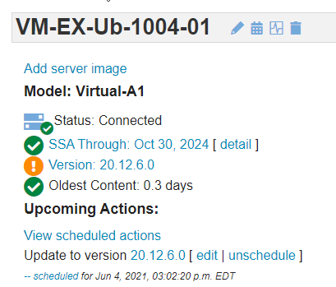
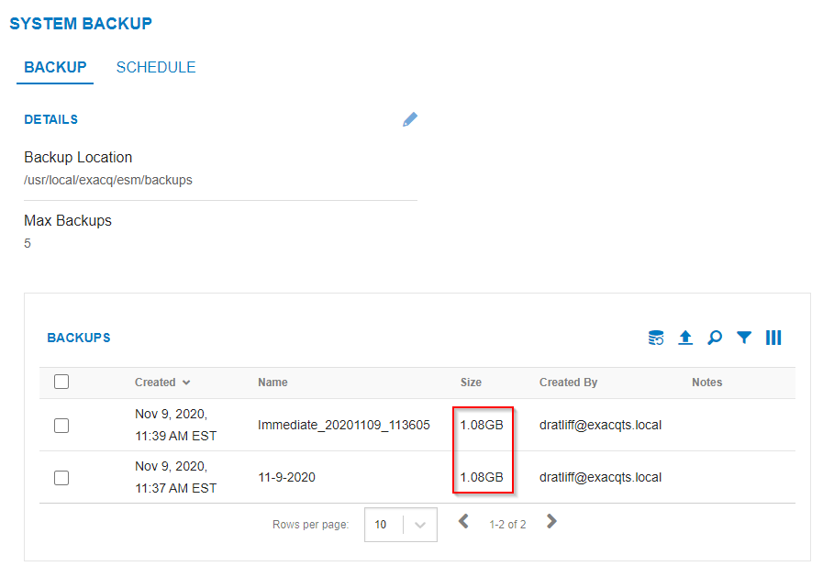
Enterprise Manager
Enhancement - Added link to view scheduled actions on server detail page #19469
Enhancement - Show Backup size in GB if appropriate #22773

Slide 28
Enterprise Manager
Enhancement - Add propagate to future child groups to memberships #16741
Notes:
Background process to accomplish auto propagation
Due to time it may take to propagate on large environments (Won’t block UI)
Also will run future propagations without user interaction

Slide 29
OS Image
Linux upgrade from 18.04 to 20.04
Improved language, locale, and keyboard layout support for other languages. When customers configure these via the OS control panels, it will be a smoother experience.
Fixed on-screen keyboard support during out-of-box experience, primarily for benefit of GPoE systems which don’t ship with physical keyboards.
Improved support for booting systems without an attached monitor. This is important for customers who use KVMs.
Refresh to Windows 10 and Server 2019 with security and stability updates

Slide 30
Questions

