Slide 1
Technical Support Training
Axis Body Worn
Isaac Penrod & Brian Clark
2021-04

Slide 2
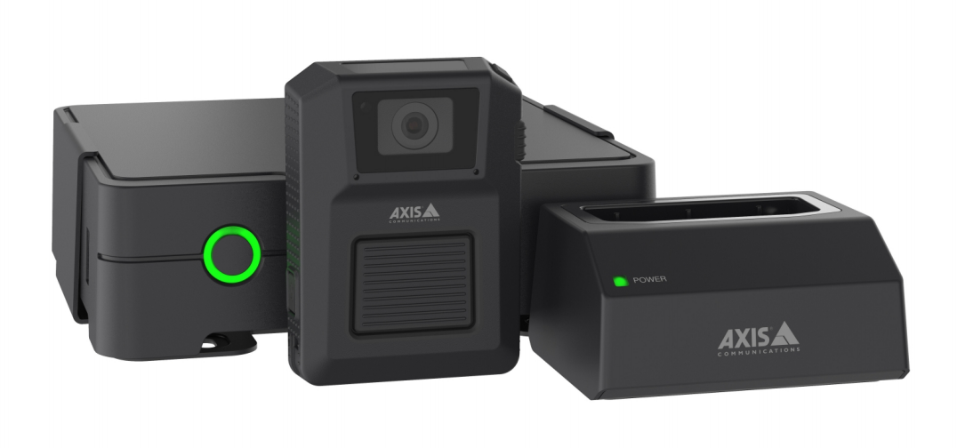
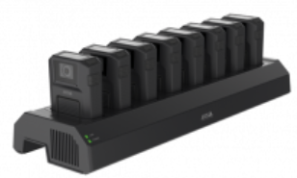
Feature – Axis Body Worn Cameras
Notes:
Multiple hardware offering from Axis.
Controller
Dock (1-8 bays)
Wearable Cameras

Slide 3
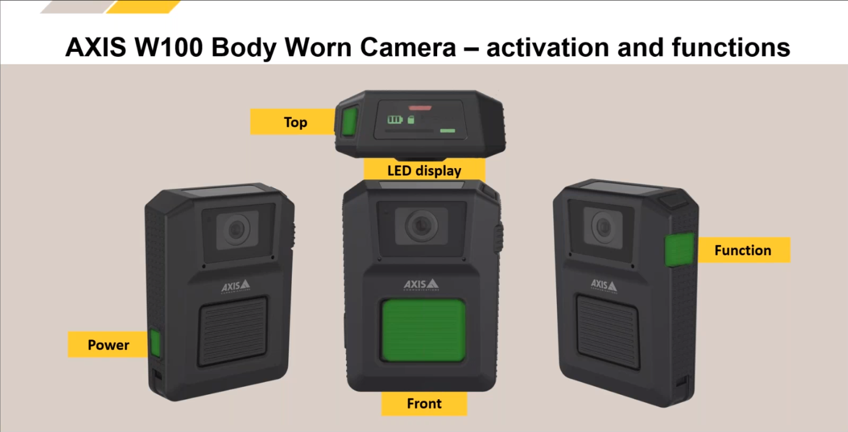
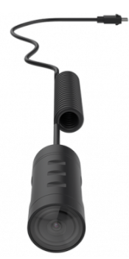
Feature – Axis Body Worn Cameras
Notes:
Optional TW1200 Body Worn Mini Bullet Sensor

Slide 4
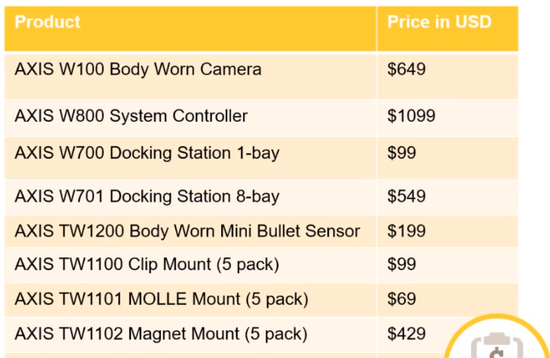
Feature – Axis Body Worn Cameras
Axis MSRP

Slide 5
Feature – Axis Body Worn Cameras
Integration – Start-to-finish

Slide 6
Feature – Axis Body Worn Cameras
Requires exacqVision 21.03 or higher and Pro/Enterprise licensing.
Current IP license must have enough available IP channels to support all BW Cameras
“Content Destination” – The exacqVision plugin is termed the CD or Content Destination in Axis’ documentation.
Cameras are either “Fixed” assigned to a wearer, or “Self-assign” using an RFID tag. This is permanently set when configuring the Controller.

Slide 7
Feature – Axis Body Worn Cameras
Unlike other IP Plugins, this plugin runs a Web Service which is used to push video files from the BWC to the exacqVision Server.
We don’t request live video from the Cameras or the Controller
No configuration is pushed from the Client to the BW Cameras or Controller
A certificate and key is generated for the BWC to utilize to secure traffic. They are stored alongside the xml:
axisbwpi_key.pem
axisbwpi_cert.pem
These can be replaced with official certificates and uploaded to the BWC in the browser.
Customers should expect a high bandwidth utilization. Having an isolated connection between the BWC and exacqVision Server is best – similar to Extended Storage (iSCSI)

Slide 8
Feature – Axis Body Worn Cameras
Recording Profiles

Slide 9
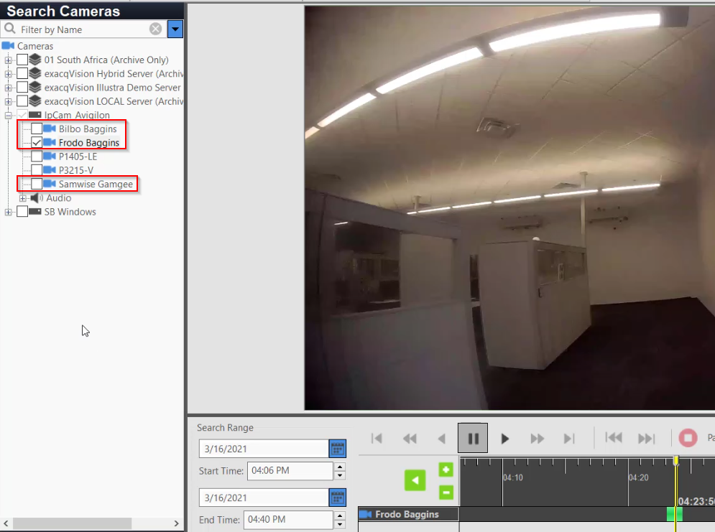
Feature – Axis Body Worn Cameras
Permissions
No specific permissions based upon the BW User. Anyone with ‘Search’ privilege will be able to see them.

Slide 10
Feature – Axis Body Worn Cameras
BodyWornConfig.json
Notes:
File should be deleted after importing to the BWC

Slide 11
Feature – Axis Body Worn Cameras
Debug Logs

Slide 12
Feature – Axis Body Worn Cameras
Debug Logs
Heartbeat communication once per minute.

Slide 13
Feature – Axis Body Worn Cameras
Debug Logs
Unix Epoch time the transfer began.

Slide 14
Feature – Axis Body Worn Cameras
Debug Logs
GUID assigned to the transaction.

Slide 15
Feature – Axis Body Worn Cameras
Debug Logs
Status ‘1’ = Received Request -> BWM is asking us if it can accept the video.​
Status ‘2’= Storage Allocated -> The plugin requested and received disk space from psfpi​.
Status ‘3’ = Clip Received -> We received the clip in an mkv file with video and audio​.
Status ‘4’ = Recontainerized -> Convert from MKV to PS file​. (state may go from 3 to 4 to 3 to 4, etc. as large files are sent in sequence)
Status ‘5’ = Transfer Complete -> Ends this particular request from BWM.
Status ‘6’ = Transfer Failed -> BWM will retry after a delay.

Slide 16
Feature – Axis Body Worn Cameras
Debug Logs
“Recontainerisation”
Video is sent in an MKV container. We extract the frames and store in our usual PS container.

Slide 17
Feature – Axis Body Worn Cameras
axixbwpi.xml Config File - 1
<Devices ID="5701632" Description="AXIS Body Worn Manager" ListenIP="172.19.238.12" ListenPort="8020" Username="Axis1" MaxDevices="1">
<Device IgnoreHierarchy="1" ipAddress="172.19.234.84" Enabled="1" Number="1" LicenseCount="1">
<Video Inputs="1">
<Input Number="0" Name="Frodo Baggins" UserId="dea27362-960e-468d-975c-aaea07737c0b" SearchOnly="1"/>
</Video>
<Audio Inputs="1">
<Input Number="0" Name="Frodo Baggins" UserId="dea27362-960e-468d-975c-aaea07737c0b" SearchOnly="1"/>
</Audio>
<Context Number="1">
<Video Inputs="1">
<Input Number="0" Name="Bilbo Baggins" UserId="75241c6d-2690-45d7-9b28-dd04ae34a35e" SearchOnly="1"/>
</Video>
<Audio Inputs="1">
<Input Number="0" Name="Bilbo Baggins" UserId="75241c6d-2690-45d7-9b28-dd04ae34a35e" SearchOnly="1"/>
</Audio>
<Codec MinStandard="5" MaxStandard="5">
<Framerate Min="30" Max="30"/>
<Resolution Name="1920x1080" Width="1920" Height="1080"/>
<Encoder Number="0" Running="0">
<AudioChannel Number="0" Enabled="1" Standard="4" SampleRate="8000" BufSizeSamples="640"/>
<Channel Number="0" Enabled="1" Standard="5" Width="1920" Height="1080" Framerate="30"/>
</Encoder>
</Codec>
</Context>

Slide 18
Feature – Axis Body Worn Cameras
axixbwpi.xml Config File - 2
<Context Number="2">
<Video Inputs="1">
<Input Number="0" Name="Samwise Gamgee" UserId="3431041d-1e1b-48fa-b6c3-55afb00e1e3d" SearchOnly="1"/>
</Video>
<Audio Inputs="1">
<Input Number="0" Name="Samwise Gamgee" UserId="3431041d-1e1b-48fa-b6c3-55afb00e1e3d" SearchOnly="1"/>
</Audio>
<Codec MinStandard="5" MaxStandard="5">
<Framerate Min="30" Max="30"/>
<Resolution Name="1920x1080" Width="1920" Height="1080"/>
<Encoder Number="0" Running="0">
<AudioChannel Number="0" Enabled="1" Standard="4" SampleRate="8000" BufSizeSamples="640"/>
<Channel Number="0" Enabled="1" Standard="5" Width="1920" Height="1080" Framerate="30"/>
</Encoder>
</Codec>
</Context>
<Codec MinStandard="5" MaxStandard="5">
<Framerate Min="30" Max="30"/>
<Resolution Name="1920x1080" Width="1920" Height="1080"/>
<Encoder Number="0" Running="0">
<AudioChannel Number="0" Enabled="1" Standard="4" SampleRate="8000" BufSizeSamples="640"/>
<Channel Number="0" Enabled="1" Standard="5" Width="1920" Height="1080" Framerate="30"/>
</Encoder>
</Codec>
</Device>

Slide 19
Feature – Axis Body Worn Cameras
Axis – Download System Report

Slide 20
Resources
https://www.axis.com/products/online-manual/58704
https://cdn.exacq.com/auto/manspec/files/c4026407-f354-50a4-e560-cb10bbf9928c.pdf?response-content-disposition=attachment;filename=%22AXIS%20-%20Integration%20Guide.pdf%22&rand=0.6443211692967252

Slide 21
Questions

