Slide 1
Video Encoding
Training
Notes:
Encoding – decoding – transcoding – containers - codecs

Slide 2
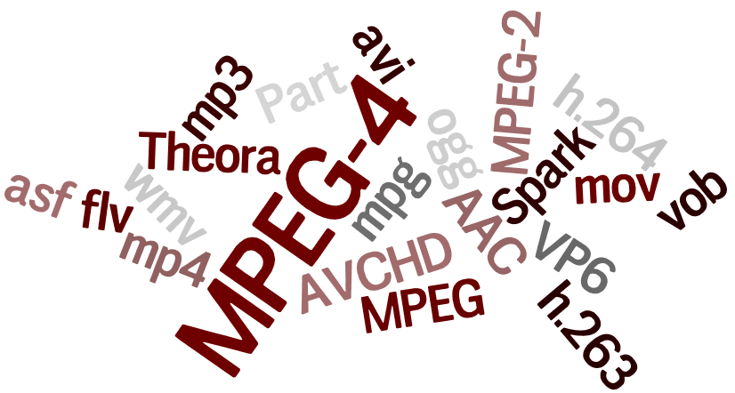
Codecs vs. Containers
CODEC
A method for encoding and decoding data and more specifically, a protocol for compressing data, especially video.
CONTAINER
A file-type that holds the grouping of compressed video as defined by the codec.
Notes:
Common codec?

Slide 3
Common Types of Codecs
MJPEG
MPEG-4 Part 2
H.264/MPEG-4 AVC
H.265/HEVC
And many others…
Notes:
Program Stream
So how are these codecs packaged?

Slide 4
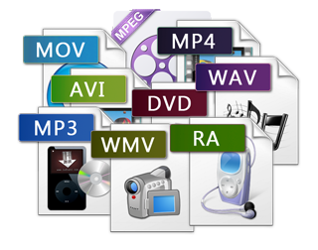
Common Types of Containers
PS - our proprietary format
AVI
MOV
MP4
And many others…
Notes:
What is compression exactly?

Slide 5
Video Compression Defined
Signal Analysis This operation performs measurements on the input video stream, computes prediction errors and transform coefficients, divides the signal into subbands, and does any correlation analysis. Input pixels are transformed into another format (for example DCT coefficients) but no data reduction is involved.
Quantization Here is where most of the compression gains are attained because the quantizer can throw away values that represent video information indiscernible to the viewer. The quantization step is usually lossy, but lossless schemes with lower compression ratios are also possible.
Variable Length Coding (Entropy Coding) Each event is assigned a code with a variable number of bits. Commonly occurring events have codes with few bits; rare events have codes with lots of bits. The expectation is that the average code length will be less than the fixed code that would otherwise be required.
Notes:
Discrete Cosine Transform

Slide 6
DCT – Discrete Cosine Transform
In DCT encoding, the image is broken up to 8x8 pixel blocks, quantized giving more weight to elements more important to the human visual system, then entropy encoded with a Huffman variable word length scheme.
The stream is decompressed using the same process in reverse.
Notes:
Why this matters?

Slide 7
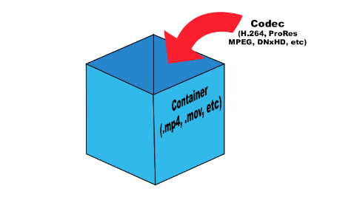
Why This Matters?
Each and every Codec uses a different method to turn the video into binary data for transmission.
The decoding device must understand how it was encoded to render the video properly.
The container the data is stored in is not nearly as important as the codec used.
Notes:
So what’s transcoding?

Slide 8
Transcoding
The direct analog-to-analog or digital-to-digital conversion of one encoding to another.

Slide 9
Supported Video Codecs
MJPEG
MPEG
H.264
Why are the data rates so different?

Slide 10
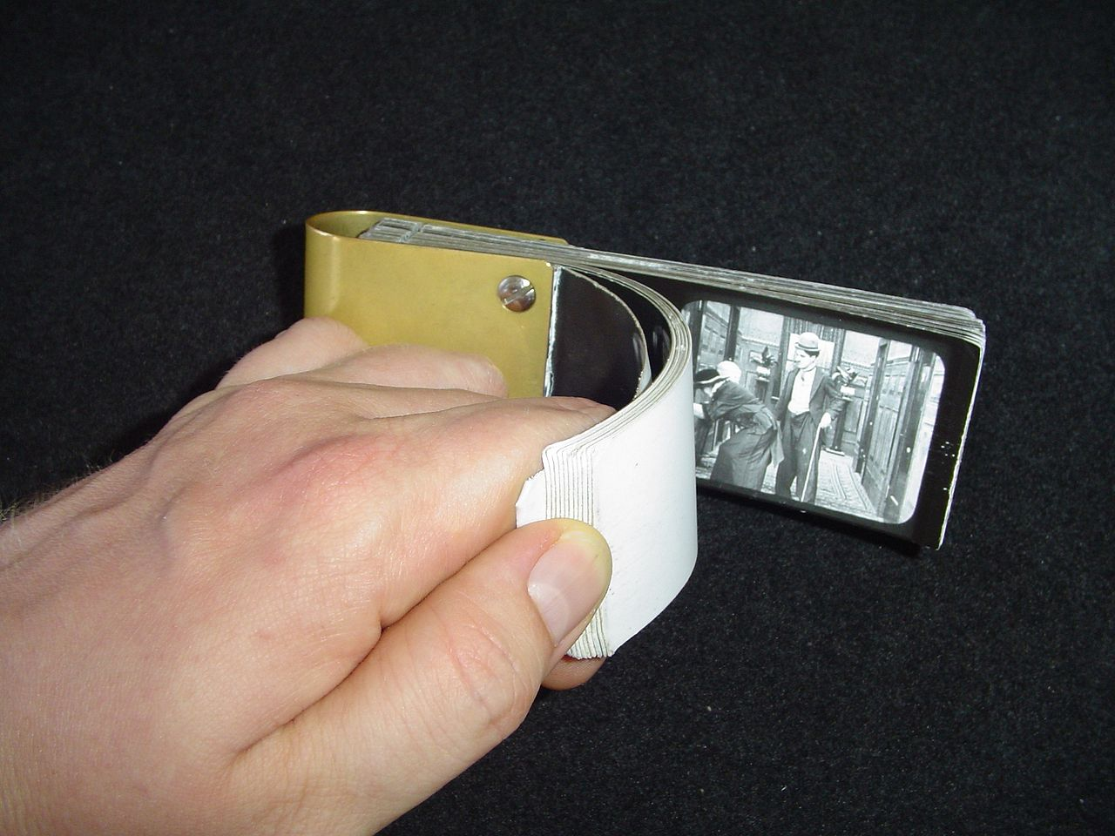
MJPEG
Each video frame is compressed separately as a JPEG image and transmitted sequentially.

Slide 11
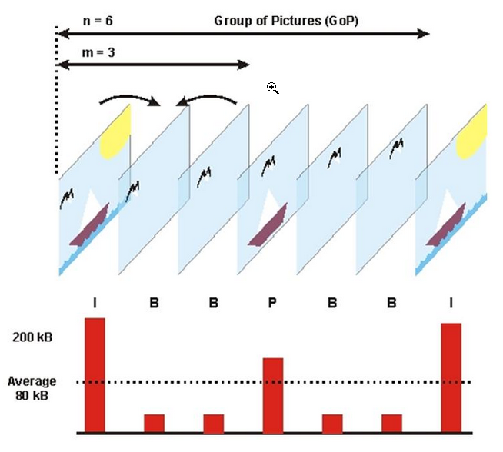
MPEG and H.264
Video is encoded and transmitted in a collection of I, P, and B frames, known as a GOP (Group of Pictures) or GOV (Group of Video).

Slide 12
I – P – and B Frames
I-frame ‘Intra-coded picture’ - in effect a fully specified picture, like a conventional static image file.
P-frame ‘Predicted picture’ - holds only the changes in the image from the previous frame.
B-Frame ‘Bi-predictive picture’ – uses the difference between the current frame and both preceding and following frames to specify its content.
Notes:
B-Frames are the “reverb” of video.

Slide 13
I-Frames
This type of frame contains every pixel block.

Slide 14
P-Frames
These frames contain only the pixel blocks that changed since the last I-Frame.

Slide 15
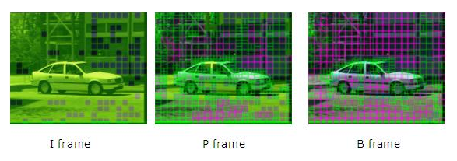
B-Frames
These frames are the predicted difference between the preceding and the following frames. B-frames are not available when using H.264’s Baseline Profile, though some supported cameras do send B-frames. These will become increasingly important as we start to support cameras that stream H.265.
Notes:
What happens when there’s a problem?

Slide 16
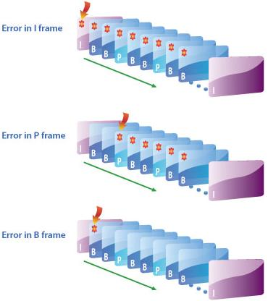
Data Transmission Problems
Knowing how the data was broken up will help you troubleshoot.
Out of Order
Notes:
Why don’t we see this more often in our software?

Slide 17
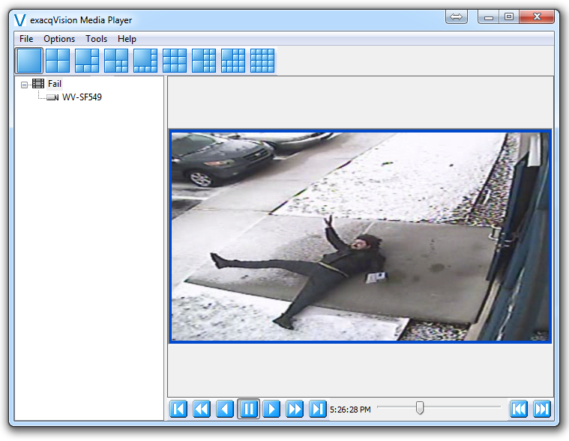
Frame Re-ordering
Since v6.4, the exacqVision Client and ePlayer re-orders the frames for Searching and Exports, excluding AVI and MOV.
Notes:
What if there are problems in the RTSP stream?

Slide 18
Verifying the RTSP Stream

Slide 19
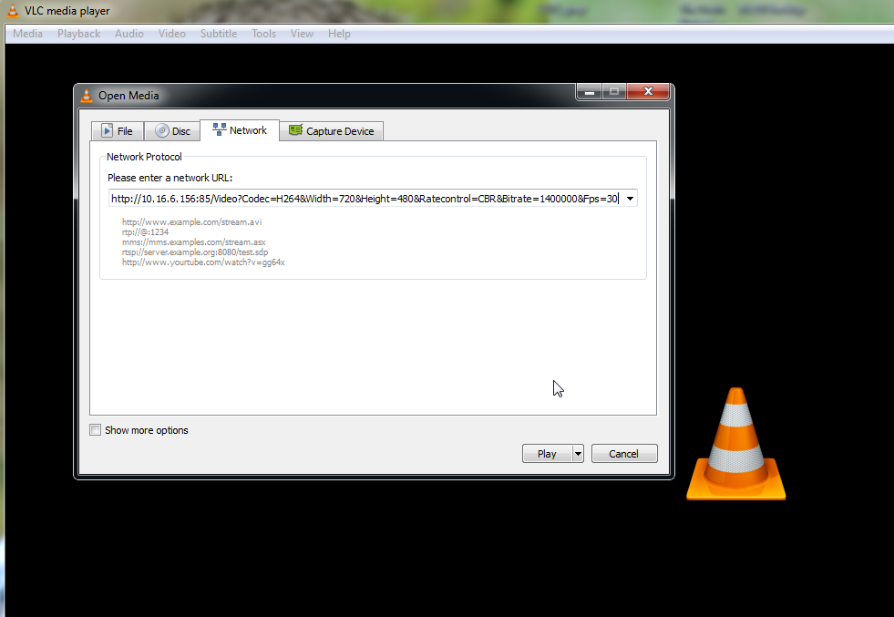
VLC Media Player
DVR Wiki -https://trac.exacq.com/DVR/wiki/GenericRtspPlugin
SoleraTec - http://www.soleratec.com/support/rtsp/rtsp_listing
Notes:
How does the encoding effect Time-Lapse recording?

Slide 20
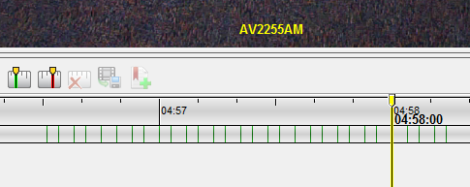
Time-Lapse Recording
Only I-Frames are utilized for time-lapse recording, and will have missing video if the GOP length is greater than the desired time-lapse setting.
A camera with a GOP of 50 and streaming at 3 frames per second will send an I-Frame every 16.7 seconds
Increasing the cameras fps, or decreasing the GOP length will allow for a lower time-lapse setting.
Notes:
psExplore

Slide 21
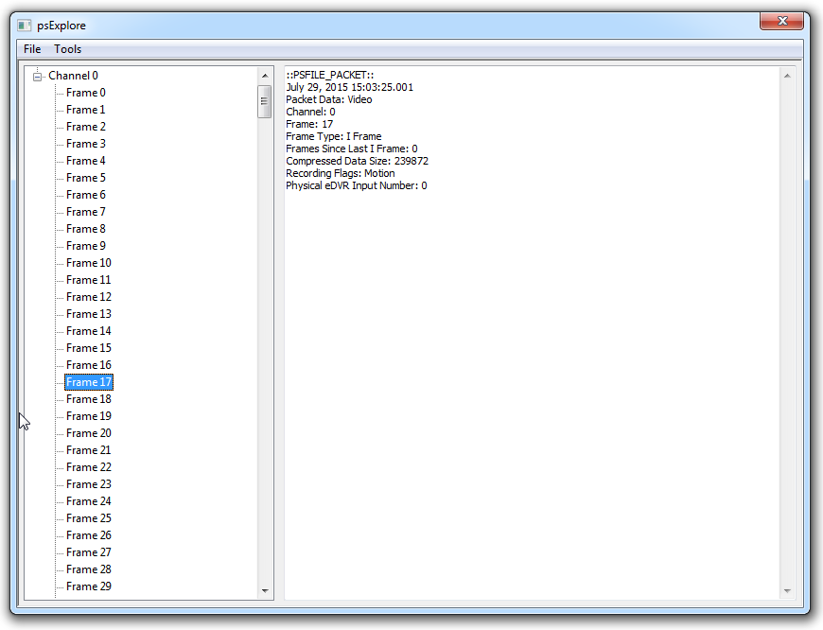
psExplore.exe
Available on the Support Wiki
Notes:
Walk-through Wrigley export.

Slide 22
References
https://en.wikipedia.org/wiki/Video_compression_picture_types
https://en.wikipedia.org/wiki/Motion_JPEG
https://en.wikipedia.org/wiki/Comparison_of_video_container_formats
http://www.eetimes.com/document.asp?doc_id=1275883
https://en.wikipedia.org/wiki/List_of_codecs
http://www.encoding.com/blog/2014/01/13/whats-difference-codecs-containers/

Slide 23
Any Questions

